Slide 1

Jesus’ Discourse on His Authority

Slide 2

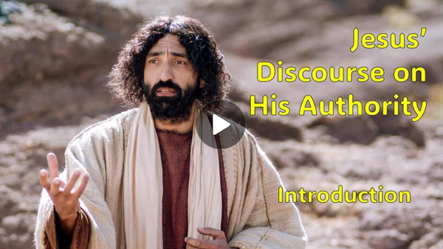
Video Introduction
View Video

Slide 3
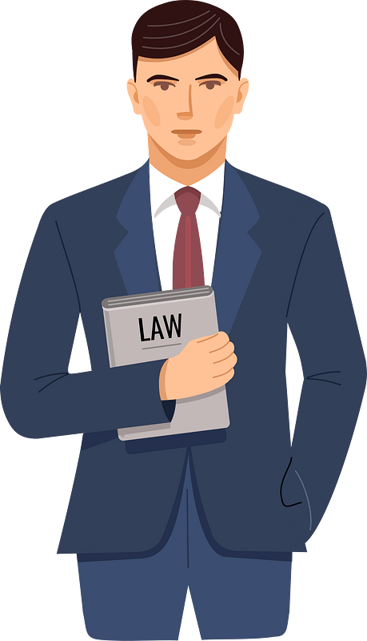


Who do you trust?
“If you were on a jury, what would make you trust one witness more than another?”
Today we look at Jesus’ testimony before the leaders of the day.
He told them they were ignoring the truth right before their eyes.
He gives them evidence that He is the Messiah.
We will consider how we respond to Jesus authority in our lives.

Slide 4
1. The Expert Witness: The Son’s Word and Authority.

Slide 5
Listen for an assassination plan.
John 5:17-20 (NIV) Jesus said to them, "My Father is always at his work to this very day, and I, too, am working." 18 For this reason the Jews tried all the harder to kill him; not only was he breaking the Sabbath, but he was even calling God his own Father, making himself equal with God. 19 Jesus gave

Slide 6
Listen for an assassination plan.
them this answer: "I tell you the truth, the Son can do nothing by himself; he can do only what he sees his Father doing, because whatever the Father does the Son also does. 20 For the Father loves the Son and shows him all he does. Yes, to your amazement he will show him even greater things than these.

Slide 7
The Son’s Word and Authority
What words and phrases point to the source of Jesus’ power to act?
Jesus gave them this answer: "I tell you the truth, the Son can do nothing by himself; he can do only what he sees his Father doing, because whatever the Father does the Son also does. For the Father loves the Son and shows him all he does. Yes, to your amazement he will show him even greater things than these.

Slide 8
The Son’s Word and Authority
What can we learn from the fact that the Son gives life to “whom He wishes” or “to whom He is pleased to give it”?
What did Jesus say that suggests what the Father does through the Son is not limited? What was at least one greater work that the Son would do?

Slide 9
The Son’s Word and Authority
Note how the courtroom image of an expert witness helps us understand Jesus’s relationship with the Father and His authority over all.
Jesus acts only with/by the authority/direction of God the Father
God the Father will speak
Those who hear/listen will live

Slide 10
The Son’s Word and Authority
Note how the courtroom image of an expert witness helps us understand Jesus’s relationship with the Father and His authority over all.
The Father has life in Himself
Elohim, God of all creation complete in and of yourself.
El Shadday the unmoving, unwanting changeless enduring all-powerful GOD.
Jesus given the authority to judge
Jesus sought not to please Himself but to please the Father

Slide 11
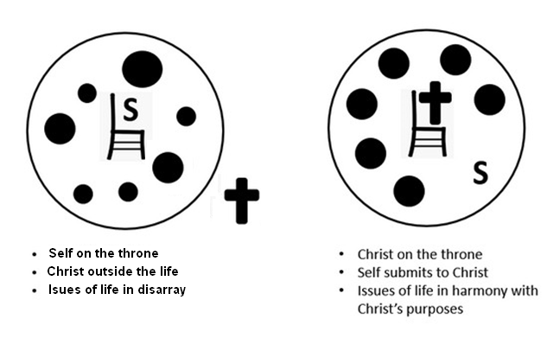
The Son’s Word and Authority
In what ways does this challenge modern notions of individual autonomy?

Slide 12
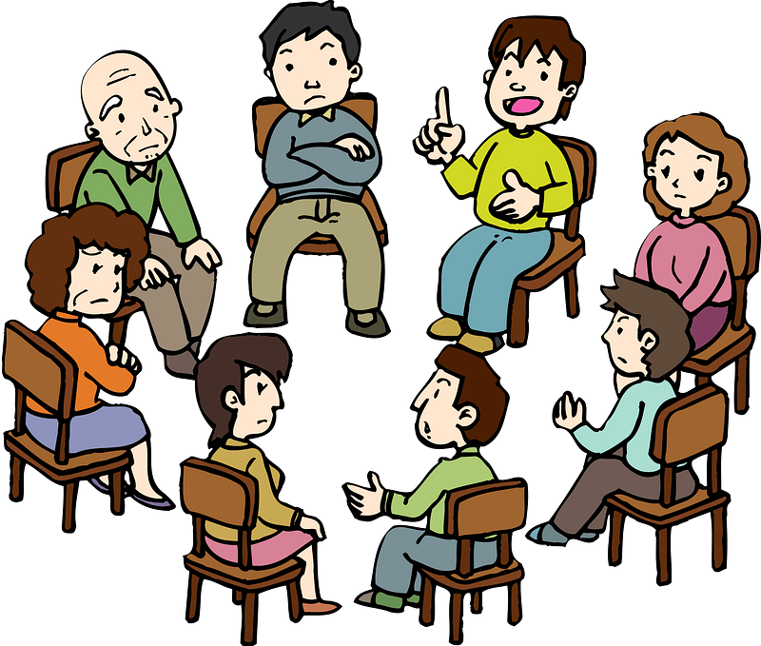
The Son’s Word and Authority
How can we join God and participate in His work?

Slide 13
2. The Corroborating Witnesses: John the Baptist, Works, the Father, Scripture.

Slide 14
Listen for three witnesses.
John 5:31-40 (NIV) "If I testify about myself, my testimony is not valid. 32 There is another who testifies in my favor, and I know that his testimony about me is valid. 33 "You have sent to John and he has testified to the truth. 34 Not that I accept human testimony; but I mention it that you may be saved. 35 John was

Slide 15
Listen for three witnesses.
a lamp that burned and gave light, and you chose for a time to enjoy his light. 36 "I have testimony weightier than that of John. For the very work that the Father has given me to finish, and which I am doing, testifies that the Father has sent me. 37 And the Father who sent me has himself testified concerning me. You have

Slide 16
Listen for three witnesses.
never heard his voice nor seen his form, 38 nor does his word dwell in you, for you do not believe the one he sent. 39 You diligently study the Scriptures because you think that by them you possess eternal life. These are the Scriptures that testify about me, 40 yet you refuse to come to me to have life.

Slide 17
Corroborating Witnesses
Note the three witnesses Jesus referenced. John the Baptist, Jesus’ own works, God the Father.
In what way did John the Baptist prepare people to recognize Jesus? Why was his testimony significant to that audience?
What are some examples of Jesus’ “works” (miracles or actions)? How do these serve as evidence of His authority?

Slide 18
Corroborating Witnesses
What events can you think of that speak to how God the Father bore witness to Jesus?
If someone questioned Jesus’ authority today, how could you point to these same three witnesses as evidence?

Slide 19
3. The Verdict of Rejection: Ignoring the Witness, Rejecting Christ.

Slide 20
Listen for Jesus’ verdict.
John 5:41 – 47 (NIV) 41 "I do not accept praise from men, 42 but I know you. I know that you do not have the love of God in your hearts. 43 I have come in my Father's name, and you do not accept me; but if someone else comes in his own name, you will accept him. 44 How can you believe if you accept praise from one another, yet

Slide 21
Listen for Jesus’ verdict.
make no effort to obtain the praise that comes from the only God? 45 "But do not think I will accuse you before the Father. Your accuser is Moses, on whom your hopes are set. 46 If you believed Moses, you would believe me, for he wrote about me. 47 But since you do not believe what he wrote, how are you going to believe what I say?"

Slide 22
The Verdict of Rejection
According to verse 43 - 44, whose approval are the people seeking instead of God’s?
I have come in my Father's name, and you do not accept me; but if someone else comes in his own name, you will accept him. How can you believe if you accept praise from one another, yet make no effort to obtain the praise that comes from the only God?

Slide 23
The Verdict of Rejection
Note the warning Jesus gave about accepting others while rejecting Him.
Jesus says it won’t have to be He who accuses at the judgment
It will be Moses … they set their hopes on him
But he will see that they have rejected God
If they believed Moses, they should believe Jesus
In reality they have believed neither Moses nor Jesus

Slide 24
The Verdict of Rejection
What does it mean to “not have the love of God” in you (v. 42)? How is that connected to rejecting Jesus?
Why do you think people sometimes reject truth even when there is strong evidence?
How can we guard against becoming familiar with Scripture but failing to truly believe and follow Christ?

Slide 25
Application
Submit to authority.
Reflect upon areas of your life where you have not submitted to God’s authority.
Consider the difference it would make if you did so today.
Write those things down and surrender them to Him.

Slide 26
Application
Share gratitude.
Gratitude helps with moments of skepticism.
Share with your group or a friend, things you are grateful for in your life.
Be sure to direct the thanks to God.

Slide 27
Application
Celebrate with others.
Find a way to celebrate with someone in your group or family, something that the Lord has done recently in his or her life.
Spend time worshiping God for His faithfulness.

Slide 28
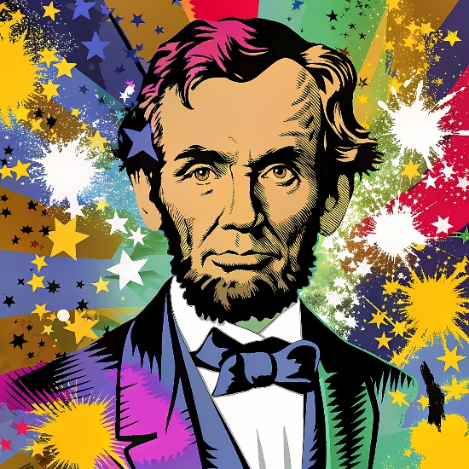
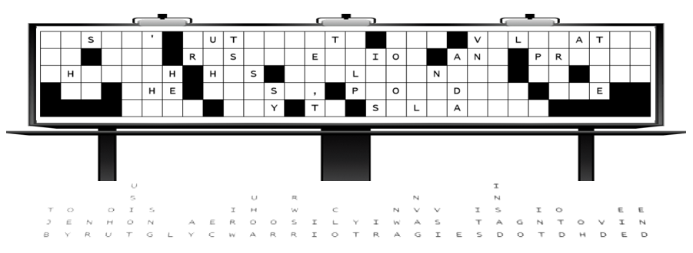
Family Activities
By an untimely and wayward storm, certain letters on the billboard have been cast down and disordered among their columns, and the civil authorities, not yet restored to their proper function, are unable to render aid. Therefore, we earnestly appeal to all who are able, that they might give their attention to this matter.

Slide 29
Jesus’ Discourse on His Authority

