Slide 1

Introduction to The Gospel of John

Slide 2

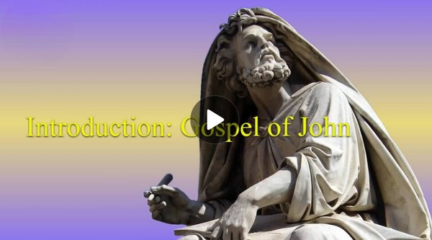
Video Introduction
View Video

Slide 3
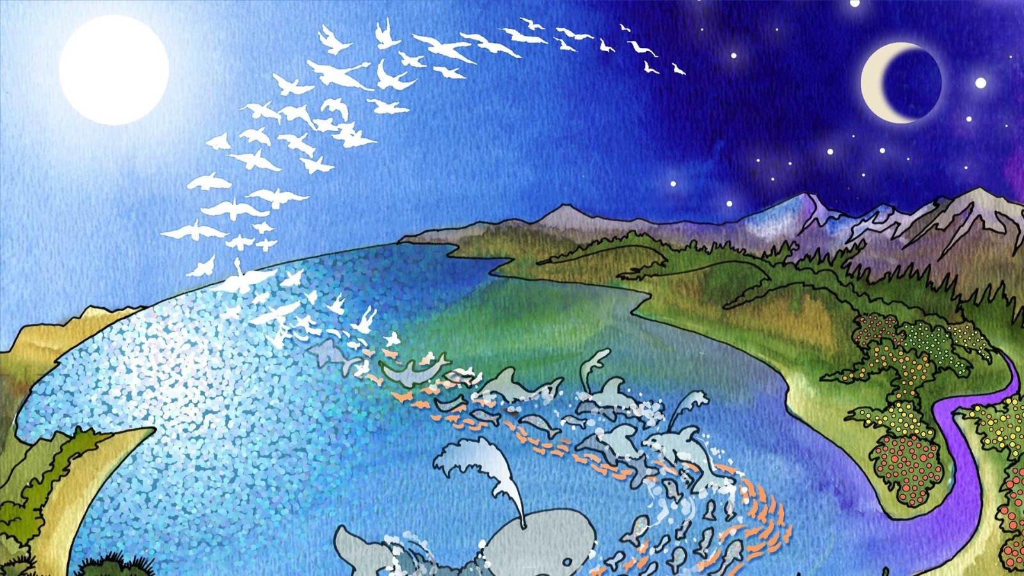
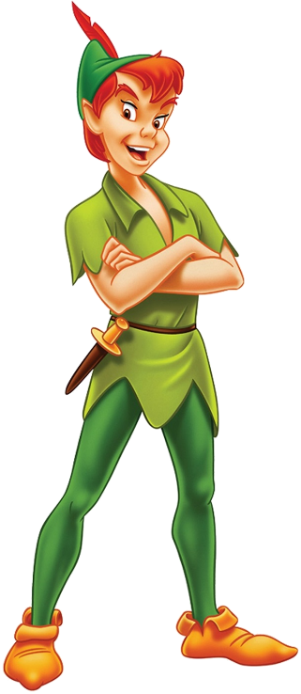


Play it again, Sam!
What are some memorable opening lines to a book or a movie.
John opens his Gospel with one of the most famous opening lines ever written:
“In the beginning was the Word.”
He was referring to Jesus
He goes on to describe attributes of Jesus

Slide 4
1. The Word — Present in Creation.

Slide 5
Listen for words and phrases which speak to the identity of Jesus.
John 1:1-5 (NIV) In the beginning was the Word, and the Word was with God, and the Word was God. 2 He was with God in the beginning. 3 Through him all things were made; without

Slide 6
Listen for words and phrases which speak to the identity of Jesus.
him nothing was made that has been made. 4 In him was life, and that life was the light of men. 5 The light shines in the darkness, but the darkness has not understood it.

Slide 7
The Word – Present in Creation
In verses 1 and 2, how does John describe someone he names as “the Word”?
In the beginning was the Word, and the Word was with God, and the Word was God. He was with God in the beginning

Slide 8
The Word – Present in Creation
What was the Word’s role in creation?
What is the description of the relationship of light and life to the one who is the Word?
Through him all things were made; without him nothing was made that has been made. The light shines in the darkness, but the darkness has not understood it.

Slide 9
The Word – Present in Creation
John uses the Greek word logos which is translated “the Word” to refer to Jesus. Why do you think John used the concept “Word” to identify Jesus?
How has Jesus been light to you?

Slide 10
The Word – Present in Creation
Verse 5 speaks of the darkness not understanding “the light.” Why do you think that happens?
How can you be more receptive to God’s light in your life?

Slide 11
2. The Word — True Light and True Life.

Slide 12
Listen for thoughts about light
John 1:6-13 (NIV) There came a man who was sent from God; his name was John. 7 He came as a witness to testify concerning that light, so that through him all men might believe. 8 He himself was not the light; he came only as a witness to the light. 9 The true light that gives light to every man was coming into the world. 10 He was in the world, and though

Slide 13
Listen for thoughts about light
the world was made through him, the world did not recognize him. 11 He came to that which was his own, but his own did not receive him. 12 Yet to all who received him, to those who believed in his name, he gave the right to become children of God-- 13 children born not of natural descent, nor of human decision or a husband's will, but born of God.

Slide 14
The Word – True Light and True Life
How did the “true light” give light to every person?
Why didn’t the world recognize the light?
What’s the difference between believing about Jesus and believing in Jesus? In what way does believe in mean more than intellectual assent?
Believing about Jesus | Believing in Jesus

Slide 15
The Word – True Light and True Life
C.S. Lewis points out three possibilities about Jesus’ claims
He was God as He said He was … or
He was a liar … or
He was a lunatic
Why could Lewis make that statement? Why could Jesus not be merely a good teacher or prophet?

Slide 16
3. The Word — Dwells Among His People.

Slide 17
Listen for more about “the Word.”
John 1:14-18 (NIV) The Word became flesh and made his dwelling among us. We have seen his glory, the glory of the One and Only, who came from the Father, full of grace and truth. 15 John testifies concerning him. He cries out, saying, "This was he of whom I said, 'He who comes

Slide 18
Listen for more about “the Word.”
after me has surpassed me because he was before me.'" 16 From the fullness of his grace we have all received one blessing after another. 17 For the law was given through Moses; grace and truth came through Jesus Christ. 18 No one has ever seen God, but God the One and Only, who is at the Father's side, has made him known.

Slide 19
The Word – Dwells among His People
In vs. 14, John declared “The Word became flesh and made his dwelling among us.” How is Jesus being completely human more significant than God the Son simply taking human form?
He had to be both God and man …
equally and totally

Slide 20
The Word – Dwells among His People
How should this truth that God the son came to earth as a human being affect the way we live?
Note the definition of “glory” and some synonyms:
Glory: high renown or honor won by notable achievements.
Synonyms : renown, fame, prestige, honor, distinction, kudos, eminence, acclaim, praise; celebrity, recognition, reputation

Slide 21
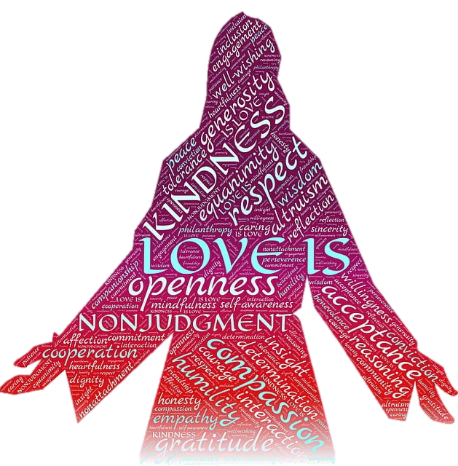
The Word – Dwells among His People
So, how did Jesus’ earthly life reveal God’s glory?
How can we reflect God’s glory?

Slide 22
Application
The Word of God was preexistent
The Word (Jesus, the Messiah) was the divine agent in creation
Allow Him to bring light and life to your life new year

Slide 23
Application
Receiving Jesus involves personal trust and commitment
Who do you know who needs to believe in Jesus and experience a new birth?
Pray for people you know who need to allow God to give them new life in Christ
Invite them to our small group Bible Study

Slide 24
Application
Faith in Christ is necessary for, is the only way to salvation
When you receive Christ as your own personal savior, you become a Child of God
A child of God seeks to please his Savior – what new commitments will you make to Jesusthis year?

Slide 25
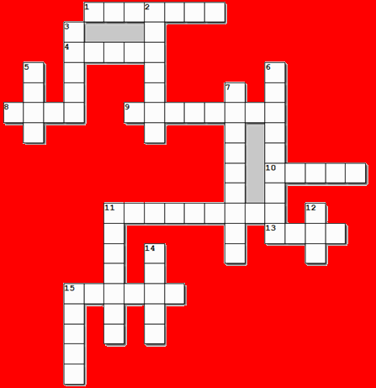
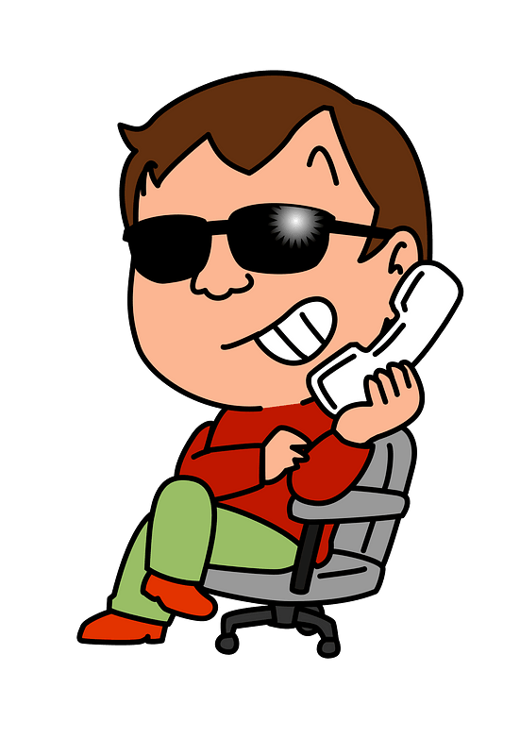

Family Activities
That’s crazy. I can find the clues and words in the Bible Study passage. And there’s even more fun Family Activities at https://tinyurl.com/4f8w9ee4
For $500 I can tell you the right words in the squares.

Slide 26
Introduction to The Gospel of John

