Slide 1

Healings and Conflict

Slide 2

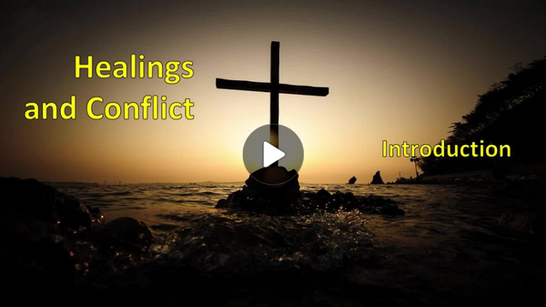
Video Introduction
View Video

Slide 3

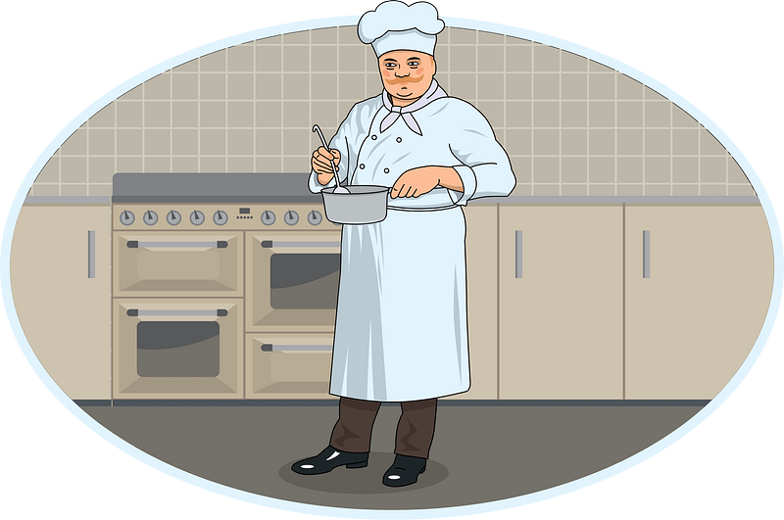

Come on, admit it …
In what situations are you least likely to ask for help?
Jesus wants us to come to Him for help.
  Jesus works on behalf of all who come to Him.
  He wants to express his grace to us.

Slide 4
1. Jesus’s Work Is Not Bound by Distance.

Slide 5
Listen for a promise
Selections from John 4:46-50 (NIV) Once more he visited Cana in Galilee, where he had turned the water into wine. And there was a certain royal official whose son lay sick at Capernaum. 47 When this man heard that Jesus had arrived in Galilee from Judea, he went

Slide 6
Listen for a promise
to him and begged him to come and heal his son, who was close to death. … 49 The royal official said, "Sir, come down before my child dies." 50 Jesus replied, "You may go. Your son will live." The man took Jesus at his word and departed.

Slide 7
Jesus’s Work Is Not Bound by Distance
List the words and phrases which indicate the earnestness and urgency of this appeal to Jesus?
When this man heard that Jesus had arrived in Galilee from Judea, he went to him and begged him to come and heal his son, who was close to death. … The royal official said, "Sir, come down before my child dies."

Slide 8
Jesus’s Work Is Not Bound by Distance
What is it about Jesus that would motivate you to take your needs to Him?
Why might people hesitate to take their needs to Jesus?
Note how the man demonstrated faith:
  Took Jesus at His word.
  Headed for home.

Slide 9
Jesus’s Work Is Not Bound by Distance
The official had to trust Jesus before seeing the miracle—how can we practice that kind of faith in our lives and take Jesus at His word.
What are some things God has told us in His Word that are sometimes challenging for you to believe?

Slide 10
2. Christ’s Work Is Not
Bound by Our Understanding of Time.

Slide 11
Listen for a complaint.
John 5:1-11 (NIV) Some time later, Jesus went up to Jerusalem for a feast of the Jews. 2 Now there is in Jerusalem near the Sheep Gate a pool, which in Aramaic is called Bethesda and which is surrounded by five covered colonnades. 3 Here a great number of disabled people used to lie--the blind, the lame, the paralyzed. One who was

Slide 12
Listen for a complaint.
there had been an invalid for thirty-eight years. 6 When Jesus saw him lying there and learned that he had been in this condition for a long time, he asked him, "Do you want to get well?" 7 "Sir," the invalid replied, "I have no one to help me into the pool when the water is stirred. While I am trying to get in, someone else goes down ahead of

Slide 13
Listen for a complaint.
me." 8 Then Jesus said to him, "Get up! Pick up your mat and walk." 9 At once the man was cured; he picked up his mat and walked. The day on which this took place was a Sabbath, 10 and so the Jews said to the man who had been healed, "It is the Sabbath; the law forbids you to carry your mat." 11 But he replied, "The man who made me well said to me, 'Pick up your mat and walk.'"

Slide 14
Christ’s Work Is Not Bound by Our Understanding of Time
Note the setting:
  Disabled people gathered around a pool.
  Believed that when the water was stirred, first one in was healed
  Jesus talked with man who had been an invalid 38 years.
  Too crippled to be first one in the water, no helper

Slide 15
Christ’s Work Is Not Bound by Our Understanding of Time
Why did Jesus ask him if he wished to get well? Isn’t that an obvious question? Why is this question important/necessary?
Note the three-pronged admonition did Jesus give to the man.
  Get up
  Pick up your mat
  Walk

Slide 16
Christ’s Work Is Not Bound by Our Understanding of Time
What were the religious leaders more concerned about?
Why do some people care more about keeping certain "religious" rules than they do about developing a meaningful relationship with Jesus?
Why do you suppose Jesus choose to heal this man on the Sabbath?

Slide 17
3. Christ Is Working
Everywhere, All the Time.

Slide 18
Listen for Jesus’ source of authority.
John 5:17-20 (NIV) Jesus said to them, "My Father is always at his work to this very day, and I, too, am working." 18 For this reason the Jews tried all the harder to kill him; not only was he breaking the Sabbath, but he was even calling God his

Slide 19
Listen for Jesus’ source of authority.
own Father, making himself equal with God. 19 Jesus gave them this answer: "I tell you the truth, the Son can do nothing by himself; he can do only what he sees his Father doing, because whatever the Father does

Slide 20
Listen for Jesus’ source of authority.
the Son also does. 20 For the Father loves the Son and shows him all he does. Yes, to your amazement he will show him even greater things than these.

Slide 21
Christ Is Working Everywhere,
All the Time.
What words and phrases point to as the source of Jesus’ power to act?
Jesus gave them this answer: "I tell you the truth, the Son can do nothing by himself; he can do only what he sees his Father doing, because whatever the Father does the Son also does. For the Father loves the Son and shows him all he does

Slide 22
Christ Is Working Everywhere,
All the Time.
For the Father loves the Son and shows him all he does. Yes, to your amazement he will show him even greater things than these.
What can we learn from the fact that the Son gives life to “whom He wishes” or “to whom He is pleased to give it”?
What did Jesus say that suggests what the Father does through the Son is not limited? What was at least one greater work that the Son would do?

Slide 23
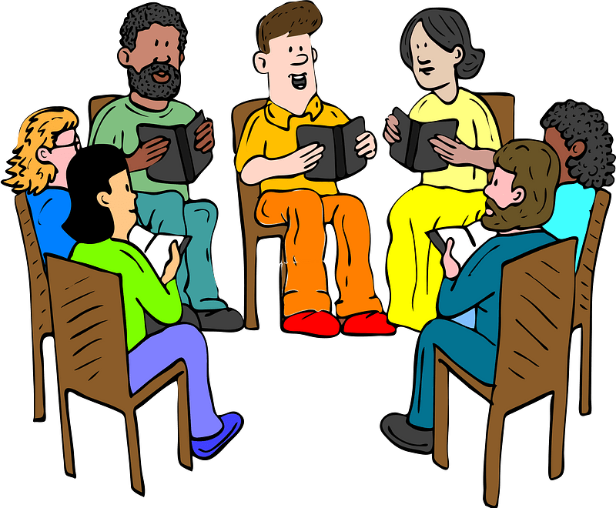
Christ Is Working Everywhere,
All the Time.
How can we join God and participate in His work?

Slide 24
Application
Watch.
  Jesus was watching what His Father was doing.
  Ask God to open your eyes to people and needs around you this week.
  You may be surprised at what you see and hear.

Slide 25
Application
Think.
  Think about some of the “God stories” you have heard in recent weeks.
  Where has God been working? Who has God been using?
  Write down any insights about what these stories and testimonies tell you of how God works. Praise God for the work He is doing around you.

Slide 26
Application
Tell.
  The greatest “God story” of my life is the moment Jesus saved me from my sin.
  If you are a believer, you have a similar testimony.
  While each story is unique, they all have Jesus at the center, saving a sinner at their root.
  Share your testimony this week. 15 second testimony https://youtu.be/hkprflNySS8

Slide 27
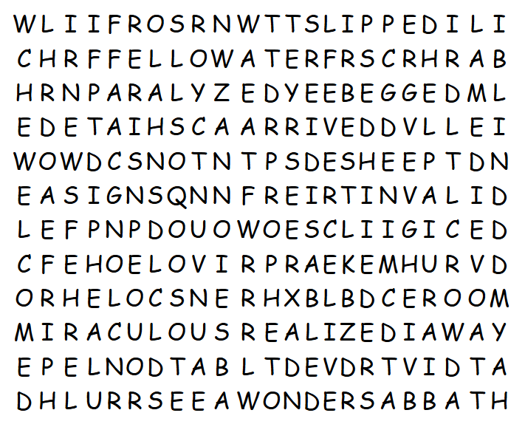

Family Activities
I see “ROOM” in the grid, but it’s not on the list … wow … I need your help. You can go to https://tinyurl.com/3mstsm98 if you get stuck. Or want to do the Color Page?

Slide 28
Healings and Conflict

