Slide 1

The First Disciples of Jesus

Slide 2

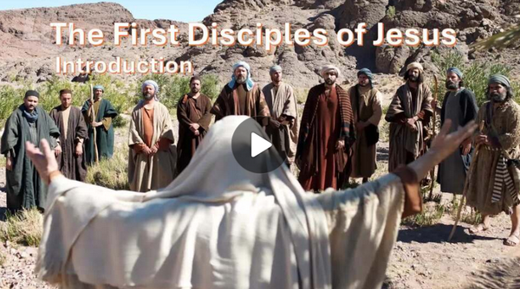
Video Introduction
View Video

Slide 3



Remember the time?
What’s the best invitation you have ever received? What made it so special?
Some of the men who became Jesus’ disciples discover the Messiah in this lesson
Here is the Messiah!! … and He invites them to follow Him.
Today He invites us to follow Him

Slide 4
1. Responding to Christ’s Invitation.

Slide 5
Listen for an invitation.
John 1:35-39 (NIV) The next day John was there again with two of his disciples. 36 When he saw Jesus passing by, he said, "Look, the Lamb of God!" 37 When the two disciples heard him say this, they followed Jesus. 38 Turning around, Jesus saw them following and

Slide 6
Listen for an invitation.
asked, "What do you want?" They said, "Rabbi" (which means Teacher), "where are you staying?" 39 "Come," he replied, "and you will see." So they went and saw where he was staying, and spent that day with him. It was about the tenth hour.

Slide 7
Responding to Christ’s Invitation
Why did John call Jesus the Lamb of God?
What prompted John’s disciples to follow Jesus?
Jesus asked the men, “what do you want?” If you had been one of the two disciples, what would you have wanted to ask?
What could Jesus offer that they had not found in John the Baptist?

Slide 8
Responding to Christ’s Invitation
John invited his followers to look at Jesus. What are some ways in which we can invite people to “look” at Jesus?
What kinds of responses would Jesus receive if He appeared on earth in bodily form in our day, instead of back 2000 years ago?

Slide 9
Responding to Christ’s Invitation
The fact is, that He is present in the world today
Like John did, we need to challenge people to follow Jesus
When people do follow Him …
They learn about Him
They learn from Him

Slide 10
2. Sharing Christ Through Our Relationships.

Slide 11
Listen for secondary invitations.
John 1:40-46 (NIV) Andrew, Simon Peter's brother, was one of the two who heard what John had said and who had followed Jesus. 41 The first thing Andrew did was to find his brother Simon and tell him, "We have found the Messiah" (that is, the Christ). 42 And he brought him to Jesus.

Slide 12
Listen for secondary invitations.
Jesus looked at him and said, "You are Simon son of John. You will be called Cephas" (which, when translated, is Peter). 43 The next day Jesus decided to leave for Galilee. Finding Philip, he said to him, "Follow me." 44 Philip, like Andrew and Peter, was

Slide 13
Listen for secondary invitations.
from the town of Bethsaida. 45 Philip found Nathanael and told him, "We have found the one Moses wrote about in the Law, and about whom the prophets also wrote--Jesus of Nazareth, the son of Joseph." 46 "Nazareth! Can anything good come from there?" Nathanael asked. "Come and see," said Philip.

Slide 14
Sharing Christ Through Our Relationships
What was the first thing Andrew did after he heard about others following Jesus?
Verse 30 says that Andrew “followed” Jesus. What does it mean to follow Jesus?
How did Philip respond to Jesus’ invitation?
Philip was skeptical about someone from Nazareth. What about Christ stirs skepticism today?

Slide 15
Sharing Christ Through Our Relationships
What convinced you that Jesus was the Son of God?
Who is someone in your circle of friends, acquaintances, family that you could bring to Jesus like Andrew brought his brother?

Slide 16
3. Called and Equipped Uniquely

Slide 17
Listen for a startling revelation.
John 1:47-51 (NIV) 47 When Jesus saw Nathanael approaching, he said of him, "Here is a true Israelite, in whom there is nothing false." 48 "How do you know me?" Nathanael asked. Jesus answered, "I saw you while you were still under the fig tree before Philip called you." 49 Then Nathanael declared,

Slide 18
Listen for a startling revelation.
"Rabbi, you are the Son of God; you are the King of Israel." 50 Jesus said, "You believe because I told you I saw you under the fig tree. You shall see greater things than that." 51 He then added, "I tell you the truth, you shall see heaven open, and the angels of God ascending and descending on the Son of Man."

Slide 19
Called and Equipped Uniquely
When Jesus first sees Nathanael, He probably surprised him with the statement, “"Here is a true Israelite, in whom there is nothing false." What does this tell us about Jesus?
What titles does Nathanael immediately use for Jesus after this moment?

Slide 20
Called and Equipped Uniquely
After Nathanael’s confession, what promise does Jesus make about what he will see?
Jesus moves Nathanael from a private sign (the fig tree) to a greater vision. What does this suggest about how discipleship works?
What might “greater things” imply for someone who follows Christ?

Slide 21
Application
Trust.
What holds you back from sharing Christ?
Pray and ask God to make your faith in Him greater than your fears.

Slide 22
Application
Invite.
Assume the same “come and see” mindset seen in both Andrew and Philip.
Invite friends to come with you to your Bible study group.
Your group can provide a non-threatening way to “come and see” Jesus as your group discussed God’s Word.

Slide 23
Application
Neighbors, Acquaintances
Share
Draw three circles and make a list of people God has put in your life.
Who in those circles does the Lord want you to reach with the gospel?
Friends, Co-Workers
Closest Relationships

Slide 24
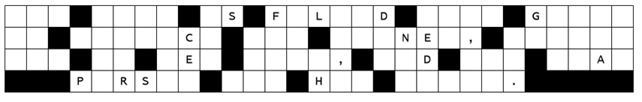
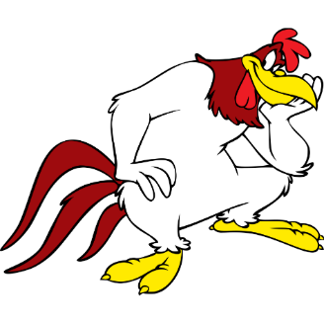
Family Activities
Can you? I say… can you help us? That confound chicken hawk knocked down a bunch of letters! Or maybe you’d rather do that crossword. Humph!

Slide 25
The First Disciples of Jesus

