Slide 1

Feeding the 5000 – Jesus Walks on the Water

Slide 2

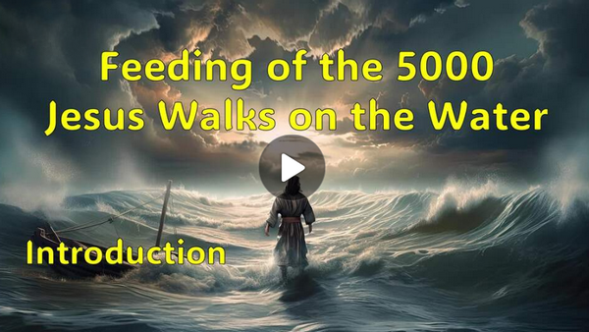
Video Introduction
View Video

Slide 3

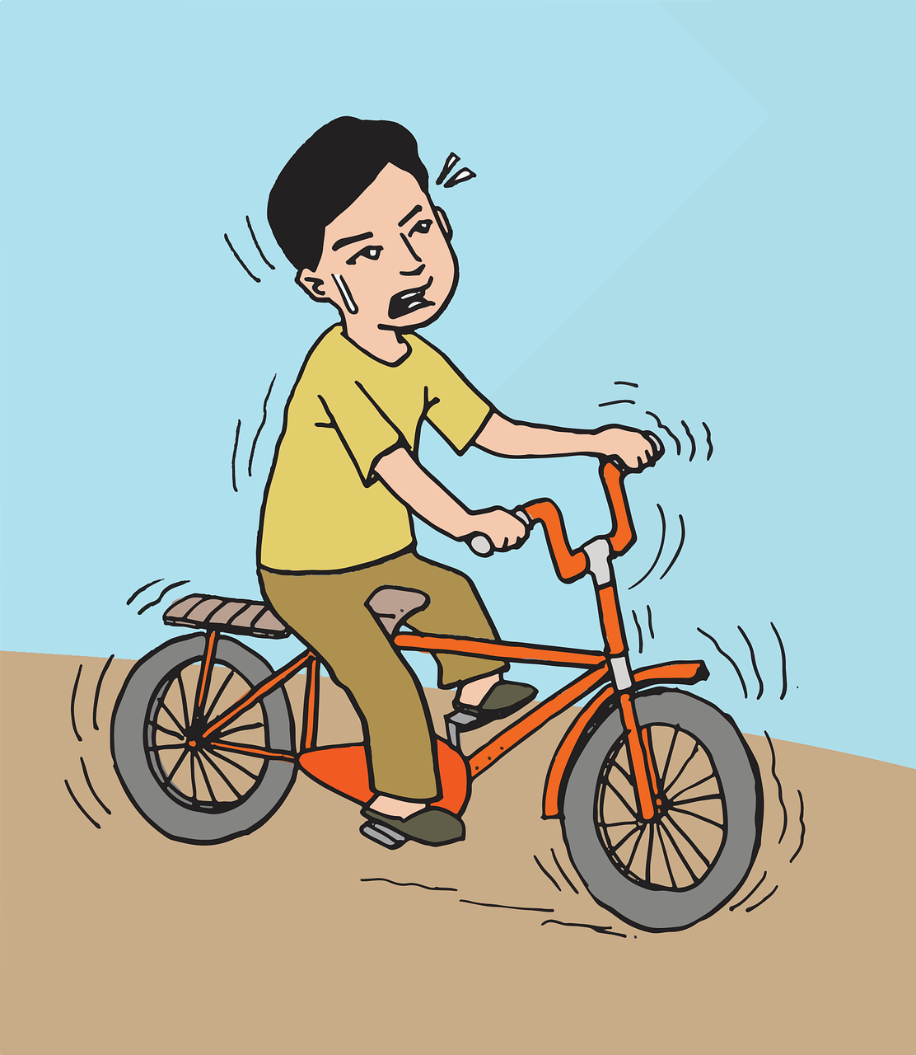
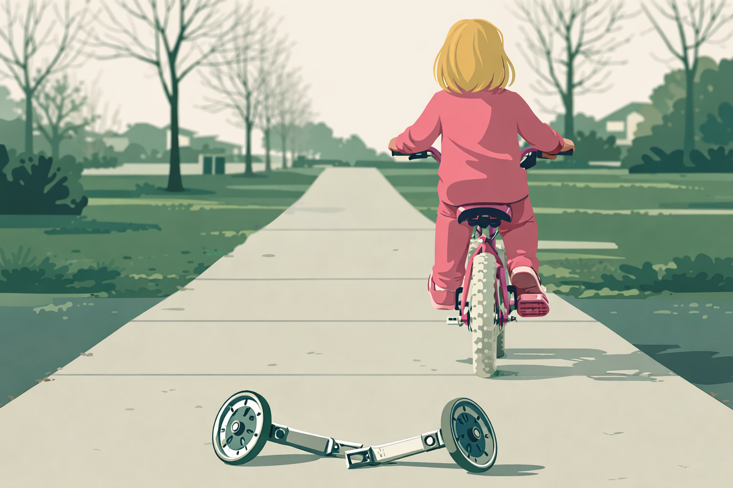
Remember ?
What do you remember about learning to ride a bike or teaching a child to ride a bike.
Children are often afraid in that learning process.
Our lives are filled with things we often fear.
In Jesus’ presence we have no need of fear.

Slide 4
1. The All-Sufficient Provider: Jesus Meets Our Need Beyond Our Means.

Slide 5
Listen for surprising provision.
John 6:5, 9-11, 12,13 (NIV) When Jesus looked up and saw a great crowd coming toward him, he said to Philip, "Where shall we buy bread for these people to eat?" … 9 "Here is a boy with five small barley loaves and two small fish, but how far will they

Slide 6
Listen for surprising provision.
go among so many?" 10 Jesus said, "Have the people sit down." There was plenty of grass in that place, and the men sat down, about five thousand of them. 11 Jesus then took the loaves, gave thanks, and distributed to those who were seated as much as

Slide 7
Listen for surprising provision.
they wanted. He did the same with the fish. … 12 When they had all had enough to eat, he said to his disciples, "Gather the pieces that are left over. Let nothing be wasted." 13 So they gathered them and filled twelve baskets with the pieces of the five barley loaves left over by those who had eaten.

Slide 8

The All-Sufficient Provider
Note Jesus’ response to coming crowd.
He saw them gathering
He asked Philip, “where can we buy bread for these hungry people?”

Slide 9
The All-Sufficient Provider
Why is it significant that Jesus noticed and cared about the physical needs of the crowd?
Why do you think Jesus asked this question of Philip?
What might be a typical reaction to situations that seem to present no readily available solution?

Slide 10
The All-Sufficient Provider
What kinds of resources are seemingly insufficient in our class to meet needs of people in our class, our church, our community?
What’s wrong with the response, “here’s a little something, but it won’t make much difference”?
How can we place our meager “loaves and fishes” (resources) in Jesus’ hands?

Slide 11

The All-Sufficient Provider
What obstacles hinder us from trusting Jesus to provide for us in today’s world?
How might Jesus multiply these things?

Slide 12
2. The Misunderstood Messiah: When We Want Jesus on Our Terms.

Slide 13
Listen for reaction to the miracle.
John 6:14-15 (NIV) After the people saw the miraculous sign that Jesus did, they began to say, "Surely this is the Prophet who is to come into the world." 15 Jesus, knowing that they intended to come and make him king by force, withdrew again to a mountain by himself.

Slide 14
The Misunderstood Messiah
What did the people desire to do?
Their thinking was flawed.
It was not the start of a political or military revolution.
This was not His mission.
The miracles were signs of His divinity.

Slide 15

The Misunderstood Messiah
How can we know if we're focused more on what Jesus can do for us than on who He is?
What small gifts have you seen multiplied when you gave them to Jesus?

Slide 16
3. The Sovereign Savior: Worship in the Storm.

Slide 17
Listen for the perfect storm.
John 6:16-21 (NIV) When evening came, his disciples went down to the lake, 17 where they got into a boat and set off across the lake for Capernaum. By now it was dark, and Jesus had not yet joined them. 18 A strong wind was blowing and the waters grew rough. 19 When they had

Slide 18
Listen for the perfect storm.
rowed three or three and a half miles, they saw Jesus approaching the boat, walking on the water; and they were terrified. 20 But he said to them, "It is I; don't be afraid." 21 Then they were willing to take him into the boat, and immediately the boat reached the shore where they were heading.

Slide 19


Worship in the Storm
Jesus sent the disciples to Capernaum.
Went down to the lake
Got in the boat
Set off across the lake
They encountered a BIG storm

Slide 20
Worship in the Storm
How does this scene depict the spiritual struggles we often face in life?
Why might Jesus allow us (and the apostles) to go through stormy situations where His presence seems absent?
What does this tell us about our perception of God’s presence in difficult times?

Slide 21

Worship in the Storm
How can we remind ourselves of Jesus’ presence when we feel overwhelmed by fear or difficulties? What practical steps can we take?

Slide 22
Application
Surrender.
Make a list of the times that you have tried to “row the boat on your own” in your life versus letting Jesus take control.
Ask God to help you avoid those choices in the future.

Slide 23
Application
Worship.
Read the lyrics for “It Is Well with My Soul.”
Worship the Lord and thank Him for seeing us through the storms of life.

Slide 24
Application
Share.
Consider how storms from the Lord are for the purpose of helping disciples see who Jesus is.
Write down something you have learned about Jesus from this week’s study.
Share that truth with someone else in your life this week.

Slide 25
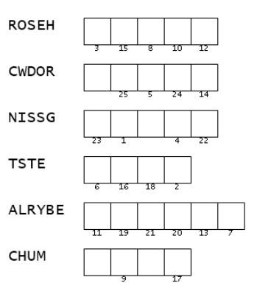

Family Activities
I’ve got all the words figured out … they were in the verses of our study. But CHUM doesn’t seem to be right, even though it’s a word. Oh, yes … it’s not in the study verses. Can you help? There’s tech help and more fun Family Activities at https://tinyurl.com/3tusfk68

Slide 26
Feeding the 5000 – Jesus Walks on the Water

