Slide 1

Cleansing the Temple

Slide 2

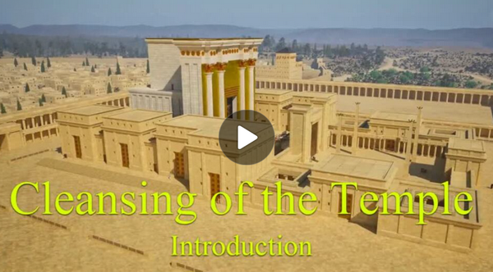
Video Introduction
View Video

Slide 3
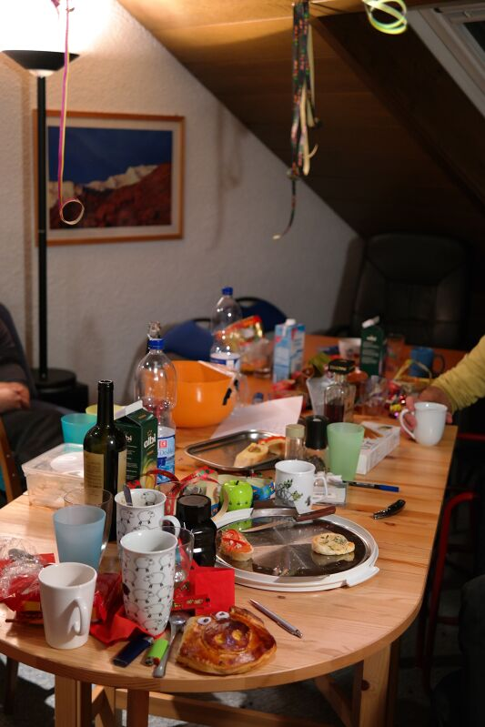
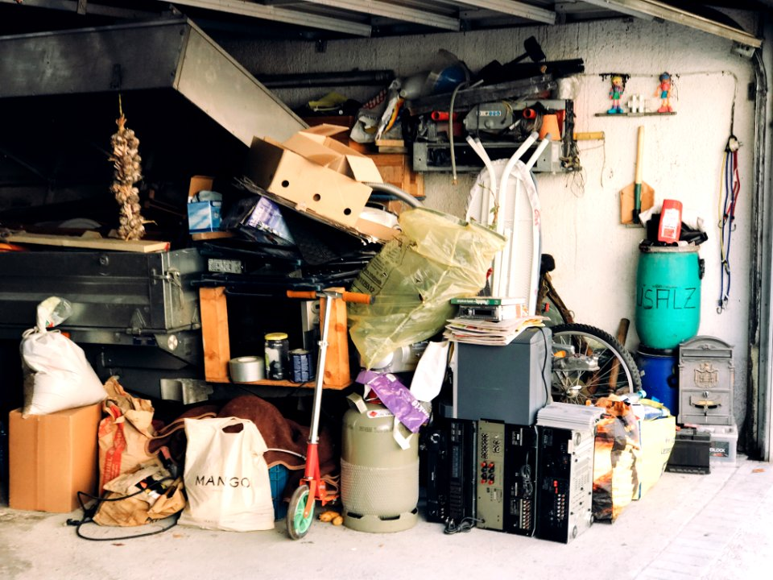
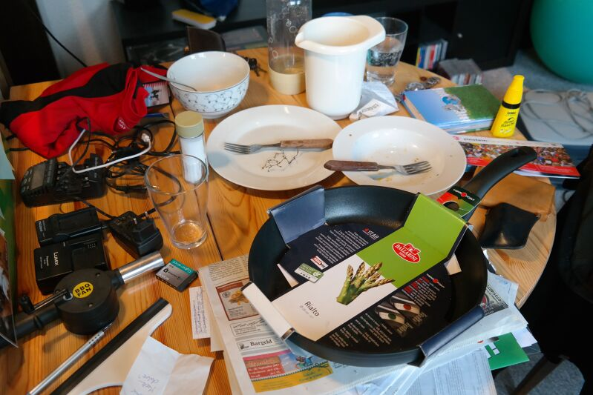
It’s a big mess …
What area of your house tends to collect clutter the fastest?
Consider that our lives can become cluttered spiritually.
  That’s what happened to the Temple in Jerusalem when Jesus attended Passover.
  Clutter for them and for us can crowd out genuine worship.

Slide 4
1. Jesus Cares About True Worship.

Slide 5
Listen for mayhem.
John 2:12-17 (NIV) After this he went down to Capernaum with his mother and brothers and his disciples. There they stayed for a few days. 13 When it was almost time for the Jewish Passover, Jesus went up to Jerusalem. 14 In the temple

Slide 6
Listen for mayhem.
courts he found men selling cattle, sheep and doves, and others sitting at tables exchanging money. 15 So he made a whip out of cords, and drove all from the temple area, both sheep and cattle; he scattered the coins of the money changers and

Slide 7
Listen for mayhem.
overturned their tables. 16 To those who sold doves he said, "Get these out of here! How dare you turn my Father's house into a market!" 17 His disciples remembered that it is written: "Zeal for your house will consume me."

Slide 8
True Worship
What do you notice about what was happening in the temple when Jesus arrived?
In the temple courts he found men selling cattle, sheep and doves, and others sitting at tables exchanging money

Slide 9
True Worship
What does Jesus actually do?
What words does He use?
So he made a whip out of cords, and drove all from the temple area, both sheep and cattle; he scattered the coins of the money changers and overturned their tables. To those who sold doves he said, "Get these out of here! How dare you turn my Father's house into a market!"

Slide 10
True Worship
The temple was supposed to represent a specific location that was identified with the very presence of Jehovah God. How did this offend Jesus, the Son of God?
Why does Jesus call it “My Father’s house”? What does that reveal about Him?

Slide 11
True Worship
How does religious activity become a distraction for us from actually honoring God?
What should “reverence” and “awe” in worship look like today?

Slide 12
2. Jesus Speaks With
Divine Authority.

Slide 13
Listen for a curious response.
John 2:18-19 (NIV) Then the Jews demanded of him, "What miraculous sign can you show us to prove your authority to do all this?" 19 Jesus answered them, "Destroy this temple, and I will raise it again in three days."

Slide 14
Divine Authority
After Jesus cleanses the temple, the Jews immediately ask for a sign. Why do you think they did that?
Why DID Jesus have the right to act the way He did in the temple?

Slide 15
Divine Authority
What does this statement reveal about Jesus’ identity?
What miraculous sign can you show us to prove your authority to do all this?" Jesus answered them, "Destroy this temple, and I will raise it again in three days."

Slide 16
Divine Authority
Why was (is) it easier to demand signs than to submit to authority?
What might be areas where we subtly ask Jesus to “prove Himself” before we obey Him?

Slide 17
3. Jesus Is The True Temple.

Slide 18
Listen for change in understanding.
John 2:20-25 (NIV) The Jews replied, "It has taken forty-six years to build this temple, and you are going to raise it in three days?" 21 But the temple he had spoken of was his body. 22 After he was raised from the

Slide 19
Listen for change in understanding.
dead, his disciples recalled what he had said. Then they believed the Scripture and the words that Jesus had spoken. 23 Now while he was in Jerusalem at the Passover Feast, many people saw the miraculous signs he was doing and

Slide 20
Listen for change in understanding.
believed in his name. 24 But Jesus would not entrust himself to them, for he knew all men. 25 He did not need man's testimony about man, for he knew what was in a man.

Slide 21
The True Temple
What misunderstanding do the Jews have about the raising the temple in three days?
Jesus answered them, "Destroy this temple, and I will raise it again in three days.” The Jews replied, "It has taken forty-six years to build this temple, and you are going to raise it in three days?" But the temple he had spoken of was his body.

Slide 22
The True Temple
If the temple was the place where God’s presence dwelled, what does it mean that Jesus calls His body the temple?
In what way does Jesus replace or fulfill the temple system?

Slide 23
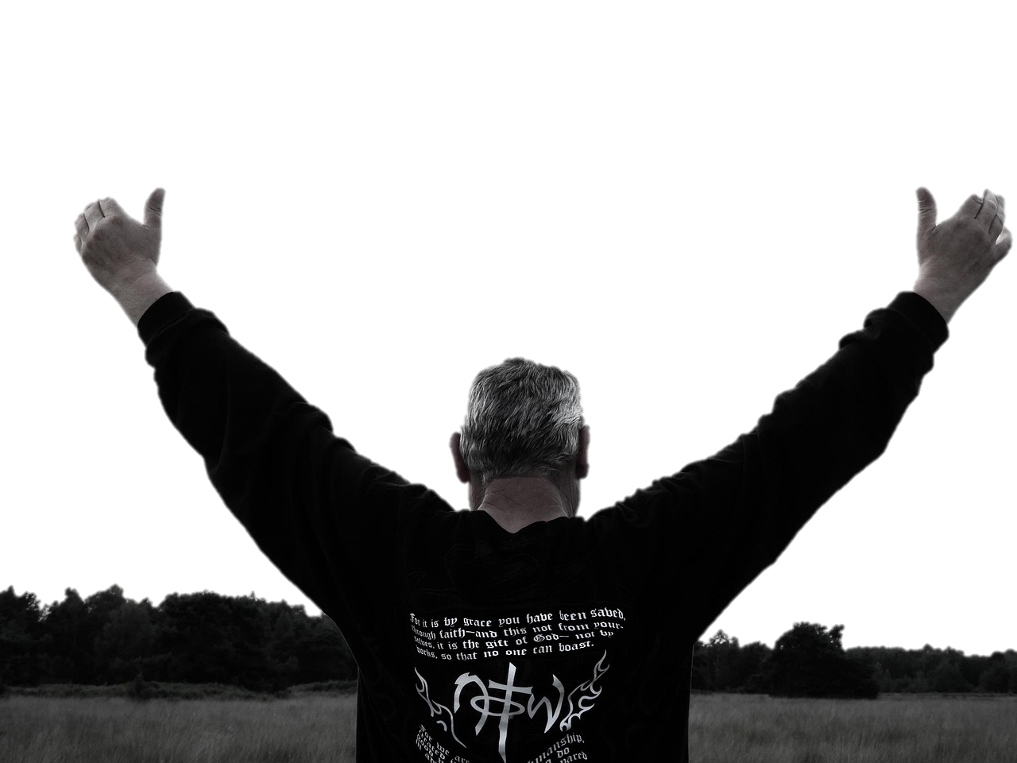
The True Temple
Why is it better to have a relationship with a person (Jesus) rather than just a special building?
If Jesus cares about true worship, speaks with divine authority, and is Himself the true temple — what kind of response does He deserve from us?

Slide 24
Application
Worship
  How can you worship, that is declare Jesus’ worth, in today’s services?
  How can you declare Jesus’ worth this week in your family?
  How can your worship influence those around you?

Slide 25
Application
Authority
  How will someone know that Jesus is the person of authority in your life?
  Ask God to show you areas in your life where you are keeping within your authority.
  Each day talk to God and surrender everything to His authority.

Slide 26
Application
The True Temple
  1 Corinthians 6:19 says that your body is the “Temple of the Holy Spirit”
  Take care of your Temple
  This should involve not only physical exercise but spiritual exercise

Slide 27
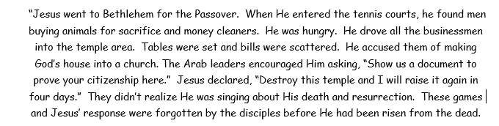

Family Activities
Hearken, scholars all! A rogue—be he mortal or sprite—hath stolen into my device of writing and jumbled certain words, so that my story lies wounded and astray. But lo! The enchanted record hath revealed the alphabetic list of those foul replacements. Set thy wits to work and mend the text aright. Or mayest be thou preferest the color page?

Slide 28
Cleansing the Temple

