Slide 1

The Bread of Life Discourse

Slide 2


Video Introduction
View Video

Slide 3
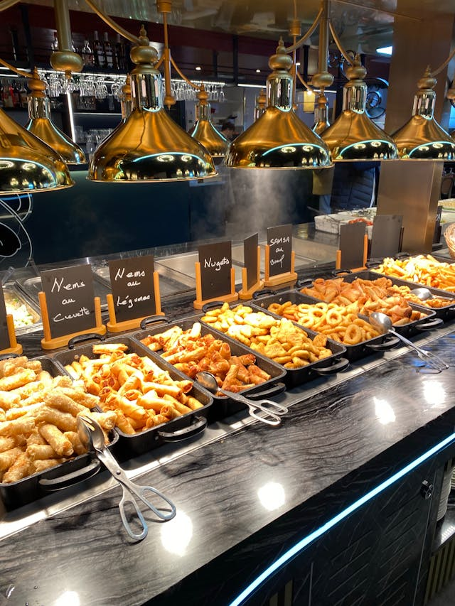


Admit it now …
When have you recently had too much of a good thing?

Slide 4
Admit it now …
We are too soon full and too late satisfied (if at all) with some of these things.
  Today we look at how to find true satisfaction
  Jesus is the Bread of Life

Slide 5
1. Believing in the
Bread of Life.

Slide 6
Listen for ulterior motives.
John 6:24-27 (NIV) Once the crowd realized that neither Jesus nor his disciples were there, they got into the boats and went to Capernaum in search of Jesus. [25] When they found him on the other side of the lake, they asked him, "Rabbi, when did you get here?" [26] Jesus answered, "I tell you the

Slide 7
Listen for ulterior motives.
truth, you are looking for me, not because you saw miraculous signs but because you ate the loaves and had your fill. [27] Do not work for food that spoils, but for food that endures to eternal life, which the Son of Man will give you. On him God the Father has placed his seal of approval."

Slide 8
Believing in the Bread of Life
What reasons are given for why the crowd followed Jesus?
Jesus implied that the people’s motives were selfish. What things do we sometimes selfishly seek from Jesus?
Why do you think people seek satisfaction in things that don’t last?

Slide 9
Believing in the Bread of Life
What do you see in the passage that tells you what Jesus really wanted them to learn from having been fed?
What kinds of things do you think Jesus meant when he said “food that endures to eternal life”?
How can we pursue “food that endures to eternal life”?

Slide 10
2. Receiving the Bread of Life.

Slide 11
Listen for misconceptions corrected.
John 6:32-37 (NIV) Jesus said to them, "I tell you the truth, it is not Moses who has given you the bread from heaven, but it is my Father who gives you the true bread from heaven. 33 For the bread of God is he who comes down from

Slide 12
Listen for misconceptions corrected.
heaven and gives life to the world." 34 "Sir," they said, "from now on give us this bread." 35 Then Jesus declared, "I am the bread of life. He who comes to me will never go hungry, and he who believes in me will never be thirsty. 36 But as I told

Slide 13
Listen for misconceptions corrected.
you have seen me and still you do not believe. 37 All that the Father gives me will come to me, and whoever comes to me I will never drive away.

Slide 14
Receiving the Bread of Life
Note the misconception Jesus corrected:
  Moses wasn't the one who supplied manna
  It was God the Father who supplied the "bread from heaven"
Jesus then makes the transition from physical bread to spiritual … "I am the bread of life."

Slide 15
Receiving the Bread of Life
How is Jesus like bread?
What did Jesus say would be the results of coming to Him?
He who comes to me will never go hungry, and he who believes in me will never be thirsty. … All that the Father gives me will come to me, and whoever comes to me I will never drive away.

Slide 16
Receiving the Bread of Life
What does this " I Am" statement teach us about Jesus' nature and character?
How does Jesus being the “bread of life” go beyond the “energy drink” pick-me-up?
What does “receiving” the Bread of Life look in your daily rhythms of prayer, worship, and dependence?

Slide 17
3. Surrendering to the
Bread of Life.

Slide 18
Listen for a strong reaction.
John 6:44-56 (NIV) "Stop grumbling among yourselves," Jesus answered. 44 "No one can come to me unless the Father who sent me draws him, and I will raise him up at the last day. 45 It is written in the Prophets: 'They will all be taught by God.' Everyone who listens to the Father and learns from him comes to me. … 47 I tell you the truth,

Slide 19
Listen for a strong reaction.
he who believes has everlasting life. 48 I am the bread of life. …. 51 I am the living bread that came down from heaven. If anyone eats of this bread, he will live forever. This bread is my flesh, which I will give for the life of the world." 52 Then the Jews began to argue sharply among themselves, "How can this man give us his flesh to eat?“ 53 Jesus

Slide 20
Listen for a strong reaction.
said to them, "I tell you the truth, unless you eat the flesh of the Son of Man and drink his blood, you have no life in you. 54 Whoever eats my flesh and drinks my blood has eternal life, and I will raise him up at the last day. 55 For my flesh is real food and my blood is real drink. 56 Whoever eats my flesh and drinks my blood remains in me, and I in him

Slide 21
Surrendering to the Bread of Life
Jesus says no one can come to Him unless the Father draws them. What do you think that means?
What does Jesus mean when He calls Himself the “bread of life”?

Slide 22
Surrendering to the Bread of Life
Why do the people react so strongly to Jesus’ words about eating His flesh and drinking His blood?
What would it look like for someone to treat Jesus as essential to life, not just helpful?

Slide 23
Application
Give it up
  Identify something temporary you have been pursuing as a means of security – a possession, an achievement, etc.
  Stop your pursuit
  Repent and ask God to grant you true contentment in Jesus

Slide 24
Application
Give thanks
  Commit to expressing gratitude this week when others serve or bless you
  Thankfulness is a great way to avoid self-centeredness and promote satisfaction

Slide 25
Application
Give it away
  Volunteer with a ministry that serves others in need
  While doing so, share the gospel with someone
  Use this Scripture passage to help them understand true satisfaction comes from Jesus Christ

Slide 26
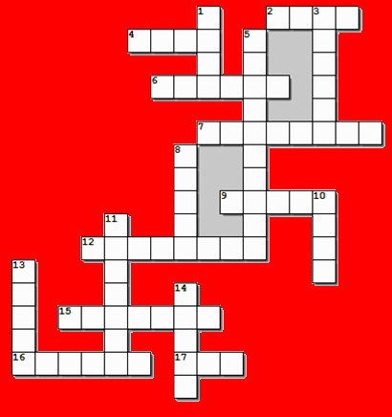


Family Activities
I heard the other puzzle got introduced by the Lone Ranger! I really like him.
I know … me too. But at least we finally got another crossword puzzle.

Slide 27
The Bread of Life Discourse

