Slide 1
Going Out
September 7

Slide 2
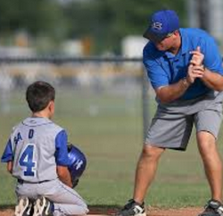
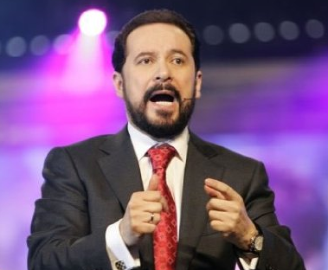
Think About It …
Who was someone in your church as you grew up that you remember touching your life through some service or ministry?
No doubt each of those people gave of their time and energy
Some went out of their way to engaging you and others with the gospel .
Sharing the Gospel often takes passion and determination.

Slide 3
Listen for “closed doors”.
Acts 16:6-8 (NIV) Paul and his companions traveled throughout the region of Phrygia and Galatia, having been kept by the Holy Spirit from preaching the word in the province of Asia. 7 When they came to the border of Mysia, they tried to enter Bithynia, but the Spirit of Jesus would not allow them to. 8 So they passed by Mysia and went down to Troas.

Slide 4
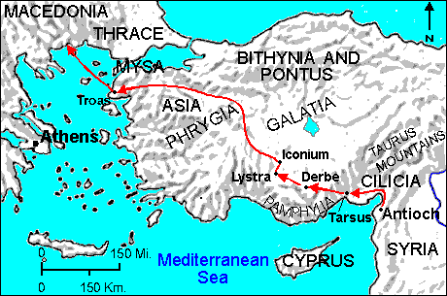
Paul’s Journey

Slide 5
Persevere in Reaching Others
What suggests that Paul and his companions had a plan in mind for their travels?
How do you think Paul, Silas, and Timothy recognized the Holy Spirit’s directions as they traveled around Asia Minor?

Slide 6
Persevere in Reaching Others
How does it make you feel when God says “no”? What are we tempted to do when the Holy Spirit thwarts your plans?
How can we be receptive to the Holy Spirit’s guidance?

Slide 7
Obstacles to Reaching Others
View the Video

Slide 8
Listen for an “open door”.
Acts 16:9-10 (NIV) During the night Paul had a vision of a man of Macedonia standing and begging him, "Come over to Macedonia and help us." 10 After Paul had seen the vision, we got ready at once to leave for Macedonia, concluding that God had called us to preach the gospel to them

Slide 9
Embrace Opportunities to Present Christ
When did Paul experience the vision and what did he see?
How did Paul and his companions interpret this vision?
How does God give direction to believers today?
⇒ Believers need to listen and obey the Word of God and heed His directions

Slide 10
Embrace Opportunities to Present Christ
How did Paul’s vision help to put in perspective the previous instance in which the Spirit had prevented them from acting?
Who in our community today might be saying, “Cross over … and help us!” ?

Slide 11
Listen for results of sharing.
Acts 16:11-15 (NIV) From Troas we put out to sea and sailed straight for Samothrace, and the next day on to Neapolis. 12 From there we traveled to Philippi, a Roman colony and the leading city of that district of Macedonia. And we stayed there several days.

Slide 12
Listen for results of sharing.
On the Sabbath we went outside the city gate to the river, where we expected to find a place of prayer. We sat down and began to speak to the women who had gathered there. 14 One of those listening was a woman named Lydia, a dealer in purple cloth from the city of Thyatira, who was a worshiper of God. The Lord opened her heart to respond to Paul's message.

Slide 13
Listen for results of sharing.
When she and the members of her household were baptized, she invited us to her home. "If you consider me a believer in the Lord," she said, "come and stay at my house." And she persuaded us.

Slide 14
Share Christ with Others
What reasons might have existed for Paul to seek a “place of prayer” rather than a synagogue?
Whom did the travelers find at the place of prayer?
Who was Lydia?
What reasons might people today gather in places other than a church to connect with God?

Slide 15
Share Christ with Others
What are some creative ways you’ve seen others share the gospel?
How would you describe God’s part and our part in leading others to Christ?
God’s Part | Our Part

Slide 16
Application
Pray about fear.
What is your biggest fear or apprehension about sharing the gospel with someone else?
Share that fear with someone in your group and ask him or her to pray for you to overcome it.

Slide 17
Application
Seek the opportunity.
Who is one person in your relational circle you know does not believe the gospel?
Pray and look for the opportunity to share with that person.

Slide 18
Application
Serve together.
Brainstorm with your group about practical ways you can go out together
To serve and
To speak the word of the Gospel

Slide 19
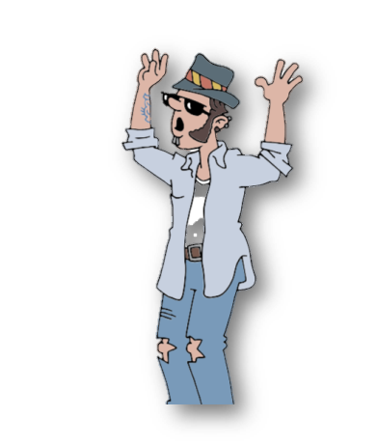
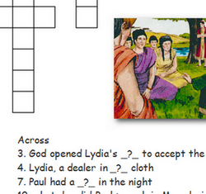
Family Activities
Oh, man … It’s happened again. The crossword is not on the handout. But never fear, you can download it and some other clever games at the Family Activities page at https://tinyurl.com/ya8f67zb

Slide 20
Going Out
September 7

