Slide 1
Godly Contentment
September 22

Slide 2
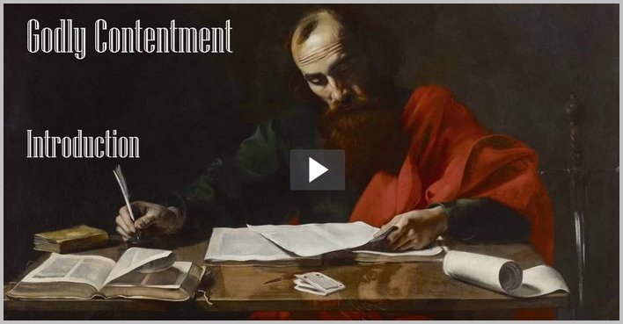
Introduction
View Video

Slide 3
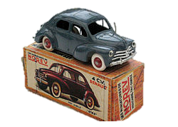
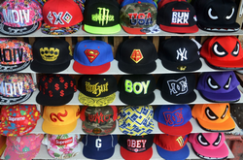
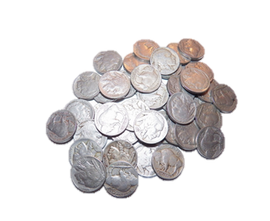
Share …
What is your favorite item to collect?
Collections are fun ways to dedicate time and money towards.
  We achieve a certain contentment from hunting for and displaying our collections.
  Ultimately our contentment can come only from the Lord.
  Today we look at Paul’s statement that “Godliness with contentment is great gain.”

Slide 4

Listen for comments on material things.
1 Timothy 6:6-8 (NIV) But godliness with contentment is great gain. 7 For we brought nothing into the world, and we can take nothing out of it. 8 But if we have food and clothing, we will be content with that.

Slide 5
Don’t Depend on Possessions
According to Paul, with what should we be content?
Why is depending on material goods and all our “stuff” a misguided and short-sighted view of life?
What does the first part of the passage also say about contentment?

Slide 6
Don’t Depend on Possessions
Consider this definition of “contentment?”
  Contentment is the experience of satisfaction and being at ease in one's situation.
Why do people today find it hard to be content?
Wanting to do well in any endeavor is a good thing. However, what kind of motives or attitudes would take us away from contentment as we have defined it?

Slide 7

Don’t Depend on Possessions
How do our lives become more satisfying when we honor God and focus our desires on Him?
The following statement is attributed to the French philosopher, Blaise Pascal: “There is a God shaped vacuum in the heart of every man which cannot be filled by any created thing, but only by God, the Creator, made known through Jesus”

Slide 8
Listen for a famous saying.
1 Timothy 6:9-11 (NIV) People who want to get rich fall into temptation and a trap and into many foolish and harmful desires that plunge men into ruin and destruction. 10 For the love of money is a root of all kinds of evil. Some people,

Slide 9
Listen for a famous saying.
eager for money, have wandered from the faith and pierced themselves with many griefs. 11 But you, man of God, flee from all this, and pursue righteousness, godliness, faith, love, endurance and gentleness.

Slide 10

Don’t Crave More “Stuff”
What kinds of warnings does Paul give concerning the desire for riches?
What did Paul identify as the root of all evil?
What would that root produce? What price do some people eager for money pay?
Illustration – person eager for money

Slide 11
Don’t Crave More “Stuff”
How can we recognize when money is becoming an idol?
What did Paul recommend Timothy should pursue?
Why do you think it is so difficult to pursue these things and wealth at the same time?

Slide 12
Listen for instructions to the rich.
1 Timothy 6:17-19 (NIV) Command those who are rich in this present world not to be arrogant nor to put their hope in wealth, which is so uncertain, but to put their hope in God, who richly provides us with everything for our enjoyment.

Slide 13
Listen for instructions to the rich.
Command them to do good, to be rich in good deeds, and to be generous and willing to share. 19 In this way they will lay up treasure for themselves as a firm foundation for the coming age, so that they may take hold of the life that is truly life.

Slide 14
Store Up Riches in Heaven
What instructions does Paul give Timothy concerning how to act when you have abundance? Categorize them into negative and positive instructions.
Negative Instructions | Positive Instructions

Slide 15
Store Up Riches in Heaven
Why should those who are rich not be arrogant or put their hope in wealth?
What benefits come to those who act with generosity toward others?
What does it mean to store up treasures in heaven? How would we do that?
What kinds of blessings result from following this advice?

Slide 16
Application
Be Content.
  Begin your day—everyday—with a focus on Christ.
  Ask Him to transform your thoughts from self to living a godly life for Him.
  Commit to finding your contentment in the things God provides and choose to live for Him.

Slide 17
Application
Be Accountable.
  If you struggle with craving and buying things to give you a sense of security and contentment, choose someone you trust to be your coach and mentor, holding you accountable for how you spend.
  Seek a person who will encourage you to find your contentment in God alone.

Slide 18
Application
Be Generous.
  If you’re not in the habit of giving, start.
  Give faithfully through your church.
  When you see a need, forego a purchase for yourself, and step in to help with the need.

Slide 19
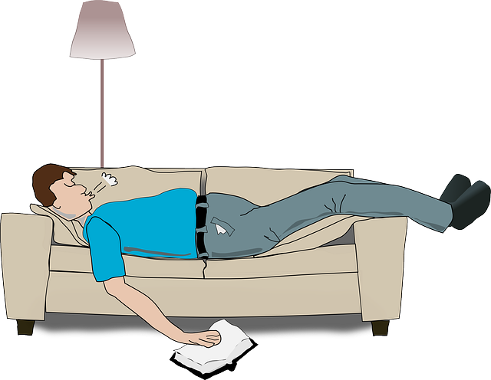

Family Activities
As you can see, this gentleman is content. We cannot judge whether it is godly contentment. But I can report he has completed the crossword puzzle. Once this current state of contentment is finished, he will go to the Family Activities page https://tinyurl.com/y4jw2lnx
for further contentment opportunities.

Slide 20
Godly Contentment
September 22

