Slide 1
Godliness
August 3

Slide 2

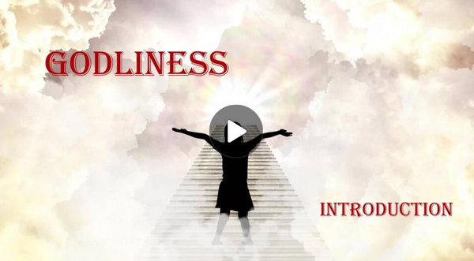
Video Introduction
View Video

Slide 3

What can you observe?
Based on what you observe in a person’s house, what kinds of activities can you tell they are “into”?
The faith of the life of a believer should be likewise observable.
A godly life points others to Christ.
“You can observe a lot just by watching.”

Slide 4
Listen for what to avoid.
1 Timothy 4:6-8 (NIV) If you point these things out to the brothers, you will be a good minister of Christ Jesus, brought up in the truths of the faith and of the good teaching that you have followed. 7 Have nothing to

Slide 5
Listen for what to avoid.
do with godless myths and old wives' tales; rather, train yourself to be godly. 8 For physical training is of some value, but godliness has value for all things, holding promise for both the present life and the life to come.

Slide 6
Godliness As a Priority
What condition did Paul cite that would make Timothy a good minister?
What was Timothy to avoid?
What are some “godless myths and old wives’ tales” in our modern culture that can distract believers from godliness today?

Slide 7
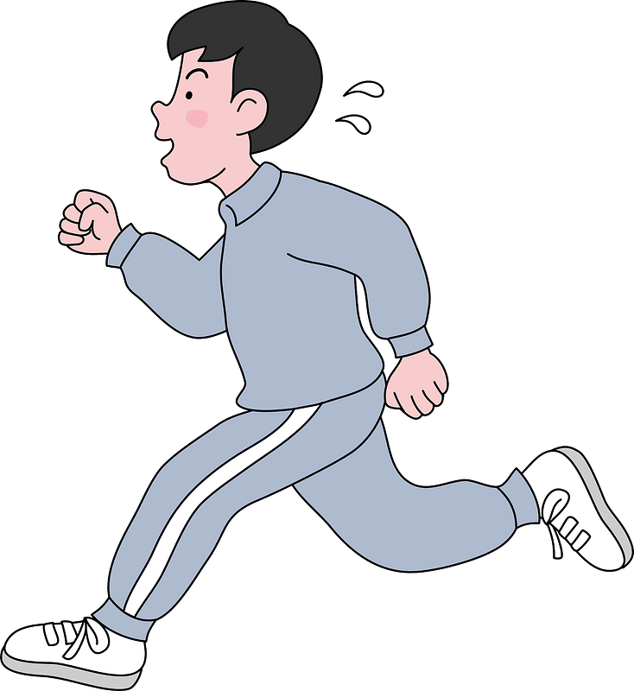
Godliness As a Priority
What effect might the irreverent and silly myths have on those who embraced them?
Paul says that physical exercise has some value. What is his point about spiritual exercise? Why is it of more value?

Slide 8

Godliness As a Priority
In what positive action did Paul urge Timothy to engage?
So, what will be the benefits of spiritual training?

Slide 9
Listen for what to teach.
1 Timothy 4:9-11 (NIV) This is a trustworthy saying that deserves full acceptance 10 (and for this we labor and strive), that we have put our hope in the living God, who is the Savior of all men, and especially of those who believe. 11 Command and teach these things.

Slide 10
Grounded in Christ-centered Hope
Paul says that “we labor and strive”. What kind of work is he referring to?
One of the synonyms of “strive” is “struggle”. What areas of life do we sometimes struggle in our walk with God?
What affirmation does Paul give about the living God?

Slide 11

Grounded in Christ-centered Hope
What does it look like in your life to “put your hope in the living God”?
How would you describe Christ-centered hope to a non-believer?

Slide 12
Listen for why to persevere.
1 Timothy 4:12-16 (NIV) Don't let anyone look down on you because you are young, but set an example for the believers in speech, in life, in love, in faith and in purity. 13 Until I come, devote yourself to the public reading of Scripture, to preaching and to teaching. 14 Do not neglect your gift, which

Slide 13
Listen for why to persevere.
was given you through a prophetic message when the body of elders laid their hands on you. 15 Be diligent in these matters; give yourself wholly to them, so that everyone may see your progress. 16 Watch your life and doctrine closely. Persevere in them, because if you do, you will save both yourself and your hearers.

Slide 14
Encourage Others to Seek Godliness
Despite Timothy’s youth, what exhortation did Paul give him?
What actions did he charge Timothy to continue?
How could his commitment to godliness be a benefit to himself and others?
Why must we constantly commit ourselves to spiritual growth?

Slide 15
Application
Examine yourself.
Recall the last time you thought about heaven.
Maybe attending a funeral, participating in a worship service, reading a book or the Bible.
See if you can remember any response that provoked from you.

Slide 16
Application
Extend yourself.
Think about your biggest obstacles in a pursuit of godliness.
Consider ways to address those obstacles.
Write somewhere in the Personal Study Guide the first step you can take toward this.

Slide 17
Application
Inventory yourself.
Make a list of the people upon whom you have, either by word or action, exerted a positive influence.
Ask your closest friend to help you make that list.
See if you can find a visible token of that influence, such as a card or a note.

Slide 18
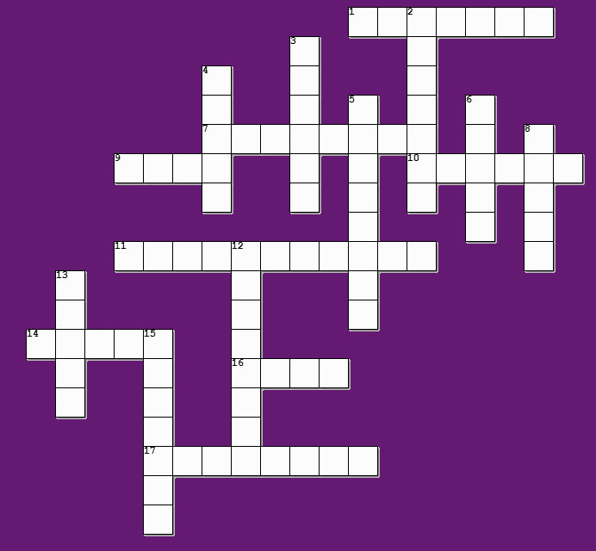

Family Activities
Remember, the clues and words are from our Bible Study passage. And if you’d rather do the Fallen Phrases go to https://tinyurl.com/3unm9sdj

Slide 19
Godliness
August 3

