Slide 1
God’s Will and the
Holy Spirit
October 27

Slide 2
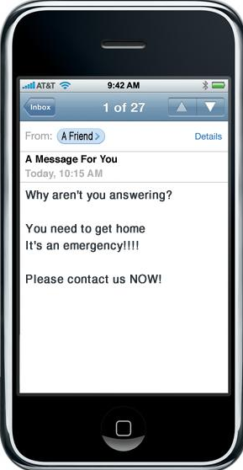


Remember the time …
When have you wished you’d
realized when someone was trying
to get your attention or get in touch
with you?

Slide 3
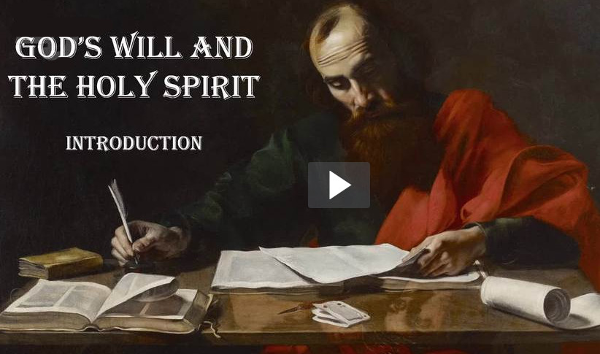
Introduction
View Video

Slide 4
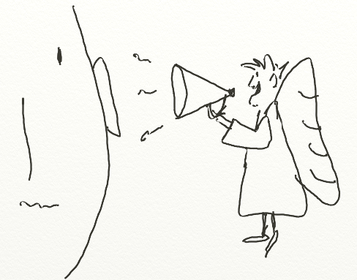
Sometimes …
Sometimes it is God who is
trying to get your attention.
  You want to be able to know what He is communicating.
  Today we consider the Truth of that the Holy Spirit will guide us in knowing God’s will.

Slide 5
Listen for comments on wisdom.
1 Corinthians 2:6-8 (NIV) We do, however, speak a message of wisdom among the mature, but not the wisdom of this age or of the rulers of this age, who are coming to nothing. 7 No, we speak of

Slide 6

Listen for comments on wisdom.
God's secret wisdom, a wisdom that has been hidden and that God destined for our glory before time began. 8 None of the rulers of this age understood it, for if they had, they would not have crucified the Lord of glory.

Slide 7
Understanding God’s Wisdom
How did Paul describe or define the substance of the message he and his coworkers preached in Corinth?
To what did he contrast his message?
What are some different kinds of “wisdom” we normally think of?
What truths or wisdom about God seem hard to believe for people in our culture?

Slide 8
Understanding God’s Wisdom
In what way does the world’s wisdom fall short? According to Paul, where does the world’s wisdom lead?
What did Paul mean in describing the wisdom of God as mystery?

Slide 9
Understanding God’s Wisdom
Consider the fact that nowhere in this passage do the words “education” or “heritage” appear in relation to God's wisdom. This is because …
  God's wisdom is not a matter of exposure to a collection of facts or collection of knowledge
  God's wisdom is not a collection of information to be passed down to succeeding generations
  God's wisdom has to do with knowing Christ as one’s personal Savior

Slide 10
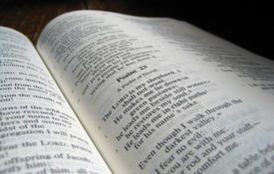
Understanding God’s Wisdom
Spiritual Truth is known only to those who …
  Believe what God says and
  Receive it in faith

Slide 11
Listen for how God’s “mystery” is discovered.
Corinthians 2:9-11 (NIV) However, as it is written: "No eye has seen, no ear has heard, no mind has conceived what God has prepared for those who love him"-- 10 but God has revealed it to us by his Spirit. The Spirit searches

Slide 12
Listen for how God’s “mystery” is discovered.
all things, even the deep things of God. For who among men knows the thoughts of a man except the man's spirit within him? In the same way no one knows the thoughts of God except the Spirit of God.

Slide 13
The Holy Spirit Reveals the Mind of God
What is the essence of verse 9 and why is verse 10a essential to understanding Paul’s intent?
Who enables us to know and understand the things of God?
Why is the Spirit capable of making known the things of God to us?
No eye has seen, no ear has heard, no mind has conceived what God has prepared for those who love him"-- 10 but God has revealed it to us by his Spirit.

Slide 14
The Holy Spirit Reveals the Mind of God
Why do people often fail to see God’s purpose for them?
How can we discern whether it’s the Holy Spirit who is speaking to and leading us?

Slide 15
Listen for the contrast between human “wisdom” and God’s true wisdom.
1 Corinthians 2:12-16 (NIV) We have not received the spirit of the world but the Spirit who is from God, that we may understand what God has freely given us. 13 This is what we speak, not in words taught us by human wisdom but in words taught by the Spirit, expressing spiritual truths in spiritual words. 14 The man without the Spirit does not accept the

Slide 16
Listen for the contrast between human “wisdom” and God’s true wisdom.
things that come from the Spirit of God, for they are foolishness to him, and he cannot understand them, because they are spiritually discerned. 15 The spiritual man makes judgments about all things, but he himself is not subject to any man's judgment: 16 "For who has known the mind of the Lord that he may instruct him?" But we have the mind of Christ.

Slide 17
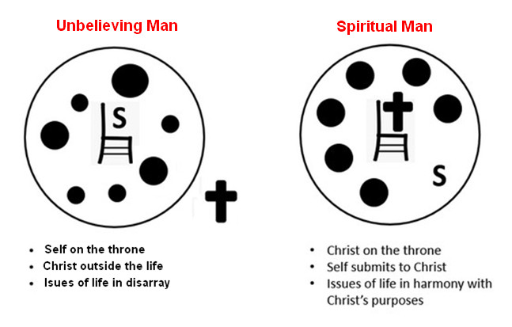
Depend on the Holy Spirit
What characteristics will the wisdom that the Spirit teaches us have?
According to this passage, how are spiritual and unspiritual people different?

Slide 18
Depend on the Holy Spirit
What does it mean to have the mind of Christ?
How can you know if you have the mind of Christ?

Slide 19
Application
Pray.
  Thank God for the presence of His Holy Spirit in your life.
  Express a desire to let Him lead you in what you think and do.

Slide 20
Application
Evaluate.
  Take an inventory of your current thinking on important subjects such as politics, marriage, work, church, family, and social issues.
  Evaluate your views in light of what Scripture teaches.
  Ask God to grow you in thinking with the mind of Christ in these matters.

Slide 21
Application
Obey.
  Act on what the Holy Spirit is leading you to do.
  It is as simple as that.
  Delayed obedience is disobedience, so trust God to empower you in what He leads you to do.

Slide 22


Family Activities
Well, I played a prank on the story editor and switched words in his document. Guess he got me back big time. You can help him out and maybe he’ll come and unroll me! You can also go to https://tinyurl.com/y5k8t2mf and find other activities your family can enjoy together

Slide 23
God’s Will and the
Holy Spirit
October 27

