Slide 1
God’s Promise of
Fruitfulness
June 2

Slide 2

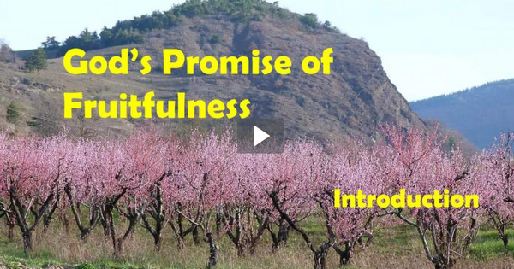
Video Introduction
View Video

Slide 3
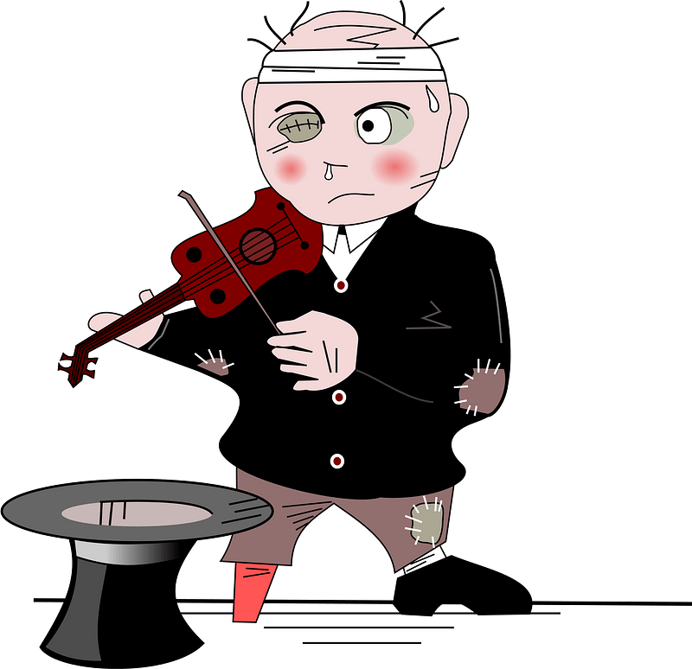
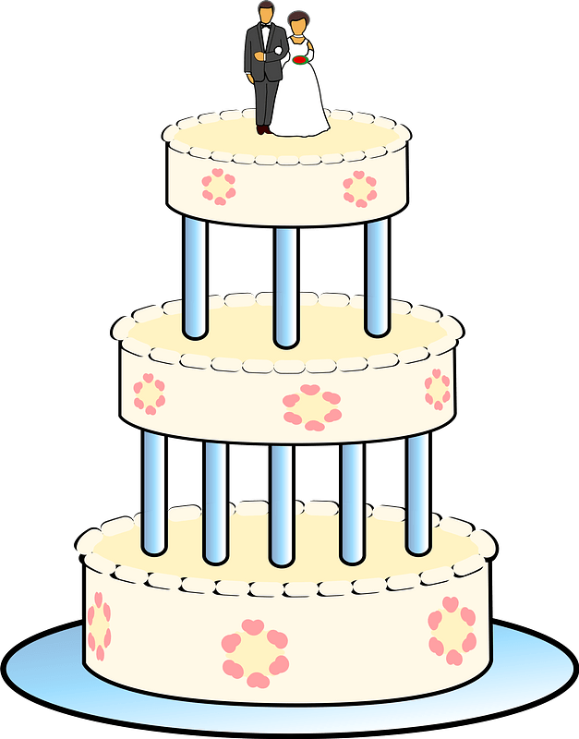

Can’t forget it …
What was a time when your plans failed to live up to your intent?
Some of those failed plans we could fix, some we could not
  Today we look at God’s original plan in designing men and women.
  We want to discover how God fixed sin’s destruction

Slide 4
Listen for God’s blessing.
Genesis 1:26-30 (NIV) Then God said, "Let us make man in our image, in our likeness, and let them rule over the fish of the sea and the birds of the air, over the livestock, over all the earth, and over all the creatures that move along the ground." 27 So God created man in his own image, in the

Slide 5
Listen for God’s blessing.
image of God he created him; male and female he created them. 28 God blessed them and said to them, "Be fruitful and increase in number; fill the earth and subdue it. Rule over the fish of the sea and the birds of the air and over every living creature that moves on the ground." 29 Then God said,

Slide 6
Listen for God’s blessing.
I give you every seed-bearing plant on the face of the whole earth and every tree that has fruit with seed in it. They will be yours for food. 30 And to all the beasts of the earth and all the birds of the air and all the creatures that move on the ground--everything that has the breath of life in it--I give every green plant for food." And it was so.

Slide 7
Be Fruitful and Steward God’s Creation
What do the verses say about how God created man?
What is different about the creation of man and the creation of the other creatures?
What do you think it means when you read that you are made “in the image of God”?

Slide 8
Be Fruitful and Steward God’s Creation
According to these verses, how does humankind fit into God’s plan and purpose for His creation?
What evidence do you see in this passage that God places high value on us?

Slide 9
Be Fruitful and Steward God’s Creation
We can celebrate the blessing of being made in God’s image!
  Since you are made like Him, show a “family resemblance”
  Submit to His Lordship
  Worship Him, praise Him
  Share who Jesus is with others around you … like showing family pictures

Slide 10
Listen for restrictions God gives.
Genesis 2:16-17 (NIV) And the LORD God commanded the man, "You are free to eat from any tree in the garden; 17 but you must not eat from the tree of the knowledge of good and evil, for when you eat of it you will surely die."

Slide 11
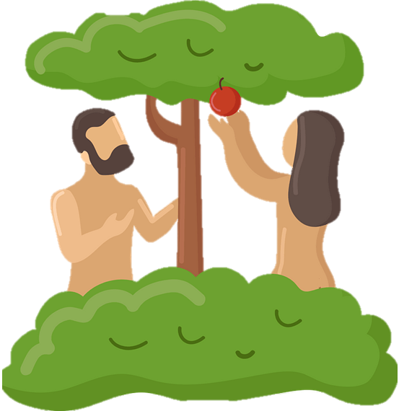
Be Obedient and Loyal
What freedoms/restrictions did God give Adam and Eve?

Slide 12
Be Obedient and Loyal
Consider the concept of the “knowledge of good and evil” that God would forbid partaking of it.
  Direct disobedience, rebellion
  Be like God, know good, evil independently
  Rejecting dependence on God
  Usurp God’s role as moral arbiter
  Breaking trust relationship with God

Slide 13
Be Obedient and Loyal
Why are we attracted to do what God has forbidden?
How do you understand death in the warning against disobedience?
How are God’s restrictions actually indications of His blessings?
How can believers protect themselves from Satan’s deception and confusion?

Slide 14
Listen for consequences of sin.
Genesis 3:16-19 (NIV) To the woman he said, "I will greatly increase your pains in childbearing; with pain you will give birth to children. Your desire will be for your husband, and he will rule over you." 17 To Adam he said, "Because you listened to your wife and ate from the tree about which I commanded you, 'You must not eat of it,'

Slide 15
Listen for consequences of sin.
"Cursed is the ground because of you; through painful toil you will eat of it all the days of your life. 18 It will produce thorns and thistles for you, and you will eat the plants of the field. 19 By the sweat of your brow you will eat your food until you return to the ground, since from it you were taken; for dust you are and to dust you will return."

Slide 16
Deal with the Consequences
What emotions do you experience when you read these verses?
How do the curses given to the man and woman affect twenty-first century humanity? How does this original sin affect us daily?

Slide 17
Deal with the Consequences
What surprises you about the way people respond to sin’s consequences?
What can mature Christians do to help people understand that sin has consequences?

Slide 18
Application
Mediate.
  Memorize Genesis 1:27: “So God created man in his own image; he created him in the image of God.”
  Think about the implications of this Truth.

Slide 19
Application
Pray.
  Spend time talking with God about what is preventing you from living a more purposeful life
  Possibly sin, fear, self-pity, selfishness, broken relationships, laziness, etc.
  Confess and repent of those sins and commit to a life of obedient fruitfulness.

Slide 20
Application
Connect with the next generation.
  Consider ways you will steward younger generations in your family and church.
  How can you invest in others so you can fulfill your purpose of providing Godly wisdom and influence to the next generations?

Slide 21
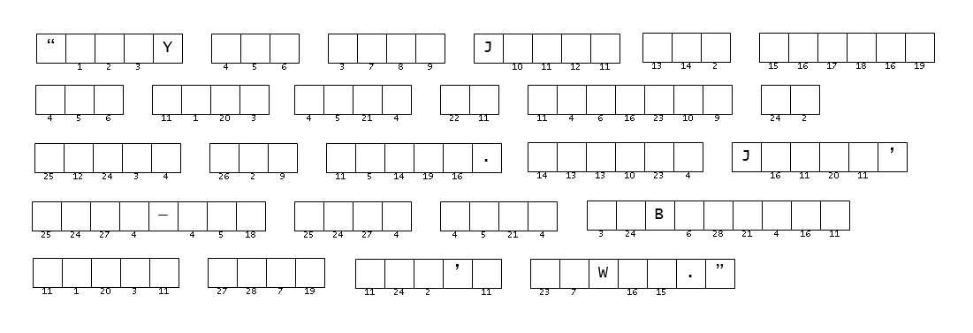

Family Activities
You’re going to want those scrambled words to get the numbers for the message. Remember, the words are found in Genesis 1:26 - 30; 2:16,17; 3:16 – 19 (NIV). Go for help (and the Crossword) at https://tinyurl.com/334vejue

Slide 22
God’s Promise of
Fruitfulness
June 2

