Slide 1
God’s Hand in Meeting Others’ Needs
May 11

Slide 2
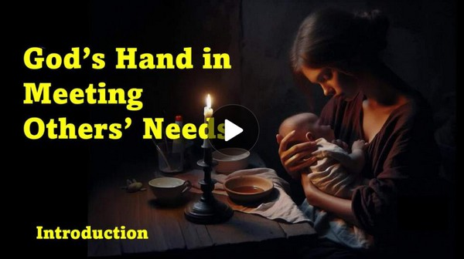
Video Introduction
View Video

Slide 3
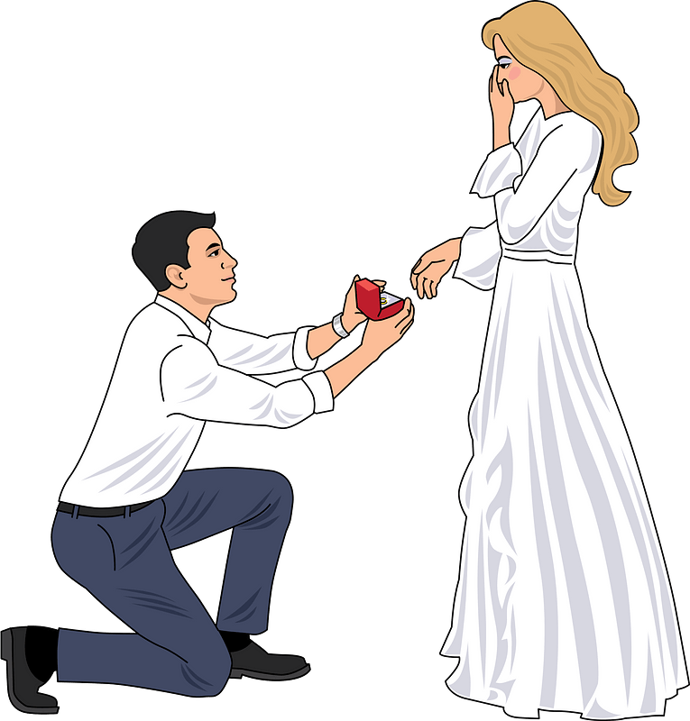
Remember that time …
When has giving to someone been a fun experience for you?
Today we read tat Elisha received and gave blessings.
Likewise, God blesses us as we bless others.

Slide 4
Listen for a blessing given.
2 Kings 4:8-10 (NIV) One day Elisha went to Shunem. And a well-to-do woman was there, who urged him to stay for a meal. So whenever he came by, he stopped there to eat. 9 She said to her husband, "I know that

Slide 5
Listen for a blessing given.
this man who often comes our way is a holy man of God. 10 Let's make a small room on the roof and put in it a bed and a table, a chair and a lamp for him. Then he can stay there whenever he comes to us."

Slide 6
Look for Opportunities
Who and in what way did someone act hospitably toward Elisha?
Who did the Shunammite woman perceive Elisha to be and how did that influence her action?
Why do you think she went beyond offering a meal and built him a room?
How does the Shunammite woman’s hospitality reflect selfless generosity?

Slide 7
Look for Opportunities
How can we develop the same kind of generous, open-hearted attitude the Shunammite woman showed, especially when there’s no guarantee of being "rewarded"?
What steps can we take to actively meet the needs of others?

Slide 8
Listen for how God responded to her sacrifice.
2 Kings 4:11-17 (NIV) One day when Elisha came, he went up to his room and lay down there. 12 He said to his servant Gehazi, "Call the Shunammite." So he called her, and she stood before him. 13 Elisha said to him, "Tell her,

Slide 9
Listen for how God responded to her sacrifice.
'You have gone to all this trouble for us. Now what can be done for you? Can we speak on your behalf to the king or the commander of the army?'" She replied, "I have a home among my own people." 14 "What can be done for her?"

Slide 10
Listen for how God responded to her sacrifice.
Elisha asked. Gehazi said, "Well, she has no son and her husband is old." 15 Then Elisha said, "Call her." So he called her, and she stood in the doorway. 16 "About this time next year," Elisha said, "you will hold a son in your

Slide 11
Listen for how God responded to her sacrifice.
arms." "No, my lord," she objected. "Don't mislead your servant, O man of God!" 17 But the woman became pregnant, and the next year about that same time she gave birth to a son, just as Elisha had told her.

Slide 12
God Just May Surprise Us
In a subsequent visit, what question did Elisha pose to the Shunammite woman and what was his reason for doing so?
She seemed to respond that she had a happy home among her own people, didn’t need much else. But what suggestion did Elisha get?

Slide 13
God Just May Surprise Us
Eventually what did he promise her? What was her response? What was the surprising result?
What does this passage tell us about the kind of heart God honors?
How do you think blessing others changes us on the inside, even before God blesses us in return?
How has God used someone to bless you an unusual way?

Slide 14
Listen for her response when the unthinkable happened.
2 Kings 4:32-37 (NIV) When Elisha reached the house, there was the boy lying dead on his couch. 33 He went in, shut the door on the two of them and prayed to the LORD. 34 Then he got on the bed and lay upon the boy, mouth to mouth, eyes

Slide 15
Listen for her response when the unthinkable happened.
to eyes, hands to hands. As he stretched himself out upon him, the boy's body grew warm. 35 Elisha turned away and walked back and forth in the room and then got on the bed and stretched out upon him once more. The boy sneezed seven times and

Slide 16
Listen for her response when the unthinkable happened.
opened his eyes. 36 Elisha summoned Gehazi and said, "Call the Shunammite." And he did. When she came, he said, "Take your son." 37 She came in, fell at his feet and bowed to the ground. Then she took her son and went out.

Slide 17
So, Trust in Him
How does this part of the story show that God had not forgotten the Shunammite woman’s kindness?
What actions did Elisha take when he arrived in the room where the dead child lay?
What stands out to you about the way the child is brought back to life? Why do you think the Bible gives us the details?

Slide 18
So, Trust in Him
How do you see the connection between the woman’s earlier generosity and this miracle?
What does this teach us about God’s ability to give us blessings that go beyond what we could ever expect — even in impossible situations?
The Shunammite woman didn’t bless Elisha expecting to one day need a miracle — but God met her deepest need. How does this challenge or encourage your attitude about serving and giving to others?

Slide 19
Application
Motivation.
Remember circumstances when others met your needs and blessed you.
Review the emotions you experienced: relief, love, hope, joy, etc.
Thank God for His provision and for those who helped you.

Slide 20
Application
Investigation.
Spend some time investigating the needs of those around you.
Pray and ask God to help you see the needs of others.
Make a list and plan ways to meet those needs.

Slide 21
Application
Implementation.
Determine who you need to assist and make a plan.
Depending on the circumstances, you may want to involve others in the process and make this a group project.

Slide 22
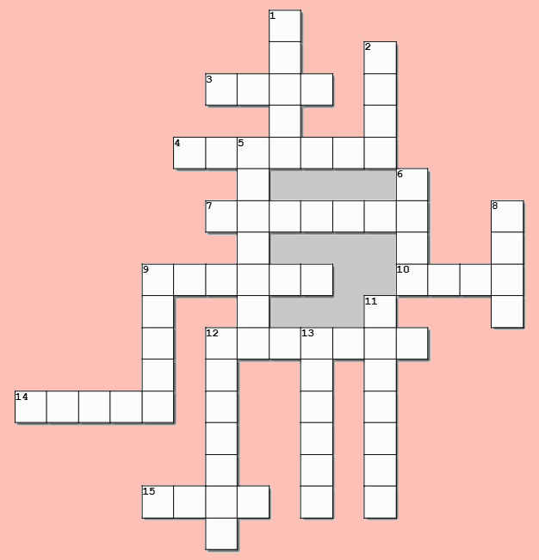
Family Activities
Our survey shows that you are hoping this would be the week for the crossword puzzle. But, for the rest of you, there are other fun Family Activities available at https://tinyurl.com/pdxw9kmy Oh yes … you can sneak a peek at the answers, also.

Slide 23
God’s Hand in Meeting Others’ Needs
May 11

