Slide 1
Give Thanks to God
November 21

Slide 2
Video Introduction
View Video

Slide 3
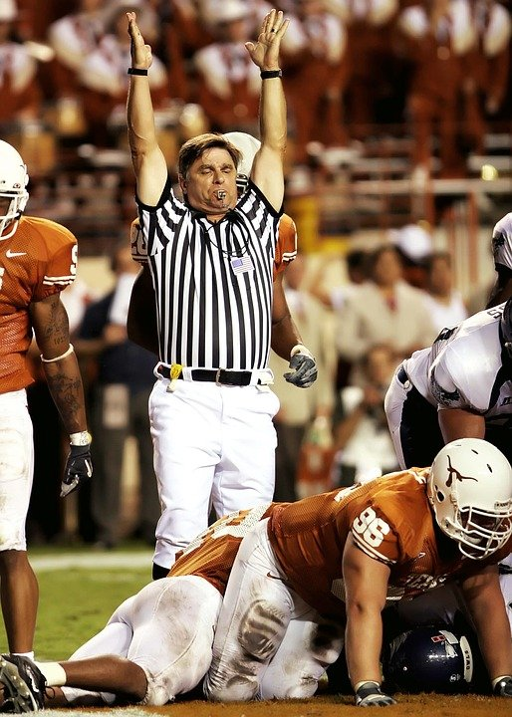
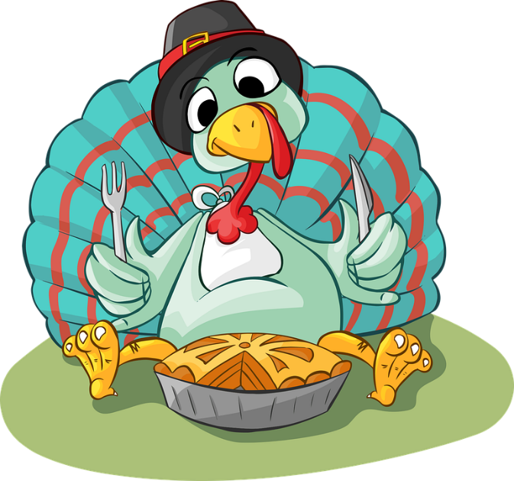
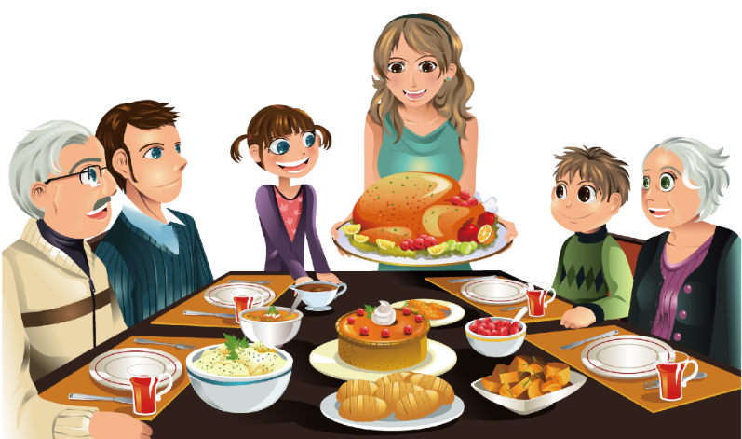
How ‘bout you?
What kinds of things do you look forward to during Thanksgiving week?
Unfortunately, we too often give lip service to giving thanks … we’re more concerned with this other stuff
Today we consider how giving thanks should come naturally
It should happen every day

Slide 4
Listen for how to worship.
Psalm 100:1-2 (NIV) Shout for joy to the LORD, all the earth. 2 Worship the LORD with gladness; come before him with joyful songs.

Slide 5
Serve the Lord with Gladness
What attitudes or traits are to be dominate in our worship?
Why is the Lord worthy of praise and worship by all nations?
The KJV says serve the Lord with gladness. What are some ways we can serve the Lord with gladness?

Slide 6
Serve the Lord with Gladness
So, what is the relationship between serving the Lord and worship?
Why do you think God would ask us to do these things?
What are some ways in which you can worship the Lord joyfully when you are alone?
What are some ways you worship the Lord joyfully when you are in group worship situations?

Slide 7
Listen for what we should know for sure.
Psalm 100:3 (NIV) Know that the LORD is God. It is he who made us, and we are his; we are his people, the sheep of his pasture.

Slide 8
Know that the Lord Is God
What do you think the psalmist meant when he said, “Know that the Lord is God”?
The Hebrew word used for “know” suggests the kind of knowledge that comes from experience. How do your experiences help you know that the Lord is God?
How does the psalm writer describe the relationship God has with His followers?

Slide 9
Know that the Lord Is God
Why is it so important that we acknowledge that God made us?
What was the psalmist trying to convey by referring to us as the sheep of God’s pasture?
How has God demonstrated that He is your Shepherd.

Slide 10
Listen for why to praise and thank God.
Psalm 100:4-5 (NIV) Enter his gates with thanksgiving and his courts with praise; give thanks to him and praise his name. 5 For the LORD is good and his love endures forever; his faithfulness continues through all generations.

Slide 11
Give Thanks and Bless His Name
What responses are generated from knowing the Lord as Creator and Shepherd?
How does thanking God and praising Him change our attitudes and actions?
Let’s enumerate the characteristics of God listed here.

Slide 12
Give Thanks and Bless His Name
Contrast these qualities … how does the world sometimes see God?
⇨ God is good … His commands are for our good and for His glory!

Slide 13
Give Thanks and Bless His Name
How do God’s goodness, His love and faithfulness motivate us to obedience?
Why is it important to regularly proclaim the goodness of God to those around us?

Slide 14
Application
Shout.
Consider a short sentence of praise for the Lord and look for every opportunity to share it with others this week.
“God is good.” “I’ve been more blessed than I deserve.” “Thank the Lord for __________ !” .
Examples

Slide 15
Application
Serve.
Whether it is service in the church or in the community, our service can be an act of worship.
Find a ministry in your church or even a community organization where you can serve others and demonstrate the love of Christ.

Slide 16
Application
Start.
Begin a neighborhood Bible study for adults or a backyard Bible club for kids in your home or in a safe neutral location nearby (playground, field, clubhouse, etc.).
Help others learn the joy of gathering together to worship God.

Slide 17
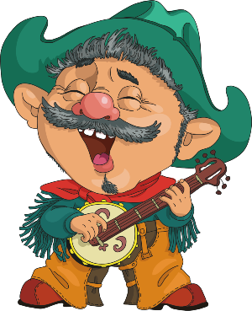
Family Activities
This singing cowboy is a clue to the author of this week’s Double Puzzle quote. Remember the clue words come from Psalm 100.
Help and other activities found at https://tinyurl.com/2yk57hyn

Slide 18
Give Thanks to God
November 21

