Slide 1
Generosity
8/24/2025

Slide 2

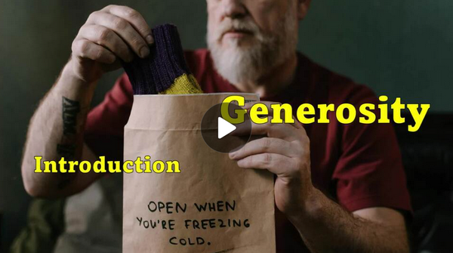
Video Introduction
View Video

Slide 3
Make a list …
What are some synonyms and antonyms for the word “generosity?”
Consider which of these descriptions you would have people think about you.
  Today we look at how God’s generous grace moves us to be generous.
Synonyms | Antonyms

Slide 4

Listen for an example of generous people.
2 Corinthians 8:1-2 (NIV) And now, brothers, we want you to know about the grace that God has given the Macedonian churches. 2 Out of the most severe trial, their overflowing joy and their extreme poverty welled up in rich generosity.

Slide 5
Do Not Depend on Wealth
What was the financial condition of the people Paul described in Macedonia?
Actually, the Romans had treated this area harshly
  Seized their mining industry
  Taxed them for the rights to smelt copper and iron
  Cancelled their rights to cut lumber for homes and ships

Slide 6
Do Not Depend on Wealth
What things did the Macedonian Christians do that impressed Paul?
So why do you think the Macedonians had overflowing joy in the midst of trials and poverty?
What prevents people from joyfully giving of their resources to the Lord for His work?

Slide 7
Do Not Depend on Wealth
What do you think could be the relationship between joy and generosity?
Why might Paul have not explicitly mentioned giving money but rather associated generous giving with grace?

Slide 8

Let’s talk about tithing …
What is a typical initial reaction when the preacher announces a message on stewardship?
Listen Macedonians’ attitudes toward Christian giving.

Slide 9
Listen Macedonians’ attitudes toward Christian giving.
2 Corinthians 8:3-6 (NIV) For I testify that they gave as much as they were able, and even beyond their ability. Entirely on their own, 4 they urgently pleaded with us for the privilege of sharing in this service to the saints. 5 And they

Slide 10
Listen Macedonians’ attitudes toward Christian giving.
did not do as we expected, but they gave themselves first to the Lord and then to us in keeping with God's will. 6 So we urged Titus, since he had earlier made a beginning, to bring also to completion this act of grace on your part.

Slide 11
Give Yourself to God
So, what attitude did the Macedonians have in their giving?
According to verse 5, how did they surprise Paul?
How can joy lead to generosity, even when a person lives in poverty?

Slide 12





Give Yourself to God
How is generosity a grace, a blessing you don’t deserve?
Consider this story of a circus strong man …

Slide 13
Give Yourself to God
Truth …
  Generosity is not squeezing another “drop” out of time, talent, and treasure from the meager supply …
  Generosity is a joyful response of my whole life to a God who loves us

Slide 14
Listen for an ultimate model of generosity.
2 Corinthians 8:7-9 (NIV) But just as you excel in everything--in faith, in speech, in knowledge, in complete earnestness and in your love for us--see that you also excel in this grace of giving. 8 I am not commanding you, but I want to test the

Slide 15
Listen for an ultimate model of generosity.
sincerity of your love by comparing it with the earnestness of others. 9 For you know the grace of our Lord Jesus Christ, that though he was rich, yet for your sakes he became poor, so that you through his poverty might become rich.

Slide 16
Christ’s Generous Love
List the areas in which Paul want the Corinthians to excel?
Why did Paul say he was not actually commanding the Corinthians to give?
What example did Christ set for us?

Slide 17

Christ’s Generous Love
How does Christ’s example motivate us to give?
What kinds of new ministries could be established if people in our church were more generous givers?

Slide 18
Application
Study.
  Do a deep-dive topical study on the grace of God.
  Using this question as a guide: “What is so amazing about God’s grace?”

Slide 19
Application
Write.
  List the traits of what it means to be generous.
  Create a checklist of the qualities and characteristics of someone who is generous.
  Share your findings with someone you trust.

Slide 20
Application
Ask.
  Identify one person whom you consider to be generous.
  Don’t simply use financial giving as an indicator.
  Look for those who freely share their time, attention, or ideas with others.
  Generosity in one area often extends to another.
  Ask this person: “What moves you to share things in your life with others?”

Slide 21
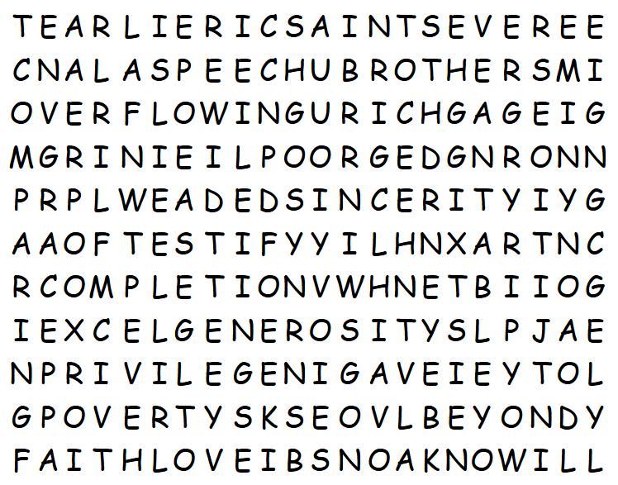

Family Activities
What is a “XART”? Oh … it’s not in the list of words. You better get going, the Word Search Lady is not a generous person. But, like she says, you can get help at https://tinyurl.com/2rvbr6m3

Slide 22
Generosity
8/24/2025

