Slide 1
Full Contentment
April 7

Slide 2
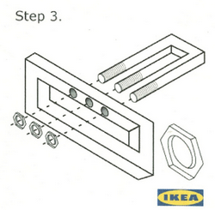
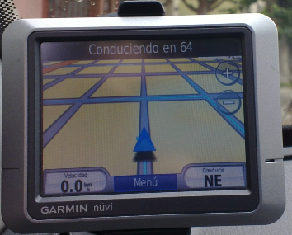
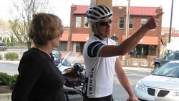
Admit it, now …
When has not following directions gotten you in trouble?
There’s just something about following directions that keeps you out of trouble.
Today we consider how obedience to God’s directions is the key to a full life.

Slide 3
Listen for the Preacher’s metaphor.
Ecclesiastes 11:7-8 (NIV) Light is sweet, and it pleases the eyes to see the sun. 8 However many years a man may live, let him enjoy them all. But let him remember the days of darkness, for they will be many. Everything to come is meaningless.

Slide 4
Light vs. Darkness
What metaphor did the Preacher use in verse 7 and what was he contrasting it with?
What was the cause for rejoicing in verse 8, but what should the person also remember and why?
Why is it easier to enjoy life when we are young than when we become old?

Slide 5
Light vs. Darkness
How does the reality of aging affect you?
How should we live our life in light of the reality of death?

Slide 6
Listen for a warning.
Ecclesiastes 11:9-10 (NIV) Be happy, young man, while you are young, and let your heart give you joy in the days of your youth. Follow the ways of your heart and whatever your eyes see, but know that for all these things God will bring you to judgment. 10 So then, banish anxiety from your heart and cast off the troubles of your body, for youth and vigor are meaningless.

Slide 7
Enjoy Life – But Beware
How did the Preacher encourage the young man to live?
⇨ This applies specifically to those who are in the “prime of life” physically, but since “youth” is a relative term, in general it can be anyone who is healthy and still able to do most of what they have always been able to do.

Slide 8
Enjoy Life – But Beware
What advice did he give to keep one’s youthful vitality in check against uncontrolled behavior?
In what sense are youth and vigor meaningless?
How should we respond to the seemingly meaningless aspects of life? How can we find meaning?

Slide 9
Enjoy Life – But Beware
How should future accountability impact our daily choices? How do we balance God’s command to enjoy life with His reminder of the coming judgment?

Slide 10
Contentment
View Video

Slide 11
Listen for Solomon’s ultimate conclusion.
Ecclesiastes 12:12-14 (NIV) Be warned, my son, of anything in addition to them. Of making many books there is no end, and much study wearies the body. 13 Now all has been heard; here is the conclusion of the matter

Slide 12
Listen for Solomon’s ultimate conclusion.
Fear God and keep his commandments, for this is the whole [duty] of man. 14 For God will bring every deed into judgment, including every hidden thing, whether it is good or evil.

Slide 13
Reverent Obedience
Verse 12 is often jokingly quoted by harried college students. But what caution would the Preacher actually express to us, especially in the view of the availability of information on the Internet?
After a long search for the meaning of life, what conclusion did the Preacher come to?

Slide 14
Reverent Obedience
What does it mean to fear God? How would you explain the concept to someone who’s never heard it?
Why does the word obedience carry a negative connotation?
How have you seen loving and obeying God lead to genuine contentment?

Slide 15
Trust and Obey
When we walk with the Lord
In the light of His Word,
What a glory He sheds on our way;
While we do His good will,
He abides with us still,
And with all who will trust and obey

Slide 16
Trust and Obey
Chorus:
Trust and Obey
For there’s no other way,
To be happy in Jesus,
But to Trust and Obey

Slide 17
Trust and Obey
Not a burden we bear,
Not a sorrow we share,
But our toil He doth richly repay;
Not a grief or a loss,
Not a frown or a cross,
But is blest if we trust and obey

Slide 18
Trust and Obey
Chorus:
Trust and Obey
For there’s no other way,
To be happy in Jesus,
But to Trust and Obey

Slide 19
Trust and Obey
But we never can prove
The delights of His love,
Until all on the altar we lay;
For the favor He shows,
And the joy He bestows,
Are for them who will trust and obey

Slide 20
Trust and Obey
Chorus:
Trust and Obey
For there’s no other way,
To be happy in Jesus,
But to Trust and Obey

Slide 21
Application
Pray.
Express your fear of the Lord through prayer.
Worship Him, surrender to Him, and acknowledge His lordship.

Slide 22
Application
Obey.
If joy is absent or if life often feels meaningless, consider areas where you’re lacking in obedience to God.
Identify those areas of disobedience, repent, and resolve to trust Christ through your obedience.

Slide 23
Application
Meet
Invite others to meet with you over coffee to talk about the meaning of life. Use this study as a springboard for your conversation.
Consider walking with them through this same study to help them discover a life of meaning in Christ

Slide 24
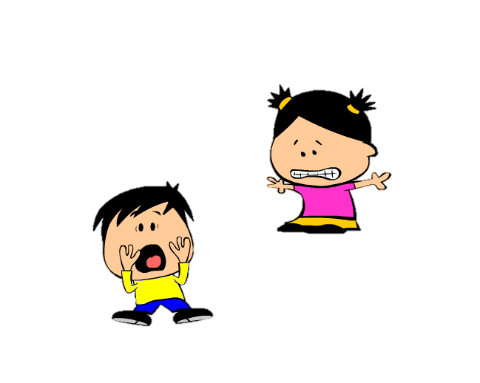
Family Activities
Eeeeeeeee ... It’s the “Word Search” lady. Quick … look up the other Family Activities at http://tinyurl.com/yy6foyfj
Humph!

Slide 25
Full Contentment
April 7

