Slide 1

Qualities of Disciple Makers

Slide 2


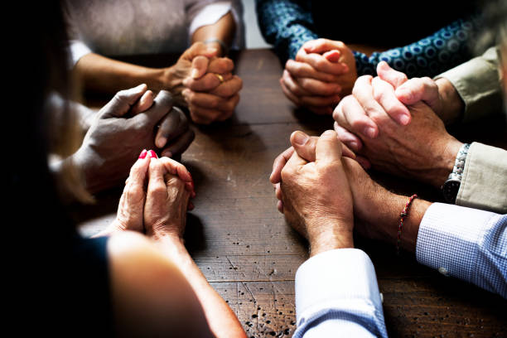
Remember ?
What are some different ways you have served in church ministry over the years?
Think about why you did that ministry …
Be encouraged today to continue to grow in your walk with Christ
Be challenged, motivated to be in service of others

Slide 3
1. The Starting Point Of Disciple Making Is Our Relationship With God And His Word.

Slide 4
Listen for what compelled Paul.
2 Corinthians 5:14-17 (NIV) For Christ's love compels us, because we are convinced that one died for all, and therefore all died. 15 And he died for all, that those who live should no longer live for themselves but for him who died for them and

Slide 5
Listen for what compelled Paul.
was raised again. 16 So from now on we regard no one from a worldly point of view. Though we once regarded Christ in this way, we do so no longer. 17 Therefore, if anyone is in Christ, he is a new creation; the old has gone, the new has come!

Slide 6
Your Relationship with God and His Word
According to Paul, what motivated the way he lived life, his attitude toward Christ, and the way he viewed others?
For Christ's love compels us, because we are convinced that one died for all, and therefore all died. And he died for all, that those who live should no longer live for themselves

Slide 7
Your Relationship with God and His Word
How is it possible for us to be motivated both by the fear (awe, reverence) of the Lord and Christ’s love?
How can we gain the same attitude and motivation that Paul had? Remember that it was Christ’s love that was the main motivation.
How does love motivate us to be involved in sharing the Good News of salvation?

Slide 8
Your Relationship with God and His Word
Why did Christ die for everyone?
What elements of the gospel message are found in these verses?
And he died for all, that those who live should no longer live for themselves but for him who died for them and was raised again. So from now on we regard no one from a worldly point of view. Though we once regarded Christ in this way, we do so no longer. Therefore, if anyone is in Christ, he is a new creation; the old has gone, the new has come!

Slide 9
Elements of 15 Second Testimony
Your life before Christ
Two words to describe struggles, emptiness, brokenness
Meeting Christ
Then I met Jesus, He forgave me
Your life after Christ
Now I am …
Invitation to dialogue
“Do you have a story like that?”

Slide 10
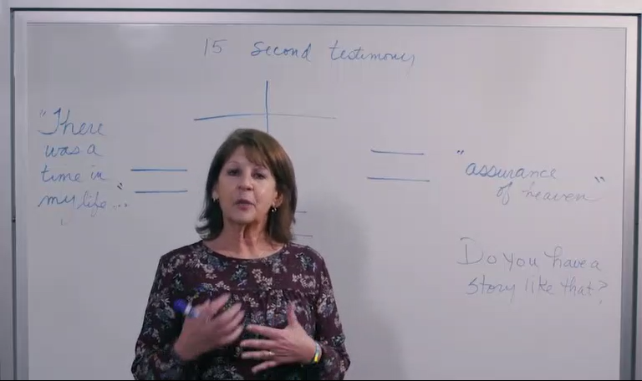
Sharing a 15 Second Testimony

Slide 11
15 Second Testimony
For some of you, what could you say? “There was a time in my life when __________”
What was the turning point, how did you encounter Christ
What can you say, that reflects the change Jesus made in your life? “Now I am _________”

Slide 12
2. The Work Of Disciple Making Is Our Investment In The Lives Of Others.

Slide 13
Listen for Jesus’ prayer request.
Luke 10:1-2 (NIV) After this the Lord appointed seventy-two others and sent them two by two ahead of him to every town and place where he was about to go. 2 He told them, "The harvest is plentiful, but the workers are few. Ask the Lord of the harvest, therefore, to send out workers into his harvest field.

Slide 14
Investment in the Lives of Others
Why do you think Jesus chose and sent out seventy-two others, rather than doing all the ministry Himself?
What does this tell us about the role of leadership in multiplying ministry?

Slide 15
Investment in the Lives of Others
Leader

Slide 16
Investment in the Lives of Others
Leader
Disciple
Disciple

Slide 17
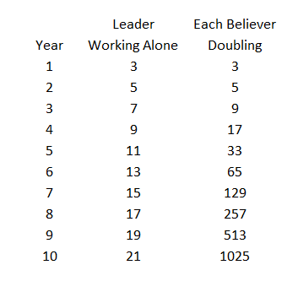
Investment in the Lives of Others
Note the difference between a leader evangelizing 2 people each year and each new believer learning to evangelize and train their new believer to evangelize

Slide 18
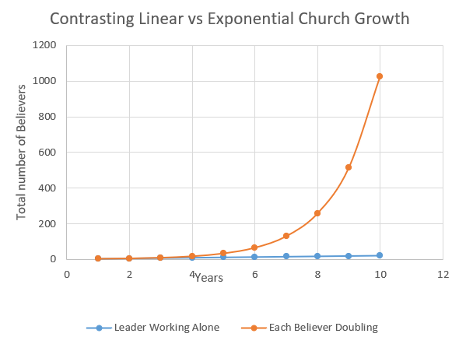
Investment in the Lives of Others
Note the difference between a leader evangelizing 2 people each year and each new believer learning to evangelize and train their new believer to evangelize

Slide 19
Investment in the Lives of Others
This example is idealistic
100% increase each year
Current worldwide increase of Christian believers is ≈ 1.18%
Higher in Africa ≈ 2.76%
Next is Asia ≈ 1.62%
But … North America ≈ 0.29%

Slide 20
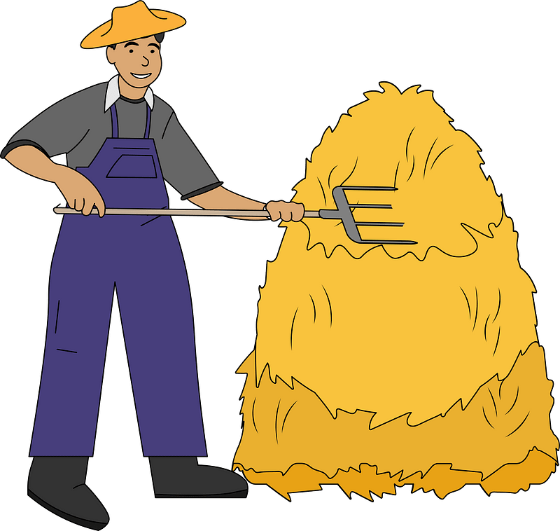
Investment in the Lives of Others
What do these numbers tell us what Jesus meant when He said, “The harvest is plentiful, but the laborers are few”?

Slide 21
3. The Discipline Of Disciple Making Is A Lifelong Commitment To Growth.

Slide 22
Listen for what Jesus made a priority.
Mark 1:35-39 (NIV) Very early in the morning, while it was still dark, Jesus got up, left the house and went off to a solitary place, where he prayed. [36] Simon and his companions went to look for him, [37] and when they found him, they exclaimed:

Slide 23
Listen for what Jesus made a priority.
"Everyone is looking for you!" [38] Jesus replied, "Let us go somewhere else--to the nearby villages--so I can preach there also. That is why I have come." [39] So he traveled throughout Galilee, preaching in their synagogues and driving out demons.

Slide 24
Lifelong Commitment to Growth
What did Jesus do? When?
What did Simon and his companions do when Jesus went to pray alone?

Slide 25
Lifelong Commitment to Growth
What attitude did Jesus have toward the people who demanded his time? Why?
Everyone is looking for you!" Jesus replied, "Let us go somewhere else--to the nearby villages--so I can preach there also. That is why I have come." So he traveled throughout Galilee, preaching in their synagogues and driving out demons.

Slide 26
Lifelong Commitment to Growth
In light of this passage, how do you think Jesus knew His life purpose so clearly?
How should we follow Christ’s example of praying?
How can you order the parts of your life to reflect the priorities Jesus had?
Very early in the morning, while it was still dark, Jesus got up, left the house and went off to a solitary place, where he prayed.

Slide 27

Application
Begin with prayer.
When you wake up in the morning, instead of picking up your cell phone,
Get on your knees and ask God to work through you.

Slide 28
Application
Learn to share.
Learn how to communicate the gospel to others.
At its simplest, witnessing is telling what Jesus has done for you.
If you want to learn some tools that would help you, talk to your pastor or church leadership.
Work on the 15 second testimony

Slide 29
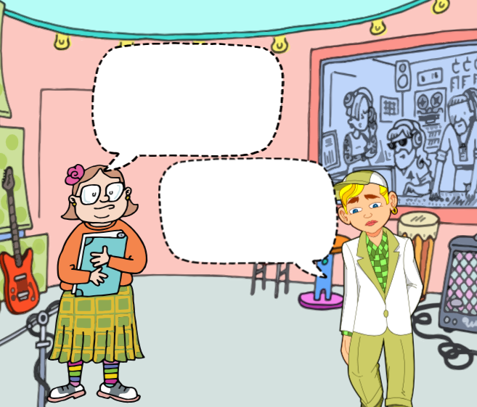
Application
Share.
Ask God to grant you one opportunity this week to be a blessing to others and share the gospel with them in both words and actions.
Write in the speech bubbles how the conversation might start

Slide 30
Qualities of Disciple Makers

