Slide 1

Obedience – The Heart of Discipleship

Slide 2


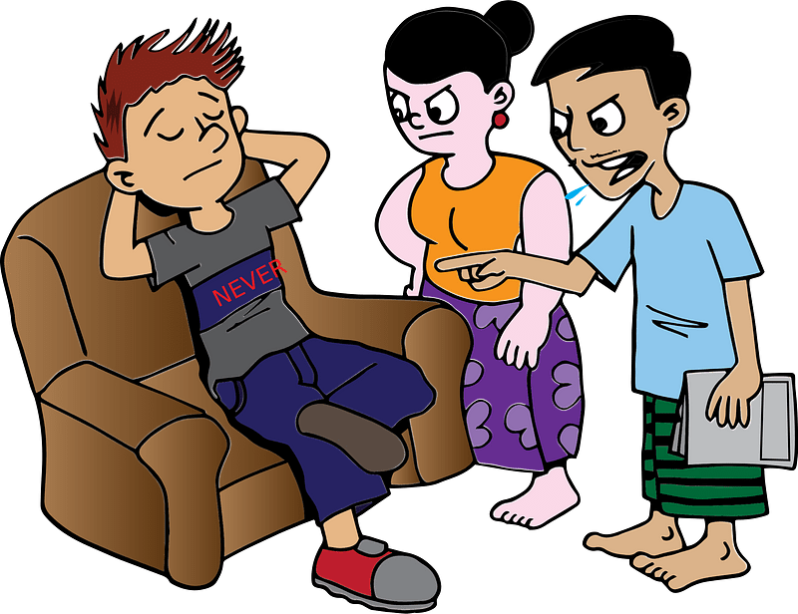

Think about it …
When was a time you had to obey a rule you didn’t understand at home, at work or at school. What did you learn was the wisdom of that standard?
Be home by 11:30 !!
SLIDE
RULES

Slide 3
Think about it …
When was a time you had to obey a rule you didn’t understand at home, at work or at school. What did you learn was the wisdom of that standard?
Today we look at obedience to God’s rules and the wisdom of His commands
Loving one another
Discipling others to love one another

Slide 4
1. Obedience to Jesus Is the Ongoing Heart of Discipleship.

Slide 5
Listen for an “if-then” conditional statement.
John 14:15-17 (NIV) "If you love me, you will obey what I command. 16 And I will ask the Father, and he will give you another Counselor to be with you forever-- 17 the Spirit of truth. The world cannot accept him, because it neither sees him nor knows him. But you know him, for he lives with you and will be in you.

Slide 6
Ongoing Heart of Discipleship
Last week we looked at the two most important commandments:
Love the Lord with all your mind, heart, strength.
Love your neighbor as yourself.
Why do you think Jesus commands us to do both?

Slide 7
Ongoing Heart of Discipleship
How does loving God with all your heart, soul, and mind (Matthew 22:37) naturally lead to obedience?
Note the things that Jesus did that the Holy Spirit also does:
Teach about God
Communicate Truth
Bring healing
Confront sin

Slide 8
Ongoing Heart of Discipleship
How does the Holy Spirit help you obey God’s commands?
How can you seek to rely on the Holy Spirit daily as you follow Jesus?
He will be different from Jesus in that the Spirit is able to live within the lives of believers everywhere at the same time …
Jesus as a human was confined in time and space
Teach about God
Communicate Truth
Bring healing
Confront sin`

Slide 9
Ongoing Heart of Discipleship
What are some different words used by some of your translations for “Counselor”
The Holy Spirit is along side (actually within) us
He helps us fulfill all that Jesus wants us to become and do
And I will ask the Father, and he will give you another Counselor to be with you forever

Slide 10
2. Obedience to Jesus Is Rooted in Love for God and Others.

Slide 11
Listen for more “if-then” statements.
1 Corinthians 13:1-3 (NIV) If I speak in the tongues of men and of angels, but have not love, I am only a resounding gong or a clanging cymbal. 2 If I have the gift of prophecy and can fathom all mysteries and all

Slide 12
Listen for more “if-then” statements.
knowledge, and if I have a faith that can move mountains, but have not love, I am nothing. 3 If I give all I possess to the poor and surrender my body to the flames, but have not love, I gain nothing.

Slide 13
Love for God and Others
What hypothetical experiences or situations did Paul identify that could be an occasion for boasting about one’s spiritual gifts?
What results when I do these things with the wrong motive?
What kinds of wrong motives might we have?
Why might it be easy to use a spiritual gift without love?
If I speak in the tongues of men and of angels, but have not love, I am only a resounding gong or a clanging cymbal. If I have the gift of prophecy and can fathom all mysteries and all knowledge, and if I have a faith that can move mountains, but have not love, I am nothing. If I give all I possess to the poor and surrender my body to the flames, but have not love, I gain nothing.

Slide 14
Love for God and Others
The kind of love Paul is writing about here is that same love God has for us, agape love.
Determined good will that has its object’s best interests at heart
Self-giving (instead of self-serving)
Expects nothing in return
Goes on offering itself, even when rejected
Acts on others’ behalf without considering their worthiness

Slide 15
3. True Discipleship Requires Transparent Modeling of Love and Obedience.

Slide 16
Listen for when not to offend unnecessarily.
1 Corinthians 10:25-30 (NIV) Eat anything sold in the meat market without raising questions of conscience, 26 for, "The earth is the Lord's, and everything in it." 27 If some unbeliever invites you to a meal and you want to go, eat whatever is put before you without raising questions of conscience. 28 But if anyone says to you, "This has

Slide 17
Listen for when not to offend unnecessarily.
been offered in sacrifice," then do not eat it, both for the sake of the man who told you and for conscience' sake-- 29 the other man's conscience, I mean, not yours. For why should my freedom be judged by another's conscience? 30 If I take part in the meal with thankfulness, why am I denounced because of something I thank God for?

Slide 18
Modeling Love and Obedience
Paul talks about the problem of whether or not to eat food offered to idols. What things in our culture are similarly debatable ?
Why would being considerate of others (loving your neighbor) be more important than knowing and claiming you are theologically correct in the actions you choose?

Slide 19
Modeling Love and Obedience
How could weaker believers be hurt by seeing more mature Christians do something the weaker believers considered wrong?
How should we demonstrate loving our neighbor by limiting our freedom out of sensitivity to weaker Christians?

Slide 20
Application
Consider.
Think about genuine vs. counterfeit love.
Write down ways you may have been influenced by definitions of love that aren’t true.
Choose to focus on the character of love as described in 1 Corinthians 13:4-7.

Slide 21
Application
Connect.
Whom do you know that exhibits and expresses the genuine love of God?
It could be a family member, someone in your church, or someone in your Bible study group.
Take five minutes this week to share with that person how you see God’s love in his or her life and express appreciation for their example.

Slide 22
Application
Care.
You know someone who needs to know of God’s love.
Ask God to show you ways to live out the love described in 1 Corinthians 13 before that person.
Invest time in the individual and love them like Christ does.

Slide 23

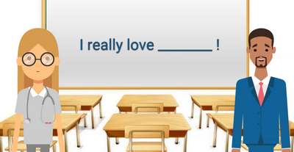
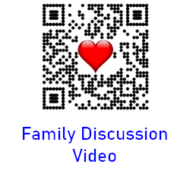
Check Out Family Discussion Video
Use the QR code on your handout

Slide 24
Obedience – The Heart of Discipleship

