Slide 1
From Problem to Praise
November 30

Slide 2

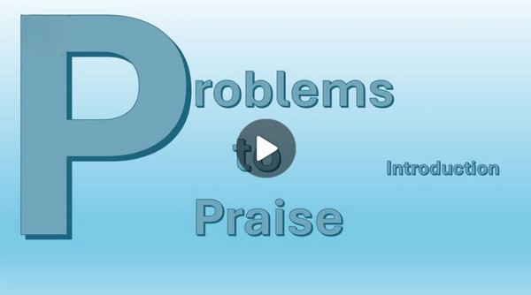
Video Introduction
View Video

Slide 3
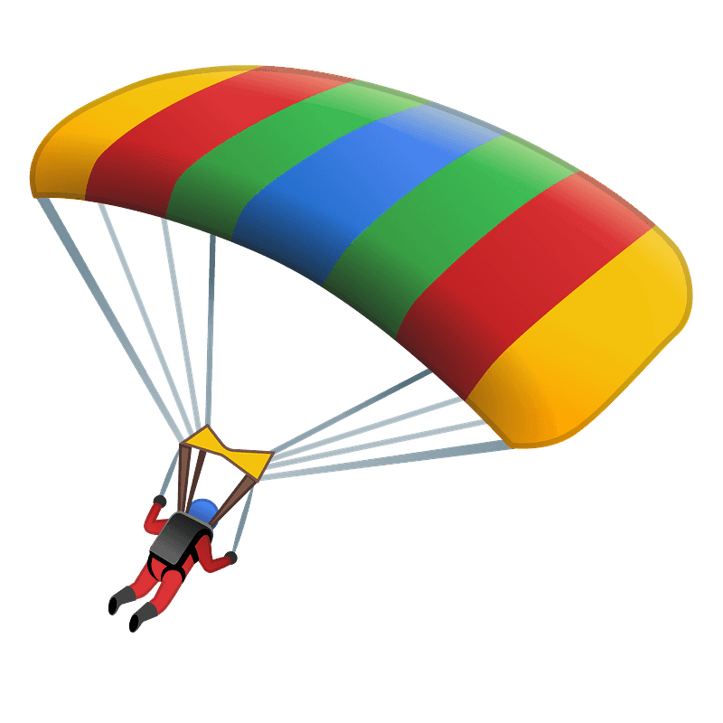

What if …
If you only had a few years to live, what would be on your bucket list to do?
Today we look at Hezekiah facing an imminent death.
  He took His problem to God
  God brought him from a problem to a time of praise.

Slide 4
Listen for tragedy diverted.
Isaiah 38:9-14 (NIV) A writing of Hezekiah king of Judah after his illness and recovery: 10 I said, "In the prime of my life must I go through the gates of death and be robbed of the rest of my years?" 11 I said, "I will not again see the LORD, the LORD, in the land of the

Slide 5
Listen for tragedy diverted.
living; no longer will I look on mankind, or be with those who now dwell in this world. 12 Like a shepherd's tent my house has been pulled down and taken from me. Like a weaver I have rolled up my life, and he has cut me off from the loom; day and night you made an

Slide 6

Listen for tragedy diverted.
end of me. 13 I waited patiently till dawn, but like a lion he broke all my bones; day and night you made an end of me. 14 I cried like a swift or thrush, I moaned like a mourning dove. My eyes grew weak as I looked to the heavens. I am troubled; O Lord, come to my aid!”

Slide 7
When Despondent, Look to God
What prompted Hezekiah’s cry for God’s aid?
From what time perspective is Hezekiah writing: past, present, future?
What are some of the images Hezekiah used to describe his view of death and dying?
Why do you think Hezekiah chose to write this reflection after his recovery?

Slide 8
When Despondent, Look to God
Why do challenges in life cause some people to question God rather than seek Him? How do these reflect the way we often feel in moments of deep distress?
What’s a situation in your life when you’ve come close to being able to relate to Hezekiah?

Slide 9
Listen for Hezekiah’s praise.
Isaiah 38:15-17 (NIV) But what can I say? He has spoken to me, and he himself has done this. I will walk humbly all my years because of this anguish of my soul. 16 Lord, by such things men live; and my spirit finds

Slide 10
Listen for Hezekiah’s praise.
in them too. You restored me to health and let me live. 17 Surely it was for my benefit that I suffered such anguish. In your love you kept me from the pit of destruction; you have put all my sins behind your back.

Slide 11
Acknowledge God’s Response of Love
How did Hezekiah acknowledge God as the source of his healing?
How did Hezekiah view his physical and mental suffering after he was delivered?
What are some of the lessons Hezekiah seemed to have learned from his experience of facing death?

Slide 12
Acknowledge God’s Response of Love
How can answered prayer change your perspective toward life?
How does God use our prayer life to get us to where He wants us to be?

Slide 13
Listen for a contrast.
Isaiah 38:18-20 (NIV) For the grave cannot praise you, death cannot sing your praise; those who go down to the pit cannot hope for your faithfulness. 19 The living, the living--

Slide 14
Listen for a contrast.
they praise you, as I am doing today; fathers tell their children about your faithfulness. 20 The LORD will save me, and we will sing with stringed instruments all the days of our lives in the temple of the LORD.

Slide 15
Urge Others to Join in Praise
What contrast did Hezekiah offer to emphasize when praise is to be given to the Lord?
Death | Life

Slide 16
Urge Others to Join in Praise
What parental responsibility did Hezekiah define?
Why do you think it’s sometimes easier to cry out in desperation than to follow up with thanksgiving?
What habits can help us remember to thank God after He answers?

Slide 17
Urge Others to Join in Praise
How can we make thanksgiving a more visible part of our lives?
How might our view of God change if we consistently responded to answered prayer with the kind of gratitude Hezekiah shows?

Slide 18
Application
Pray alone.
  Wherever you are in the discipline of prayer, take things up a notch.
  Set aside time every day for uninterrupted conversation with God.
  Present your desires and requests to Him and watch for His response.

Slide 19
Application
Pray together.
  Invite others to pray for you and with you.
  Most of the instructions in the New Testament are not only for the individual believer but for the entire faith community.
  Prayer is a team sport; choose your teammates wisely.

Slide 20
Application
Proclaim.
When God responds to your prayers, share it with other people, especially unbelievers.
This will encourage believers to pray and unbelievers to consider the work of God in their own lives

Slide 21
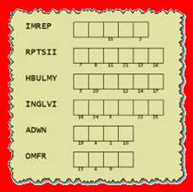
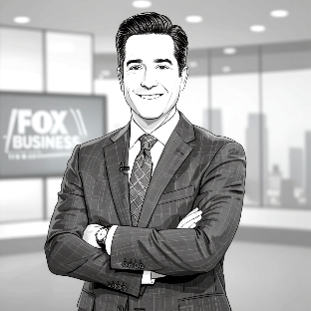
Family Activities
We’ve got breaking news out of Itan Ladesh — and it’s not your typical headline. You see the scrambled word key here. Fix the words, use the numbers to decrypt the message from the underground church printed on your handout. Tech help and more is available at
https://tinyurl.com/2usab27c

Slide 22
From Problem to Praise
November 30

