Slide 1
Forgive
May 10

Slide 2
Video Lesson Introduction
View Video

Slide 3
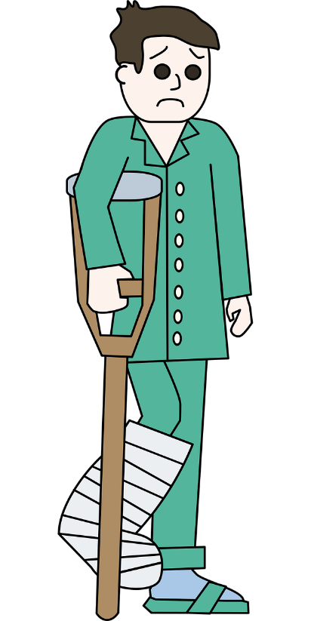
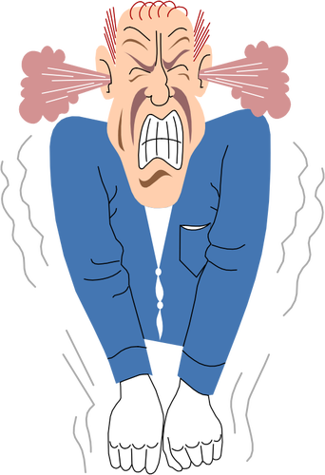
Admit it, now …
I just don’t FEEL like forgiving !
What makes forgiveness difficult?
Forgiveness restores and strengthens relationships.
Peter wanted to know more about forgiveness
Today we look at Jesus’ answer and His further teaching on the subject
Oh, she done me wrong …

Slide 4
Listen for Peter’s question.
Matthew 18:21-22 (NIV) Then Peter came to Jesus and asked, "Lord, how many times shall I forgive my brother when he sins against me? Up to seven times?" 22 Jesus answered, "I tell you, not seven times, but seventy-seven times.

Slide 5
Keep On Forgiving
What question did Peter ask Jesus? What appears to be the attitude behind his question?
What does the question imply that can occur even in the best of relationships?
What surprising answer did Jesus give Peter?
Whichever number Jesus used, why do you think he was not intending an exact number?

Slide 6
Keep On Forgiving
Why do many people want to know the limits of forgiveness?
How does Jesus’ reply challenge Peter’s apparent attitude toward forgiveness?
What are some different opinions on how dependent your forgiveness is on the other person’s apology?

Slide 7
Keep On Forgiving
What might be wrong with going to someone and saying “I forgive you for offending me”?
So how do you handle an offense by the other person that they don’t even realize?

Slide 8
Keep On Forgiving
Note there are some things that unlimited forgiveness does not mean …
We don’t bless wrongdoing
We don’t allow cruel people to hurt others without end
Neither should someone feel forced to endure an abusive relationship

Slide 9
Listen for how much was forgiven.
Matthew 18:23-27 (NIV) "Therefore, the kingdom of heaven is like a king who wanted to settle accounts with his servants. 24 As he began the settlement, a man who owed him ten thousand talents was brought to him. 25 Since he was not able to pay, the master ordered that he and his

Slide 10
Listen for how much was forgiven.
wife and his children and all that he had be sold to repay the debt. 26 "The servant fell on his knees before him. 'Be patient with me,' he begged, 'and I will pay back everything.' 27 The servant's master took pity on him, canceled the debt and let him go.

Slide 11
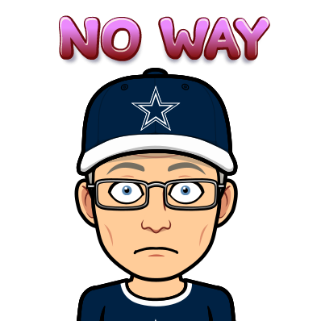
Remember God Forgave You
Note how large is the indebtedness described in this parable.
One talent = 6000 denarii
10,000 talents = 60,000,000 denarii
Daily wage = 1 denarii
Money owed = 60 million days of work

Slide 12
Remember God Forgave You
How was the king prepared to get the large amount of money owed him by a particular servant?
What did the indebted servant do?
Why is this request for mercy so unreasonable?
How did the king graciously respond to the indebted servant’s desperate plea?

Slide 13
Remember God Forgave You
Jesus is speaking to an issue that is more than our interpersonal squabbles. What is the implication for us of the huge amount owed by the king’s slave?
Jesus began this parable stating “The Kingdom of Heaven is like …” What is the significance of this parable being a parable of the kingdom?
How does this illustrate God’s attitude towards our sin debt?

Slide 14
Listen for lack of forgiveness.
Matthew 18:28; 32 – 35 (NIV) "But when that servant went out, he found one of his fellow servants who owed him a hundred denarii. He grabbed him and began to choke him. 'Pay back what you owe me!' he demanded. … 32 "Then the master called the servant in. 'You wicked servant,' he said, 'I canceled all that debt of yours

Slide 15
Listen for lack of forgiveness.
because you begged me to. 33 Shouldn't you have had mercy on your fellow servant just as I had on you?' 34 In anger his master turned him over to the jailers to be tortured, until he should pay back all he owed. 35 "This is how my heavenly Father will treat each of you unless you forgive your brother from your heart."

Slide 16
Forgive Because God Forgave You
What surprising actions does the recently forgiven servant do?
What parallels exist in this second scene?
How did the behavior by the servant contrast with his experience with the king?

Slide 17
Forgive Because God Forgave You
What point does Jesus make with the parable? How did Jesus apply this parable to us as believers today?
If we have been forgiven so much, why are we often unwilling to forgive?
Why is forgiving others actually an act of worship?

Slide 18
Application
Evaluate.
Consider your current relationships.
Spend time identifying areas of unforgiveness in your heart.

Slide 19
Application
Take a small step.
Make an effort to extend forgiveness in a relationship where you’ve been wronged or slighted.
Take the first step even if you’ve done nothing wrong.

Slide 20
Application
Take a large step.
Identify a relationship in which you need to be forgiven—one where you’ve contributed to bad feelings, or even where you’re completely in the wrong.
With humility, make an effort to bridge the gap.

Slide 21
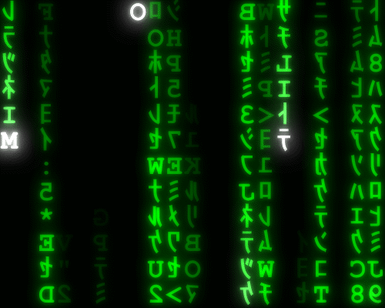
Family Activities
It’s happened again … letters falling off the signs. Please forgive the mess. The author of the quote will forgive us if we can fix the quote. Help and more forgiving activities can be found at https://tinyurl.com/yaob45of

Slide 22
Forgive
May 10

