Slide 1
Forgive Your Neighbor
August 21

Slide 2
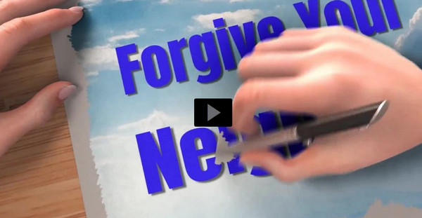
Video Introduction
View Video

Slide 3
Admit it now …
What makes forgiveness difficult?
Forgiveness restores and strengthens relationships.
Peter wanted to know more about forgiveness
Today we look at Jesus’ answer and His further teaching on the subject

Slide 4
Listen for a limit.
Matthew 18:21-22 (NIV) Then Peter came to Jesus and asked, "Lord, how many times shall I forgive my brother when he sins against me? Up to seven times?" 22 Jesus answered, "I tell you, not seven times, but seventy-seven times.

Slide 5
Love Keeps Forgiving
What appears to be the attitude behind Peter’s question about forgiveness?
Why do many people want to know the limits of forgiveness?
How does Jesus’s reply challenge Peter’s (or our) attitude toward forgiveness?
What does the question imply that can occur even in the best of relationships?

Slide 6
Love Keeps Forgiving
Whichever number Jesus used, why do you think he was not intending an exact number?
What makes it hard to forgive repeated offenses?

Slide 7
Love Keeps Forgiving
Note there are some things that unlimited forgiveness does not mean …
We don’t bless wrongdoing.
We don’t allow cruel people to hurt others without end.
Neither should someone feel forced to endure an abusive relationship.
We should forgive but might not continue to trust the offender.

Slide 8
Listen for a parable about forgiveness.
Matthew 18:23-27 (NIV) "Therefore, the kingdom of heaven is like a king who wanted to settle accounts with his servants. 24 As he began the settlement, a man who owed him ten thousand talents was brought to him. 25 Since he was not able to pay, the master ordered

Slide 9
Listen for a parable about forgiveness.
that he and his wife and his children and all that he had be sold to repay the debt. 26 "The servant fell on his knees before him. 'Be patient with me,' he begged, 'and I will pay back everything.' 27 The servant's master took pity on him, canceled the debt and let him go.

Slide 10
God Extends Forgiveness to Us
Look ahead to the next passage and note the contrast of how much was owed by each slave.
10,000 talents ⇨ more than 100,000 years of wages
100 denarii ⇨ three months of wages
Note that selling the whole family into slavery would not come close to paying off the debt
At the very least, it would punish the servant for acquiring such debt

Slide 11
God Extends Forgiveness to Us
Why is this request for mercy so unreasonable?
Jesus is speaking to an issue that is more than our interpersonal squabbles. What is the implication for us of the huge amount owed by the king’s slave?
Why do you think the master was willing to forgive such a huge debt?

Slide 12
God Extends Forgiveness to Us
How does this illustrate God’s attitude towards our sin debt?
How dependent should your forgiveness be on someone else’s apology?
What actually happens when you forgive someone?

Slide 13
God Extends Forgiveness to Us
Jesus began this parable stating “The Kingdom of Heaven is like …” What is the significance of this parable being a parable of “the Kingdom”?

Slide 14
Listen for a lack of forgiveness.
Matthew 18:28-35 (NIV) "But when that servant went out, he found one of his fellow servants who owed him a hundred denarii. He grabbed him and began to choke him. 'Pay back what you owe me!' he demanded. 29 "His fellow servant fell to his knees and begged him,

Slide 15
Listen for a lack of forgiveness.
'Be patient with me, and I will pay you back.' 30 "But he refused. Instead, he went off and had the man thrown into prison until he could pay the debt. 31 When the other servants saw what had happened, they were greatly distressed and went and told their master everything that had happened. 32 "Then the master called the servant in.

Slide 16
Listen for a lack of forgiveness.
'You wicked servant,' he said, 'I canceled all that debt of yours because you begged me to. 33 Shouldn't you have had mercy on your fellow servant just as I had on you?' 34 In anger his master turned him over to the jailers to be tortured,

Slide 17
Listen for a lack of forgiveness.
until he should pay back all he owed. 35 "This is how my heavenly Father will treat each of you unless you forgive your brother from your heart."

Slide 18
Forgiven by God, We Also Forgive
How was the behavior of the first servant so incongruent with his own experience before the king?
The glaring difference is that now the one owed the money is unwilling to forgive. Why do you think he took this attitude when he had just been forgiven so much?

Slide 19
Forgiven by God, We Also Forgive
If we have been forgiven so much, why are we often unwilling to forgive someone else?
How does forgiving someone release us from a type of “prison”?

Slide 20
Application
Seek God’s forgiveness.
Confess any and all sin to God and ask His forgiveness.
He has promised to forgive you. “If we confess our sins, he is faithful and righteous to forgive us our sins and to cleanse us from all unrighteousness” (1 John 1:9).

Slide 21
Application
Seek others’ forgiveness.
To love your neighbor means forgiving, but it also may call for asking for forgiveness.
If you have hurt or offended someone else, no matter how unintentionally, apologize.
Seek to restore that relationship by removing the offense.

Slide 22
Application
Offer forgiveness.
Regardless of who may have hurt you, forgive.
It may just be a matter of forgiving in your heart, but you may need to tell the person who hurt you that you forgive them.
Ask God for wisdom regarding the best way to approach the situation.

Slide 23
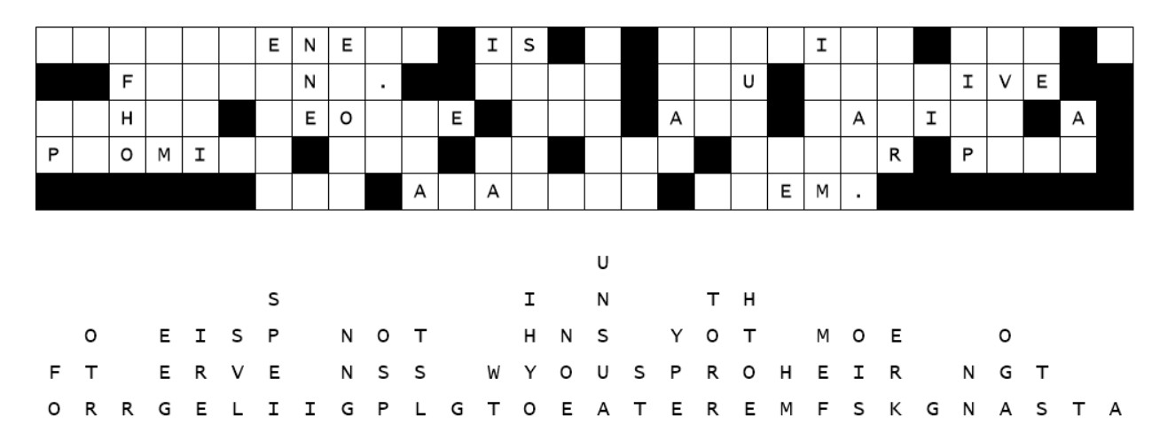
Family Activities
Aiee, Cucaracha! A bunch of letters fell straight down. Reconstruct the message to see something important about forgiveness. Help is available at https://tinyurl.com/3mzba6c2 And the Color Page is available for the folks in the back row.

Slide 24
Forgive Your Neighbor
August 21

