Slide 1
Filled by the Spirit
June 26

Slide 2
Video Introduction
View Video

Slide 3
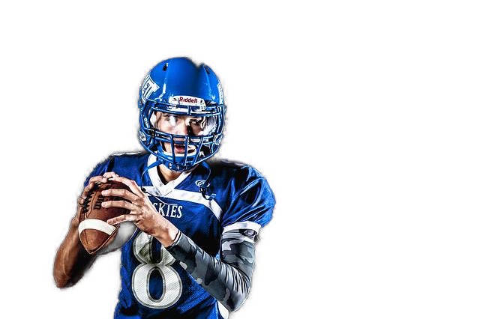
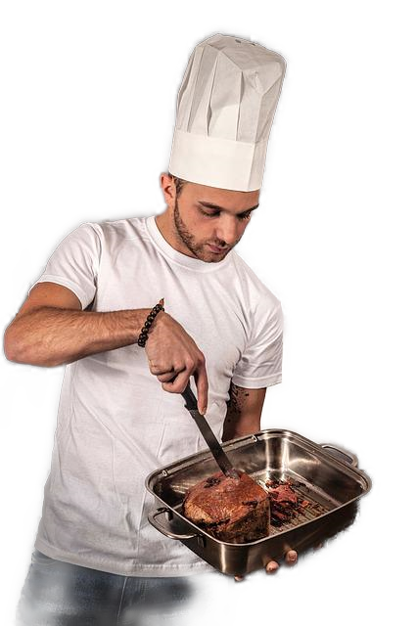
Be honest, now …
Whom (besides Jesus) would you most like to imitate in some area of life?
While we might wish to have special skills like people we know of …
The Holy Spirit enables us to live as fully devoted disciples of Jesus.

Slide 4
Listen for a contrast.
Ephesians 5:8-14 (NIV) For you were once darkness, but now you are light in the Lord. Live as children of light 9 (for the fruit of the light consists in all goodness, righteousness and truth) 10 and find out what pleases the Lord. 11 Have nothing to do with the fruitless deeds of darkness, but rather expose them.

Slide 5
Listen for a contrast.
For it is shameful even to mention what the disobedient do in secret. 13 But everything exposed by the light becomes visible, 14 for it is light that makes everything visible. This is why it is said: "Wake up, O sleeper, rise from the dead, and Christ will shine on you."

Slide 6
The Ways of the World
Paul used contrasting imagery to describe the change that had taken place in the lives of his readers.
Once darkness
Now light in the Lord

Slide 7
The Ways of the World
So, how does life in darkness contrast with life in the light?
Life in Darkness | Life in Light

Slide 8
The Ways of the World
How does the apostle describe light or its fruit in Ephesians 5:9? Define each term in your own words.
Verse 3 of this chapter talks of the fruits of darkness … sexual immorality, impurity, and greed. Why would it not be possible to have both these qualities and the fruit of light in in our lives at the same time?

Slide 9
The Ways of the World
Note Paul talks about the fruit of the Spirit, then things that are fruitless. That implies that they are …
The opposite of goodness, they are evil
They are unrighteous, not right, not just
They are based on Satan’s lies who tries to tell us they are OK

Slide 10
The Ways of the World
What is to be the relationship of the believer to works of darkness?
How can we avoid becoming desensitized to this darkness?
How can we expose fruitless works of darkness without saying a word?

Slide 11
Listen for how to walk wisely.
Ephesians 5:15-18 (NIV) Be very careful, then, how you live--not as unwise but as wise, 16 making the most of every opportunity, because the days are evil. 17 Therefore do not be foolish, but understand what the Lord's will is. 18 Do not get drunk on wine, which leads to debauchery. Instead, be filled with the Spirit.

Slide 12
Life Controlled by the Spirit
List the admonitions in these verses?
Paul talks about wine or alcohol … how does alcohol control a person?
What other kinds of things are people controlled by in our culture?

Slide 13
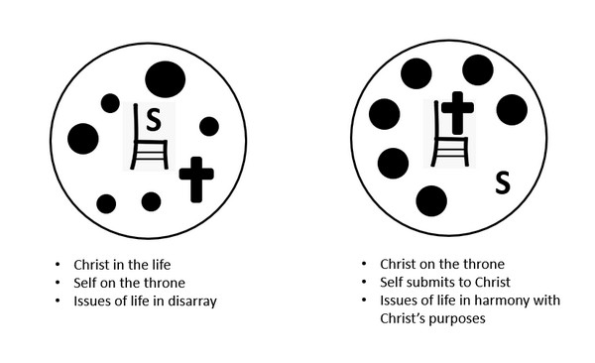
Life Controlled by the Spirit
When you are filled with or controlled by God’s Holy Spirit you will …
Surrender to God’s direction in your life
Obey to His guidance
Be aware of, follow God’s purposes
Depend on God’s empowering influence in your life

Slide 14
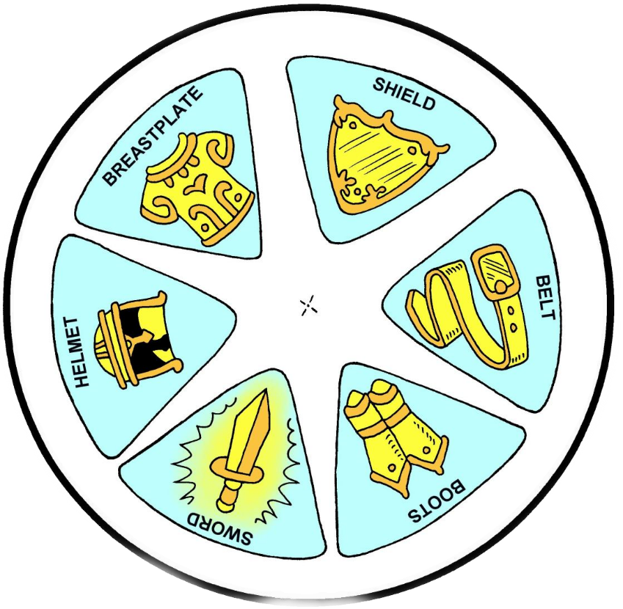
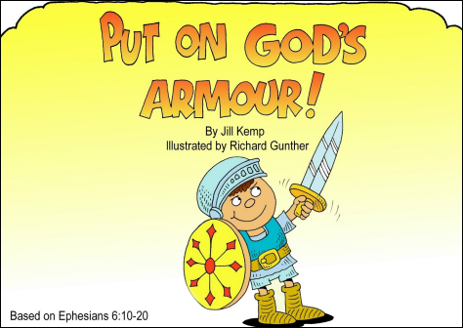
Life Controlled by the Spirit
What are some of the results of being filled with (controlled by) the Spirit?

Slide 15
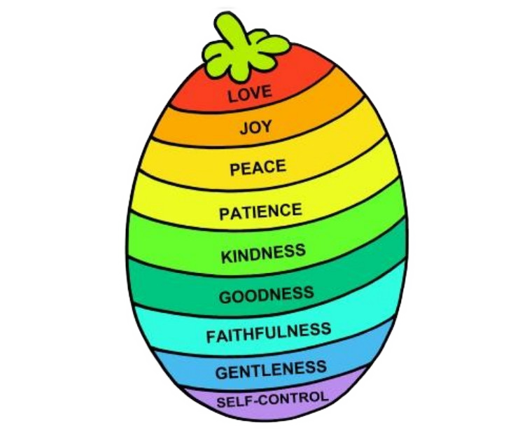
Life Controlled by the Spirit
What are some of the results of being filled with (controlled by) the Spirit?
Coming next week … The Fruit of the Spirit

Slide 16
Listen for impacts on worship.
Ephesians 5:19-21 (NIV) Speak to one another with psalms, hymns, and spiritual songs. Sing and make music in your heart to the Lord, 20 always giving thanks to God the Father for everything, in the name of our Lord Jesus Christ. 21 Submit to one another out of reverence for Christ.

Slide 17
Worship and Live Thankfully
How should Spirit-controlled believers relate to one another?
How is this different than how the world looks at life?

Slide 18
Worship and Live Thankfully
Consider the one act that characterizes living in the Spirit.
Always giving thanks
Whatever happens in our lives, be giving thanks to God for
Who He is … His power, His authority. His love
Remember that some people have power but no authority,
Others have authority, but no power
God has both … and He loves us dearly

Slide 19
Worship and Live Thankfully
How are our thankfulness in the midst of hardships and our attitude of submission a witness to unbelievers?

Slide 20
Application
Think.
Paul describes in practical terms how to live a life pleasing to God.
Ask the Holy Spirit to convict you of any behavior that is unpleasing to God.

Slide 21
Application
Decide.
Choose a behavior that has been brought to your attention by the Holy Spirit.
Make it a focus of your prayer time.
Ask the Holy Spirit to fill you with His presence regarding this issue.

Slide 22
Application
Act.
Speak with a trusted believer about this issue.
Give them permission to hold you accountable for this behavior.

Slide 23
Family Activities
First thought to be European hieroglyphics, this is a message passed to one of our people in Zerasantu. Spiros the Spy needs your help to decrypt this important note. Technical assistance and other intriguing activities are available at https://tinyurl.com/y6t5eeta

Slide 24
Filled by the Spirit
June 26

