Slide 1
Faithful in All Things
July 11

Slide 2
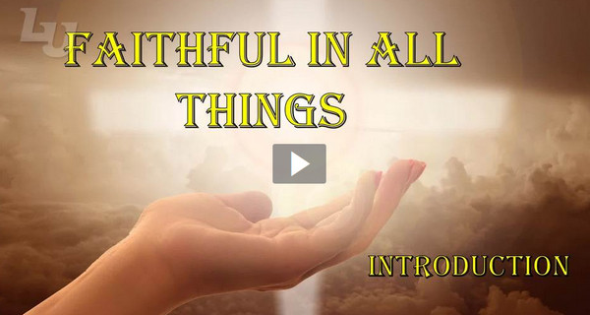
Video Introduction
View Video

Slide 3
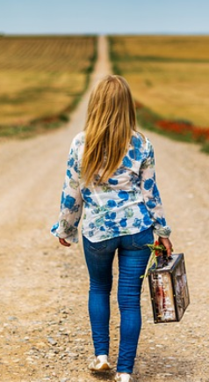
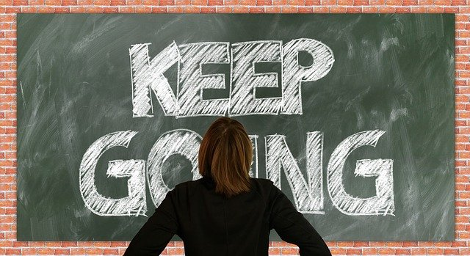
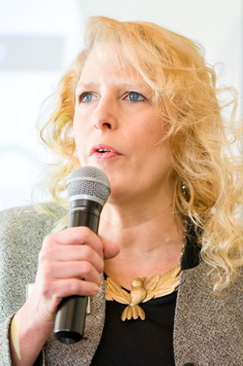
Remember that time …
When has a word of encouragement been especially timely?
Jesus speaks encouragement to the church at Philadelphia.
They had been faithful in their ministry
He encourages us also as we faithfully trust God and minister to others.

Slide 4
Listen for an offered opportunity.
Revelation 3:7-8 (NIV) "To the angel of the church in Philadelphia write: These are the words of him who is holy and true, who holds the key of David. What he opens no one can shut, and what he shuts no one can open.

Slide 5
Listen for an offered opportunity.
I know your deeds. See, I have placed before you an open door that no one can shut. I know that you have little strength, yet you have kept my word and have not denied my name.

Slide 6
The Door to the Kingdom Is Open
How does the Lord identify Himself to the church at Philadelphia?
How are these descriptive words significant to a church?
Words | Significance to a Church
Holy True Holds key of David

Slide 7
The Door to the Kingdom Is Open
What difference does it make to you that Christ is "holy and true"?
What commendation do you see here?
To what might the “open door” allude?
What kinds of opportunities might God be giving us … as individuals, as a group, as a church?

Slide 8
The Door to the Kingdom Is Open
What might be a particular demographic in our church’s neighborhood or community who are open to help?
Why do you think the weak become strong when they commit themselves to the Lord in faithful service?

Slide 9
Listen for the importance of endurance.
Revelation 3:9-10 (NIV) I will make those who are of the synagogue of Satan, who claim to be Jews though they are not, but are liars--I will make them come and fall down at your feet and acknowledge that I have loved you.

Slide 10
Listen for the importance of endurance.
Since you have kept my command to endure patiently, I will also keep you from the hour of trial that is going to come upon the whole world to test those who live on the earth.

Slide 11
God’s Dependable Protection
According to verse 9, who does it appear is guilty of persecuting the Christians in Philadelphia?
How will the Christians be vindicated?
Why can we rejoice even when we are persecuted by hostile anti-God forces?

Slide 12
God’s Dependable Protection
What promise was given to the Christians for obeying the challenge to exercise patient endurance?
What are some things we can do to obey Jesus’ command to endure?
How do you remain faithful to God during difficult times?

Slide 13
Listen for a promise.
Revelation 3:11-13 (NIV) I am coming soon. Hold on to what you have, so that no one will take your crown. 12 Him who overcomes I will make a pillar in the temple of my God. Never again will he leave it. I will write on him the name

Slide 14
Listen for a promise.
of my God and the name of the city of my God, the new Jerusalem, which is coming down out of heaven from my God; and I will also write on him my new name. 13 He who has an ear, let him hear what the Spirit says to the churches.

Slide 15
Hold On
What promise was given to the Christians for obeying the challenge to exercise patient endurance?
How can we help each other hold on to all that we have in Christ?

Slide 16
Hold On
What are some tools that God gives us to help us remain faithful?
How are you continuing to hold on to and nurture a persevering faith in God’s Word in your life?

Slide 17
Application
Endure.
Identify times or areas of your life when enduring in your faith have been hardest.
Pray for Christ’s power to stand strong. Let the reminder that He is coming soon to set you free from your difficulties serve as a motivation to stand with Him.

Slide 18
Application
Encourage.
As you see others standing and enduring in their faith, commend them for their faithfulness.
Encourage them to continue being a faithful witness.

Slide 19
Application
Invite.
Invite others to walk through “the open door” of salvation and enter into eternity with Christ.
Be faithful in your witness of Christ’s salvation.

Slide 20
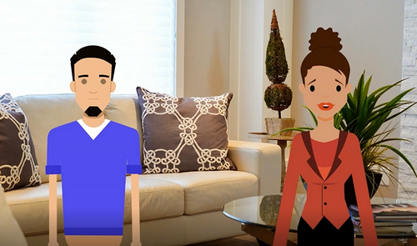
New Feature Family Discussion Time Video
You can view us at https://tinyurl.com/27vsrh32

Slide 21
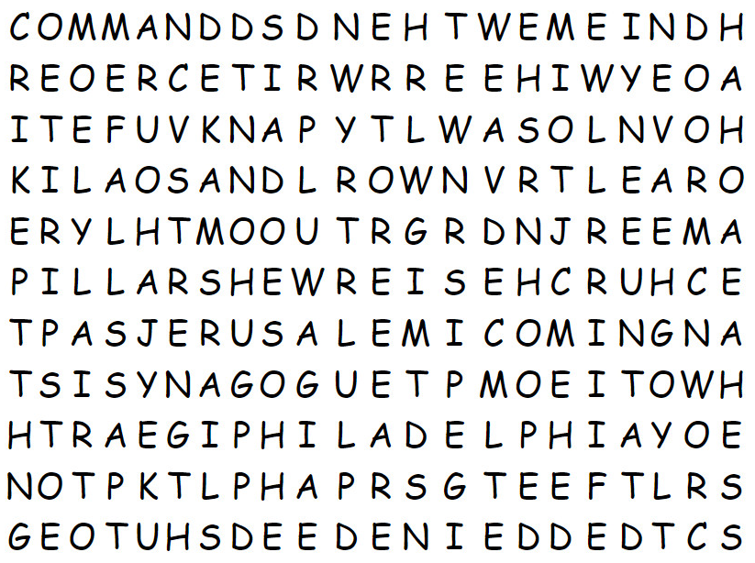
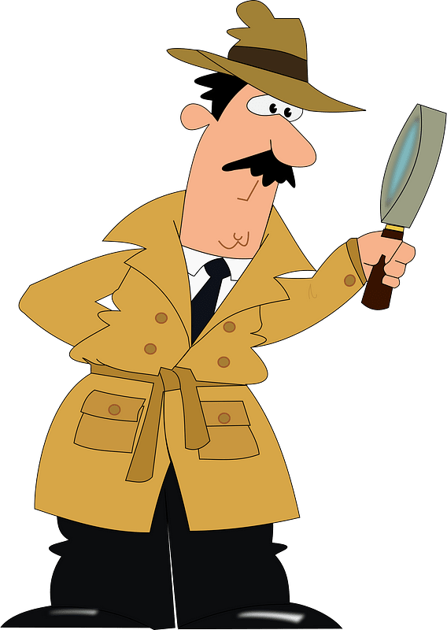
Family Activities
Hmm … seems there are words hidden in this grid. I believe they are words from your Bible passage. But they’re up, down, right, left, even diagonal. If you need help or would rather do the crossword, go to https://tinyurl.com/27vsrh32

Slide 22
Faithful in All Things
July 11

