Slide 1
Faith
March 29

Slide 2
Introduction Video
View Video

Slide 3
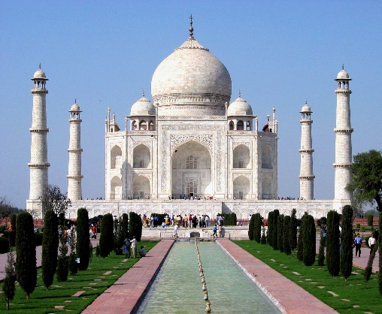
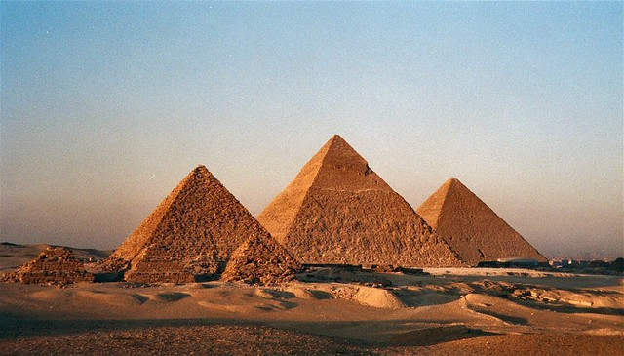
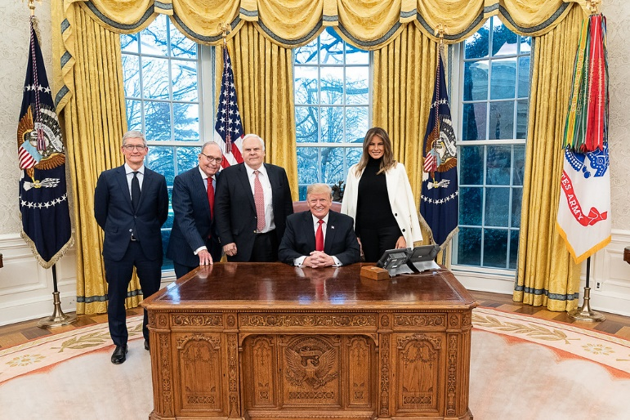
Think About It …
What are some things you’ve never seen but still believe exist?
Some things we have to believe and take on faith.
We are told by authorities they exist or we’ve seen pictures
At the same time, we struggle with the reality of some things we’ve been told or shown.
But … we can confidently trust in what God says and does.

Slide 4
Listen for a definition.
Hebrews 11:1-3 (NIV) Now faith is being sure of what we hope for and certain of what we do not see. 2 This is what the ancients were commended for. 3 By faith we understand that the universe was formed at God's command, so that what is seen was not made out of what was visible.

Slide 5
Faith Responds with Belief and Reliance
And a couple of other versions of verse 1:
(HCSB) Now faith is the reality (assurance) of what is hoped for, the proof (conviction) of what is not seen.
(AMP) Now faith is the assurance (title deed, confirmation) of things hoped for (divinely guaranteed), and the evidence of things not seen [the conviction of their reality—faith comprehends as fact what cannot be experienced by the physical senses].

Slide 6
Faith Responds with Belief and Reliance
Let’s list the key words in the writer’s explanation of faith.
Note the two descriptive phrases from other versions.
NIV | KJV | NLT
being sure of what we hope for certain of what we do not see | substance of things hoped for evidence of things not seen | confident assurance that what we hope for is going to happen evidence of things we cannot yet see

Slide 7
Faith Responds with Belief and Reliance
We see two basic elements:
The reality required for having hope
Evidence beyond what we see and feel
What does faith help us to comprehend about the creation of the world?
Why does believing God is Creator require faith on our part?

Slide 8
Faith Responds with Belief and Reliance
Agree or disagree?
Faith is merely a leap in the dark. If you know something, you don’t need faith. To accept something about which you know little or nothing you are acting blindly.
Agree | Disagree

Slide 9
Faith Responds with Belief and Reliance
What are some “invisible realities” faith helps us to see?
What do you think the writer of Hebrews meant when he described people as “approved” because of their faith?
⇨ This is still true today … we are approved by God by our faith, our personal acceptance of the redemptive work of Jesus when He died on the cross for our sins.

Slide 10
Listen for the first hero of faith.
Hebrews 11:4 (NIV) By faith Abel offered God a better sacrifice than Cain did. By faith he was commended as a righteous man, when God spoke well of his offerings. And by faith he still speaks, even though he is dead.

Slide 11
Faith Responds with Worship
How did Abel demonstrate faith?
How did God commend him?
How does our influence as people of faith live long past us and affect those who follow us?
What are some daily practices that strengthen your faith?

Slide 12
Listen for a unique experience.
Hebrews 11:5-6 (NIV) By faith Enoch was taken from this life, so that he did not experience death; he could not be found, because God had taken him away. For before he was taken, he was commended as one who pleased God. 6 And without faith it is impossible to please God, because anyone who comes to him must believe that he exists and that he rewards those who earnestly seek him.

Slide 13
Faith Responds with Obedience
What makes Enoch unusual in the annals of the biblical accounts?
What does he illustrate about faith?
What do you think it means to earnestly seek God?

Slide 14
Faith Responds with Obedience
The passage says God rewards those who earnestly seek Him. What “rewards” do we receive from the Lord?

Slide 15
Application
Thank God for faith.
Thank God for bringing you to faith in Christ.
Acknowledge your belief in Him and seek to please Him in how you live out your faith.

Slide 16
Application
Walk in faith.
Choose to walk in obedience to Christ.
Daily read God’s Word, and identify areas in which you need to walk in faith and obedience.

Slide 17
Application
Express your faith.
As you live in obedient faith, ask God for opportunities to tell someone else why you believe in Him and choose to live by faith in Christ.

Slide 18
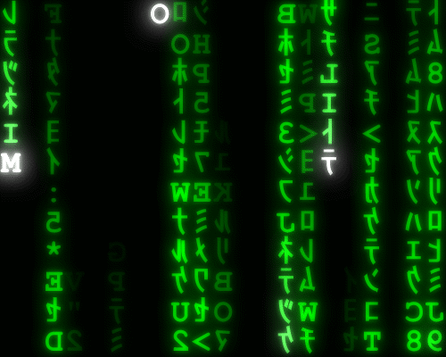
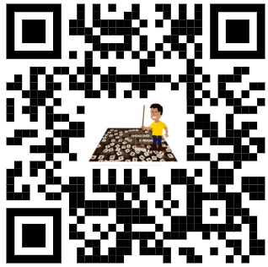
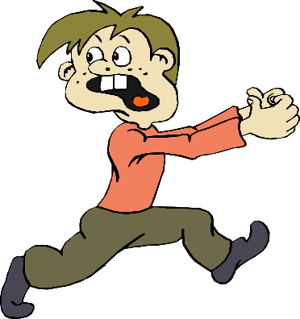
Family Activities
Whoa … this is scary … the letters are falling and we’ve lost the message. Can you help? If you get stuck use the QR code. It’s worth the effort … have FAITH in what I’m telling you

Slide 19
Faith
March 29

