Slide 1
Faith on Display in Your Relationships
Sept. 11

Slide 2
Video Introduction
View Video

Slide 3
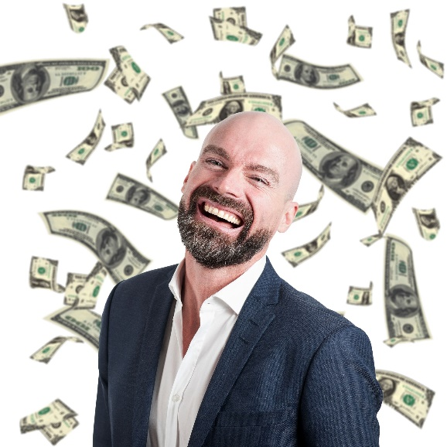
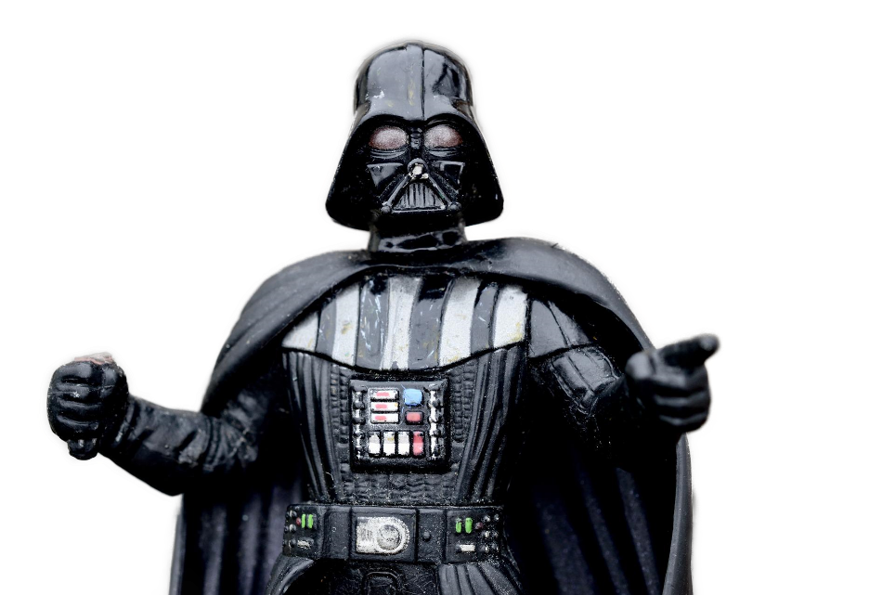
Think about this …
For what reasons might a person think he or she is more important than another person?
The Point
We sometimes treat people differently, based on their position
Today James will tell us not to play favorites

Slide 4
Listen for criteria of favoritism.
James 2:1 – 4 (NIV) My brothers and sisters, believers in our glorious Lord Jesus Christ must not show favoritism. 2 Suppose a man comes into your meeting wearing a gold ring and fine clothes, and a poor man in filthy old clothes also comes in. 3 If you show

Slide 5
Listen for criteria of favoritism.
special attention to the man wearing fine clothes and say, “Here’s a good seat for you,” but say to the poor man, “You stand there” or “Sit on the floor by my feet,” 4 have you not discriminated among yourselves and become judges with evil thoughts?

Slide 6
Outward Appearances
What examples of prejudice and partiality does James describe?
What rationale might an usher or deacon give for such treatment to someone today?
What other qualifications might cause special treatment (either positive or negative)?

Slide 7
Outward Appearances
Why is faith in Christ and an attitude of favoritism toward others incompatible?
What could be some consequences of showing favoritism in the church?
How does James characterize those who engage in these attitudes or actions?

Slide 8
Outward Appearances
How is showing favoritism or preference to one person or group an act of “prejudging?”
You likely know people of some “group” that were not like what you assumed about that group…
“He’s a ________, but I can tell he really knows Jesus as Savior.”
You only discover that by getting to know the person, not by practicing favoritism.

Slide 9
Listen for God’s perspective on the poor.
James 2:5 – 7 (NIV) Listen, my dear brothers and sisters: Has not God chosen those who are poor in the eyes of the world to be rich in faith and to inherit the kingdom he promised those who love him? 6 But you have dishonored the

Slide 10
Listen for God’s perspective on the poor.
poor. Is it not the rich who are exploiting you? Are they not the ones who are dragging you into court? 7 Are they not the ones who are blaspheming the noble name of Him to whom you belong?

Slide 11
Don’t Discount Those God Accepts
What does James say about what God has promised the poor of this world?
Why do you think God has a special concern for poor people?
At the same time what did rich people have a history of doing to people in the early church (who were not often well to do)?

Slide 12
Don’t Discount Those God Accepts
What life events condition you to show favoritism?
What steps can we take to overcome favoritism?

Slide 13
Listen for the “Royal Law”.
James 2:8 – 13 (NIV) If you really keep the royal law found in Scripture, “Love your neighbor as yourself,” you are doing right. 9 But if you show favoritism, you sin and are convicted by the law as lawbreakers. 10 For whoever keeps the whole law and yet stumbles at just one point is guilty of breaking all of it. 11 For he who said, “You shall

Slide 14
Listen for the “Royal Law”.
not commit adultery,” also said, “You shall not murder.” If you do not commit adultery but do commit murder, you have become a lawbreaker. Speak and act as those who are going to be judged by the law that gives freedom, because judgment without mercy will be shown to anyone who has not been merciful. Mercy triumphs over judgment.

Slide 15
Obey God’s Call to Love Others
The “Royal Law” is to love your neighbor as yourself.
Jesus refers to it as the “second greatest commandment”
It is the primary starting point for all commandments regarding interpersonal relationships

Slide 16
Obey God’s Call to Love Others
In what practical ways can we show genuine love to people of different races, cultures, and economic standing?
How does mercy triumph over judgment (or judgmentalism)?

Slide 17
Obey God’s Call to Love Others
Consider this “law that gives freedom” that James is talking about…
It is not law that condemns
It is God’s law of grace and mercy that he provides
We are set free from a law that we cannot measure up to
The law that gives freedom enables us to obey Jesus willingly
We do the right thing because God places the desire in our heart

Slide 18
Application
Make contact.
In your group and congregational setting, greet those you don’t know.
Smile. Make eye contact. Ask their names.
Practice the five-minute rule. Five minutes before and after a church gathering, seek out people you do not know very well and spend a few minutes chatting with them.

Slide 19
Application
Invite someone.
You likely have friends and acquaintances who outwardly may not “fit in” with your group or church.
Don’t assume they won’t fit in. Invite them to come with you.
Show them the love of Christ.

Slide 20
Application
Help end poverty for someone.
Find a way to help someone in need.
While you cannot end all poverty, you can help someone in need.

Slide 21
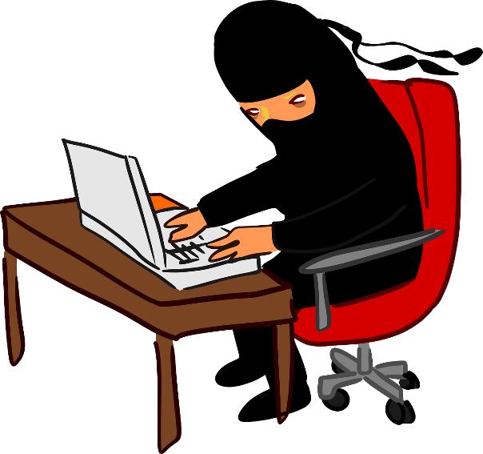
Family Activities
Spiros really needs your help on this one.
Don’t forget the other cool stuff on the Family Activities Page

Slide 22
Faith on Display in Your Relationships
Sept. 11

