Slide 1
Faith on Display in Your Priorities
October 9

Slide 2
Video Introduction
View Video

Slide 3
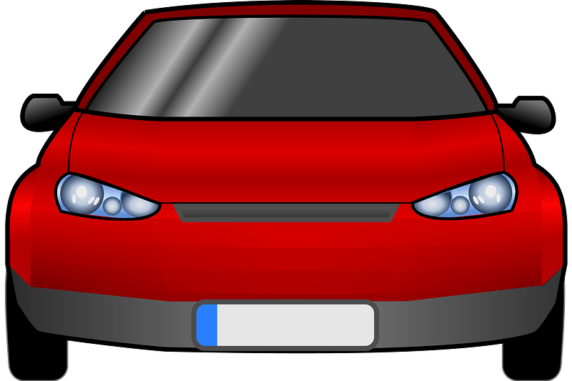
Remember that time?
When has an unexpected change turned out better than the original plan?
We might be initially disappointed with the way things are going.
But no matter what lies ahead, maintain your trust and dependence on God.
He will accomplish His good purposes for you
CLOSED

Slide 4
Listen for an example of planning.
James 4:13-17 (NIV) Now listen, you who say, "Today or tomorrow we will go to this or that city, spend a year there, carry on business and make money." 14 Why, you do not even know what will happen tomorrow. What is your life? You are a mist that appears for a little

Slide 5
Listen for an example of planning.
while and then vanishes. 15 Instead, you ought to say, "If it is the Lord's will, we will live and do this or that." 16 As it is, you boast and brag. All such boasting is evil. 17 Anyone, then, who knows the good he ought to do and doesn't do it, sins.

Slide 6
Your Plans and God’s Will
In James’s illustration, what were some assumptions the businessmen made in planning their future ventures?
What kinds of events can so easily alter our carefully made plans?
What does he say we should do instead?
What imagery did James use to emphasize the brevity of life?

Slide 7
Your Plans and God’s Will
If life is so brief and uncertain, how should we approach it as a people of faith?
How does James characterize presumptuousness, arrogance, and failure to do the good we know to do?

Slide 8
Your Plans and God’s Will
How can we find the right balance between planning for our future and trusting God for our future? What steps can we take to determine God’s will?

Slide 9
Listen for the need for patience and perseverance.
James 5:7-9 (NIV) Be patient, then, brothers, until the Lord's coming. See how the farmer waits for the land to yield its valuable crop and how patient he is for the autumn and spring rains.

Slide 10
Listen for the need for patience and perseverance.
You too, be patient and stand firm, because the Lord's coming is near. 9 Don't grumble against each other, brothers, or you will be judged. The Judge is standing at the door!

Slide 11
Focus on Christ’s Return
What area of life have you found it difficult to completely depend on God? When have you had to be patient while waiting for the Lord to provide?
What do we need to do as we wait for the Lord’s return to earth?
What makes it hard to wait on God’s timing?

Slide 12
Focus on Christ’s Return
What effects should the belief of the return of the Lord have on the way you view life and establish priorities?
What kind of changes does God want to make in us over an extended period of time?

Slide 13
Listen for how the prophets were an example.
James 5:10-11 (NIV) Brothers, as an example of patience in the face of suffering, take the prophets who spoke in the name of the Lord. 11 As you know, we consider blessed those who have persevered. You have heard of Job's perseverance and have seen what the Lord finally brought about. The Lord is full of compassion and mercy.

Slide 14
Stay the Course
James mentions the prophets and people who endured in the face of suffering. How did they model endurance?
Why can those who endure be characterized as happy?
What are lessons that can be learned from the example of Job?

Slide 15
Stay the Course
According to this passage, in what ways does God help us when we must endure suffering?
How will God reward us if we are patient?

Slide 16
Application
Pray with praise.
Trust God, knowing Christ’s return will bring full justice, freedom, and deliverance.
Consider ways you can pray and praise God for how He is working in your life.
Thank Him for the future that awaits you when He returns.

Slide 17
Application
Pray over your plans.
Give all your scheduling, appointments, and plans—both big and small—to God and trust Him with them.
If those plans change, thank Him and pray to see how He is at work throughout your day.

Slide 18
Application
Pray for the persecuted church.
Take time to pray for believers who face persecution for their belief in Jesus.
With your group, make prayer for the persecuted church an intentional part of your prayer time together.
Check out imb.org for specific places and ways to pray.

Slide 19
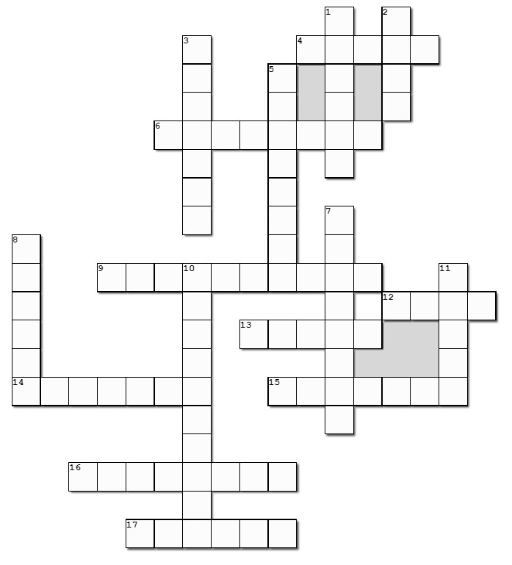
Family Activities
Looks like a Cross Word to me. Hope no one takes offense. All the clues and words come from our Bible Study passage. If you get stuck or would rather decrypt a message for Spiros the spy, go to
https://tinyurl.com/457s3rs8

Slide 20
Faith on Display in Your Priorities
October 9

