Slide 1
Faith on Display in Facing the Enemy
October 2

Slide 2
Video Introduction
View Video

Slide 3
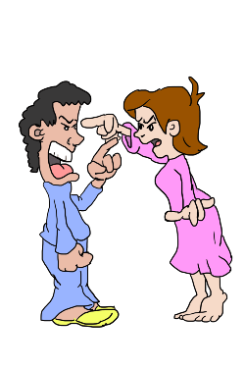
Be honest, now …
What do families and friends commonly fight about?
Today we look at James’ answer to this question …
And his recommendations for the solution.
You can stand triumphantly in Christ over sin, the world, and Satan.
One of these days, Alice … to the MOON!

Slide 4
Listen for causes of conflict.
James 4:1-3 (NIV) What causes fights and quarrels among you? Don't they come from your desires that battle within you? 2 You want something but don't get it. You kill and covet, but you cannot have what you want. You

Slide 5
Listen for causes of conflict.
quarrel and fight. You do not have, because you do not ask God. 3 When you ask, you do not receive, because you ask with wrong motives, that you may spend what you get on your pleasures.

Slide 6
Repent of Living in Conflict
According to this passage what causes difficulty between people?
What does James say how people react to not being able to get what they want?
What kinds of desires or cravings often lead us into conflict?

Slide 7
Repent of Living in Conflict
What evidence can you give from history that wars and fights are caused by selfish ambitions?
James says “you cannot have what you want . . . You do not have, because you do not ask God.” He is talking about things that
We want,
But cannot , do not have,
And could have if we prayed?

Slide 8
Repent of Living in Conflict
What could we be praying for that down deep we want?
Then he says that when we do pray, it’s wrong … how so?
We should realize that this too can be a source of conflict … our whole outlook on life and the purpose for which God is working in our lives
Our lives are meant to be lived to God’s glory … not our own pampering

Slide 9
Listen for what happens to friends of the world.
James 4:4-5 (NIV) You adulterous people, don't you know that friendship with the world is hatred toward God? Anyone who chooses to be a friend of the world becomes an enemy of God. 5 Or do you think Scripture says without reason that the spirit he caused to live in us envies intensely?

Slide 10
Reject the World View – Hostility to God
How might the term “adulterous people” be understood as a comment on people’s flawed relationship to God?
What kinds of friendships with the world alienate us from God?
Where do you see evidence that the world is hostile to God?

Slide 11
Reject the World View – Hostility to God
Consider the warped view of today’s culture, even among some believers.
We too easily rationalize our behavior
From West Side Story, “I’m depraved on account of I’m deprived!”
“It’s not my fault” … “I have the gene for anger” … or “I was abused”
This is my besetting sin – you need to adjust to me

Slide 12
Listen for how to walk humbly with God.
James 4:6-10 (NIV) But he gives us more grace. That is why Scripture says: "God opposes the proud but gives grace to the humble." 7 Submit yourselves, then, to God. Resist the devil, and he will flee from you. 8 Come near to God and he will come near to you.

Slide 13
Listen for how to walk humbly with God.
Wash your hands, you sinners, and purify your hearts, you double-minded. 9 Grieve, mourn and wail. Change your laughter to mourning and your joy to gloom. 10 Humble yourselves before the Lord, and he will lift you up.

Slide 14
Resist Your Enemy, Satan
Let’s list all the crucial elements, the imperatives James gives for overcoming conflict.
What promises are attached to these imperatives?
James mentions “double-mindedness” … how does that pull us away from God instead of drawing near to God?

Slide 15
Resist Your Enemy, Satan
What are some ways in which we can resist the devil?

Slide 16
Application
Confess.
If this passage has convicted you of self-centeredness, covetousness, or a worldly attitude, confess and repent.
Use Psalm 51 as the structure for your prayer.

Slide 17
Application
Retreat.
Spend half a day in prayer.
Begin with confession and submission.
Ask God to guide you in planning a course of action to avoid the temptation of materialism.
Evaluate the effects of what you read or watch on encouraging a worldly mindset.

Slide 18
Application
Clean house.
Take inventory of what you possess that reflects a worldly mindset or was purchased from a heart of materialism.
This may need to be done with a spouse or family member, but consider removing those things from your life.
Sell them if necessary and give the money to support mission work through your church.

Slide 19
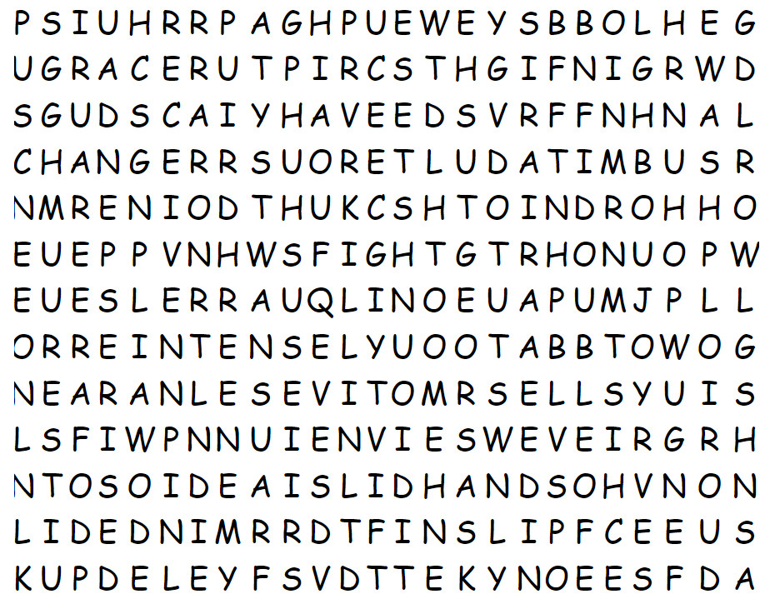
Family Activities
Don’t fight with me on this. And no quarrelling amongst yourselves. Just find the words. If you need help or want to wimp out and do the crossword, go to https://tinyurl.com/4x4nj7xb There are other uplifting family activities there as well.

Slide 20
Faith on Display in Facing the Enemy
October 2

