Slide 1
Expectant Faith
February 4

Slide 2
Video Introduction
View Video

Slide 3
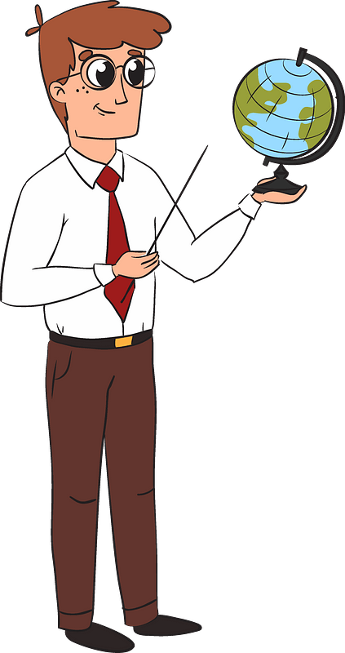
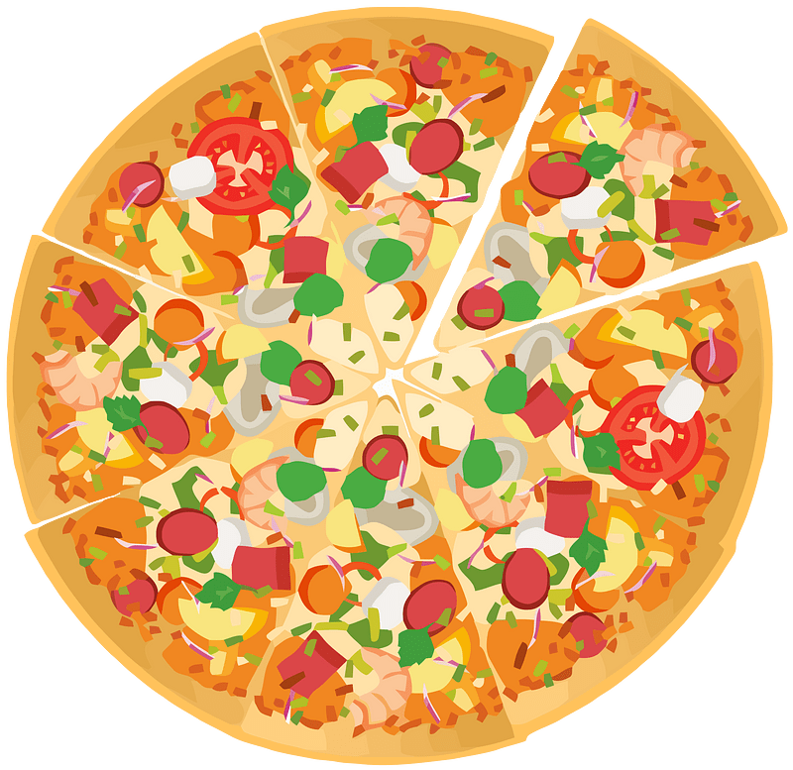
Can you recall?
What was a time when something exceeded your expectations?
God’s response to our faith will always ultimately exceed our expectations.
Faith maintains trust in God to do what no one else can do.

Slide 4
Listen for despair.
Luke 8:41-42 (NIV) Then a man named Jairus, a ruler of the synagogue, came and fell at Jesus' feet, pleading with him to come to his house 42 because his only daughter, a girl of about twelve, was dying. As Jesus was on his way, the crowds almost crushed him.

Slide 5
Trust Jesus with Your Needs
Jairus was a ruler of a local synagogue. What mixed feelings might he have had as he approached Jesus for help regarding his daughter’s illness?
How did Jesus respond to his appeal?

Slide 6
Trust Jesus with Your Needs
Jairus was an important person. He was probably quite religious. But he had a tragic situation. What does that tell us about how life happens?
When problems do come along, what might keep us from bringing our needs to Jesus?
Why do delays like the pressing crowd put our faith to the test?

Slide 7
Listen for increasing tragedy
Luke 8:49-53 (NIV) While Jesus was still speaking, someone came from the house of Jairus, the synagogue ruler. "Your daughter is dead," he said. "Don't bother the teacher any more." 50 Hearing this, Jesus said to Jairus, "Don't

Slide 8
Listen for increasing tragedy
be afraid; just believe, and she will be healed." 51 When he arrived at the house of Jairus, he did not let anyone go in with him except Peter, John and James, and the child's father and mother. 52 Meanwhile,

Slide 9
Listen for increasing tragedy
all the people were wailing and mourning for her. "Stop wailing," Jesus said. "She is not dead but asleep." 53 They laughed at him, knowing that she was dead.

Slide 10
Trust Jesus when Things Go Awry
What dire message came to Jairus concerning his daughter? What emotions do you think Jarius probably had?
What in the passage indicates that people with Jairus were limited in what they believed about Jesus?
Upon hearing the message, what encouragement did Jesus give to him?

Slide 11
Trust Jesus when Things Go Awry
This could have seemed like a trite response but actually Jesus gave him sound advice. How are fear and faith opposites, in a way?
How did Jesus’ manner and words stand in sharp contrast to the mood outside and inside Jairus’s house?
Why did Jesus separate the mourners from where the little girl lay dead?

Slide 12
Trust Jesus when Things Go Awry
What opposition do believers sometimes face when they express an expectant faith?
At the same time, when God takes a believer home …
Death is the ultimate healer – no more suffering.
For a believer, Heaven is a good place to be.

Slide 13
Listen for Jesus’ power and love.
Luke 8:54-56 (NIV) But he took her by the hand and said, "My child, get up!" 55 Her spirit returned, and at once she stood up. Then Jesus told them to give her something to eat. 56 Her parents were astonished, but he ordered them not to tell anyone what had happened.

Slide 14
Trust Jesus to Provide
Rather than respond to scoffers, what did Jesus proceed to do? What method did He use in this case to work a miracle?
What was the result for the girl? How did her parents respond?
What two commands did Jesus give to her parents?

Slide 15
Consider Jesus’ Command
Child not be the center of unneeded attention
Just a little girl wanting to get on with life
Jesus not a traveling miracle show
Ministry not totally about displays or power
Main lesson was faith
He has power to deliver life
His timing and sovereignty are to be respected

Slide 16
Trust Jesus to Provide
How does Jesus' healing power extend beyond physical ailments to address deeper spiritual and emotional needs

Slide 17
Application
Pray.
Ask God to reveal the people in your life who need a spiritual resurrection.
Pray for spiritual awakening and the courage to speak into their lives.

Slide 18
Application
Memorize.
As you reflect on this amazing story, let its meaning sink in by memorizing this promise from Jesus:
“A thief comes only to steal and kill and destroy. I have come so that they may have life and have it in abundance” (John 10:10).

Slide 19
Application
Go.
Sometime in the next week or so, get out of the safety zone of your ordinary life and visit a jail, homeless shelter, or compassion ministry site.
Volunteer to help and, as you do, pray that God will once again show off His power in the lives of the people you encounter.

Slide 20
Family Activities
But you have to go to http://tinyurl.com/4hs5jf9t for help. And I want to do that color page!
Looks like the clues are in the Bible passage.

Slide 21
Expectant Faith
February 4

