Slide 1
Eternal Life
April 5

Slide 2
Video Introduction
View Video

Slide 3
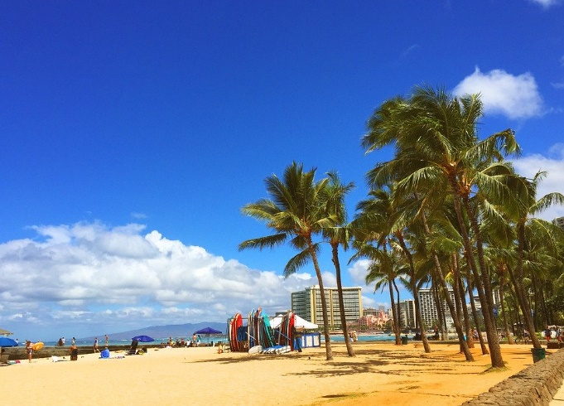
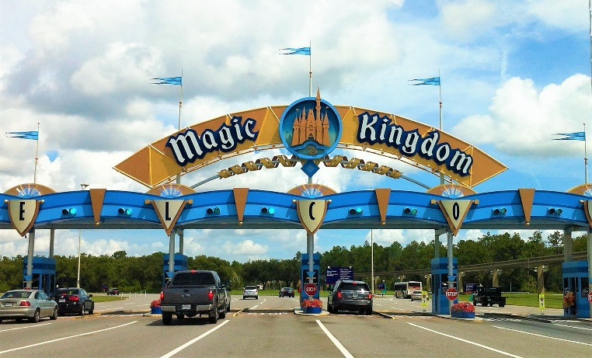
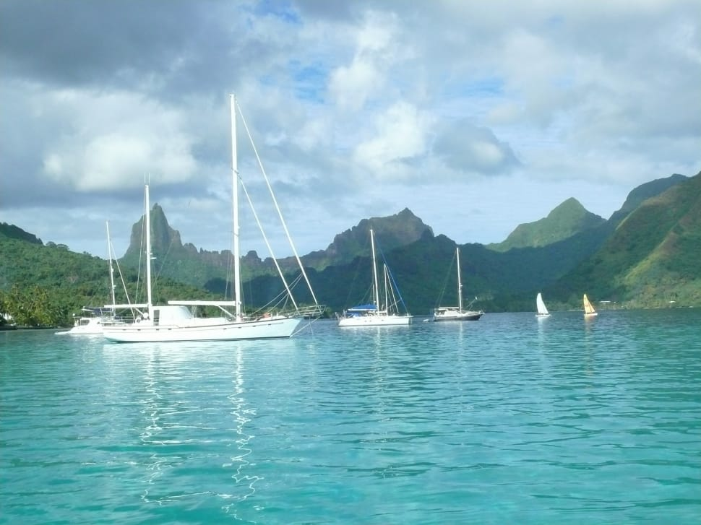
Dream a little bit …
If you could live anywhere in the world, where would it be?
Certainly in this world, no matter where we live, God is with us.
At the same time, each of those locations have some drawbacks.
But when we are with God in Heaven, we can live forever in His very presence there will be no negatives

Slide 4
Listen for things present, things absent.
Revelation 21:1-5 (NIV) Then I saw a new heaven and a new earth, for the first heaven and the first earth had passed away, and there was no longer any sea. 2 I saw the Holy City, the new Jerusalem, coming down out of heaven from God, prepared as a bride beautifully dressed for her husband. 3 And I heard a loud voice from the throne saying,

Slide 5
Listen for things present, things absent.
"Now the dwelling of God is with men, and he will live with them. They will be his people, and God himself will be with them and be their God. 4 He will wipe every tear from their eyes. There will be no more death or mourning or crying

Slide 6
Listen for things present, things absent.
or pain, for the old order of things has passed away." 5 He who was seated on the throne said, "I am making everything new!" Then he said, "Write this down, for these words are trustworthy and true."

Slide 7
With God Forever
What things are listed as present, what are missing in the new heaven and new earth?
In what life situations are these verses comforting?
What is the significance of the absence of these things?
Present in Heaven | Missing from Heaven

Slide 8
With God Forever
What do you think is the significance of the newness? Why is it important to understand that heaven is a place where everything is made new?
What are the implications for us that this present earth will pass away?

Slide 9
With God Forever
In what ways is the promise that God will dwell with us meaningful to you?
What does it mean that God will wipe every tear from our eyes?
How can this vision of heaven have a positive effect on your attitudes and actions regarding health and relationship issues?

Slide 10
Listen for more about eternal life.
Revelation 21:6-8 (NIV) He said to me: "It is done. I am the Alpha and the Omega, the Beginning and the End. To him who is thirsty I will give to drink without cost from the spring of the water of life. 7 He who overcomes will inherit all this, and I will be his God and he will be my son

Slide 11
Listen for more about eternal life.
But the cowardly, the unbelieving, the vile, the murderers, the sexually immoral, those who practice magic arts, the idolaters and all liars--their place will be in the fiery lake of burning sulfur. This is the second death."

Slide 12
Our Relationship with Christ
How did the Lord identify Himself and what does the phrase say about Him?
What does the Lord promise as the blessing of the redeemed?
What is the fate of the unbelievers who choose a lifestyle of wickedness and perversion over eternal life and the promise of victory?

Slide 13
Our Relationship with Christ
What symbolizes the second death and what does “second death” mean?
What are ways you can honor God whether you are still on earth or when you get to heaven?

Slide 14
Listen for what John saw.
Revelation 22:1-5 (NIV) Then the angel showed me the river of the water of life, as clear as crystal, flowing from the throne of God and of the Lamb down the middle of the great street of the city. On each side of the river stood the tree of life, bearing twelve crops of fruit, yielding its fruit every month. And the leaves of the tree are for the healing of the nations.

Slide 15
Listen for what John saw.
No longer will there be any curse. The throne of God and of the Lamb will be in the city, and his servants will serve him. They will see his face, and his name will be on their foreheads. There will be no more night. They will not need the light of a lamp or the light of the sun, for the Lord God will give them light. And they will reign for ever and ever.

Slide 16
Reign with Christ Forever
What are some major elements John saw in the garden of paradise? Think of these glimpses of heaven as a peek between the curtains of a stage play before it starts. What unusual things is John able to see?
Note verse 3 where it says we will serve God … What kinds of things might this include?

Slide 17
Reign with Christ Forever
In what ways do you feel prepared / not prepared to be in the presence of God?
What could you be doing to prepare for heaven and show appreciation for God's promise?
Prepared for Heaven | Not Prepared

Slide 18
Application
Look to Christ.
If you have not trusted Christ, place your faith in Him.
He desires for you to come to Him and live with Him for eternity

Slide 19
Application
Focus on heaven.
As a follower of Christ, your citizenship is in heaven (Phil. 3:20).
Don’t let the temporary things of life consume you.
“Seek the things above, where Christ is, seated at the right hand of God. Set your mind on the things above, not on earthly things” (Col. 3:1-2).

Slide 20
Application
Invite others to heaven.
Identify specific people you know who have no hope of eternal life because they have not placed their faith in Christ.
Pray and seek opportunities to tell them how they can have an eternal life in heaven with Christ.

Slide 21
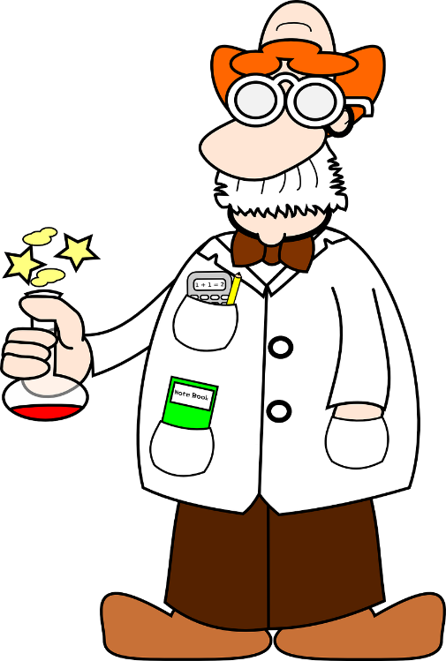
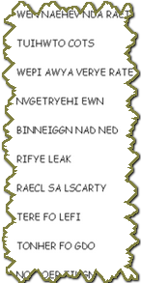
Family Activities
This is tragic. The lab just exploded and burned. These important phrases must be re-assembled so you can determine the message about heaven. Hint: Check out the Bible passages we studied today. And find more great Family Activities at https://tinyurl.com/scvggnx

Slide 22
Eternal Life
April 5

