Slide 1
Encourage
May 3

Slide 2
Introduction Video
View Video

Slide 3
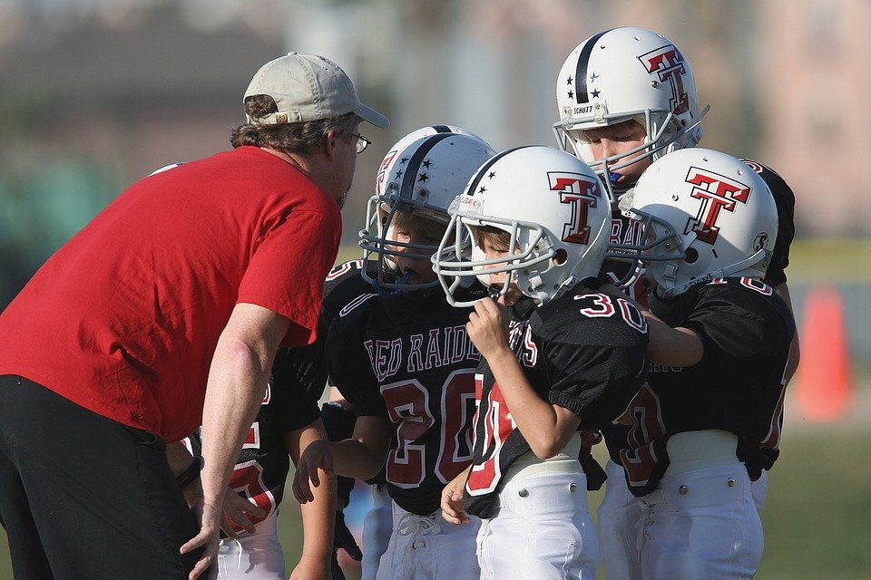
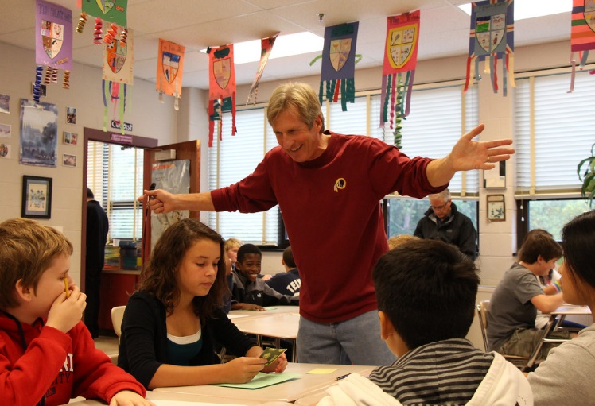
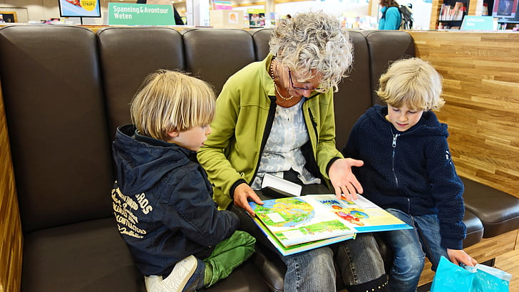
Think about it …
Who has been the most encouraging person in your life?
Today we look at a biblical character whose name actually meant “Son of Encouragement”
We find that encouragement strengthens relationships.

Slide 4
Listen for someone needing acceptance.
Acts 9:26-28 (NIV) When he came to Jerusalem, he tried to join the disciples, but they were all afraid of him, not believing that he really was a disciple. 27 But Barnabas took him and brought him to the apostles. He told them how Saul on his journey

Slide 5
Listen for someone needing acceptance.
the Lord and that the Lord had spoken to him, and how in Damascus he had preached fearlessly in the name of Jesus. 28 So Saul stayed with them and moved about freely in Jerusalem, speaking boldly in the name of the Lord.

Slide 6
Encourage Acceptance
Who mistrusted Saul in Jerusalem? Why?
What difference did Barnabas make to Saul personally and to the fellowship in general?
What did Barnabas risk in standing up for Saul?
What might we risk by investing in others? What risks do you take when you put yourself on the line for an outsider?

Slide 7
Encourage Acceptance
What would be the benefits of investing in Saul if he turned out to be genuine?
Saul/Paul became one of the world’s premier missionaries. How would history be different if Barnabas had not taken the risk to involve Saul?
How could a person like Barnabas help heal wounds in a church group?

Slide 8
Listen for encouragement of spiritual growth.
Acts 11:21-24 (NIV) The Lord's hand was with them, and a great number of people believed and turned to the Lord. 22 News of this reached the ears of the church at Jerusalem, and they sent Barnabas to Antioch. 23 When he arrived and

Slide 9
Listen for encouragement of spiritual growth.
saw the evidence of the grace of God, he was glad and encouraged them all to remain true to the Lord with all their hearts. 24 He was a good man, full of the Holy Spirit and faith, and a great number of people were brought to the Lord.

Slide 10
Encourage Growth
What was taking place in Antioch that caught the attention of the church in Jerusalem?
What words and phrases in these verses support the choice of Barnabas as the right person to go to Antioch?
What was his assessment of what he saw?
Why is someone like Barnabas a real asset to a church?

Slide 11
Encourage Growth
How is encouragement like a set of jumper cables?
What encouragement might Barnabas have to say to us during these days of “sheltering in place,” quarantine, and shut down?
How can we intentionally grow into the role of an encourager?

Slide 12
Listen for efforts to involve others to serve.
Acts 11:25-26 (NIV) Then Barnabas went to Tarsus to look for Saul, 26 and when he found him, he brought him to Antioch. So for a whole year Barnabas and Saul met with the church and taught great numbers of people. The disciples were called Christians first at Antioch.

Slide 13
Encourage Service
What kinds of things can you imagine made it hard for Barnabas to find and bring Saul back to Tarsus?
It had been about 10 years since their acquaintance in Jerusalem. Why do you think Barnabas expended such effort to find Saul?

Slide 14
Encourage Service
What is our responsibility toward someone who has faded from view?
How can we actively encourage others to use their spiritual gifts?

Slide 15
Application
Express thanks.
Express thanks to someone who has been an encouragement to you.
Be specific regarding how their words or actions helped you.

Slide 16
Application
Evaluate your life.
Consider whether people are encouraged by your example or actions.
Consider what you might need to change to be an encourager like Barnabas.

Slide 17
Application
Encourage each other.
Share ways each person in the group lives out one or more of the character traits in the fruit of the Spirit (Gal. 5:22-23).

Slide 18
Family Activities
A coded message awaits.
The Ninja Secret Services send an encouraging word to YOU.
And be encouraged to go to
https://tinyurl.com/ya3ea7ju for more important encouraging activities.

Slide 19
Encourage
May 3

