Slide 1
Doing Life Together in Christ
May 19

Slide 2
Introduction Video
View Video

Slide 3
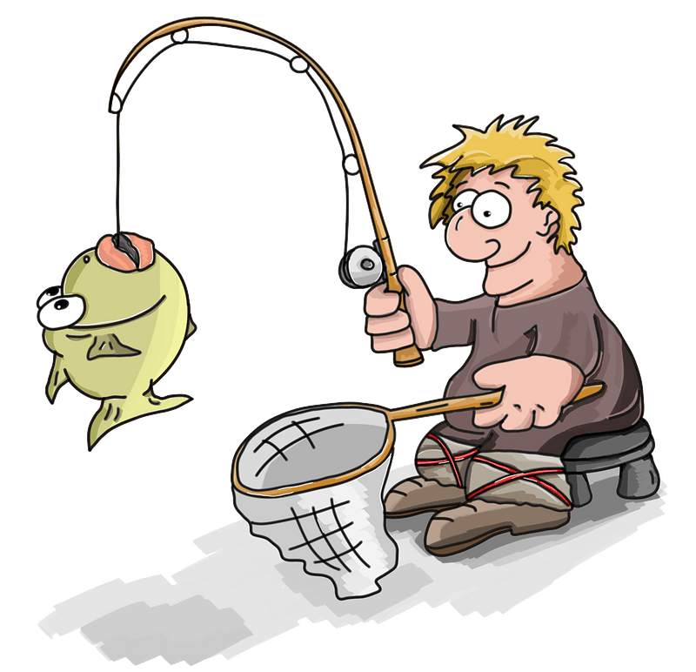
How about it?
What are some hobbies or interests that have connected you with other people?
We need that interaction with others.
This is especially important in our Christian life
Believers share and experience life in Christ together

Slide 4
Listen for contrasts.
1 Thessalonians 5:4-8 (NIV) But you, brothers, are not in darkness so that this day should surprise you like a thief. 5 You are all sons of the light and sons of the day. We do not belong to the night or to the darkness. 6 So then, let us not be like others, who are

Slide 5
Listen for contrasts.
asleep, but let us be alert and self-controlled. 7 For those who sleep, sleep at night, and those who get drunk, get drunk at night. 8 But since we belong to the day, let us be self-controlled, putting on faith and love as a breastplate, and the hope of salvation as a helmet.

Slide 6
Children of Light
Identify the several contrasting metaphors Paul used in these verses and identify the meaning of each.
What concepts in these verses suggest a sense of togetherness or fellowship among those who believe?
How can we help one another navigate through a world growing increasingly dark?

Slide 7
Children of Light
What are some threats to the church standing united in a world wrapped in darkness?
How are faith and love like a breastplate?
How is salvation like a helmet?
How can the themes of vigilance and sobriety, mentioned in verses 6 and 8, help us navigate the challenges and temptations of the world around us?

Slide 8
Listen for how to encourage.
1 Thessalonians 5:9-11 (NIV) For God did not appoint us to suffer wrath but to receive salvation through our Lord Jesus Christ. 10 He died for us so that, whether we are awake or asleep, we may live together with him. 11 Therefore encourage one another and build each other up, just as in fact you are doing.

Slide 9
Encourage One Another
What has God appointed for those who believe and how was it accomplished?
God did not appoint us to suffer wrath but to receive salvation through our Lord Jesus Christ. He died for us so that, whether we are awake or asleep, we may live together with him.

Slide 10
Encourage One Another
Consider all the benefits of salvation Paul focused on in verse 10.
Jesus took the punishment we deserved
When you confess and repent from your sin and receive by faith the salvation Jesus has accomplished … you are FORGIVEN!
The believer who dies goes directly into God’s presence.
While the believer lives, he or she is made into a new person.
God’s holy Spirit dwells within that believer.

Slide 11
Encourage One Another
What instruction did Paul give that would be helpful to the body of believers?
What are some practical ways we can build one another up?
How can talking about God’s promises for our future encourage us in our daily lives?

Slide 12
Listen for challenges given.
1 Thessalonians 5:12-15 (NIV) Now we ask you, brothers, to respect those who work hard among you, who are over you in the Lord and who admonish you. 13 Hold them in the highest regard in love because of their work. Live in peace with

Slide 13
Listen for challenges given.
each other. 14 And we urge you, brothers, warn those who are idle, encourage the timid, help the weak, be patient with everyone. 15 Make sure that nobody pays back wrong for wrong, but always try to be kind to each other and to everyone else.

Slide 14
Challenge One Another
Note the antecedent of the pronoun “those” in verse 12.
They “work hard among you”
They are “over you in the Lord”
They “admonish” you
Paul is speaking of pastors and ministers.

Slide 15
Challenge One Another
How were the brethren to treat “those who work hard among you”?
How can we best honor our church leaders who provide us with spiritual guidance?

Slide 16
Challenge One Another
How might the closing admonition in verse 13 apply to leaders and followers alike?
What are some appropriate ways to challenge and spur one another on within the church?
Hold them in the highest regard in love because of their work. Live in peace with each other.

Slide 17
Application
Find fellowship.
Regularly invite someone at church you don’t know well to dinner.
Get to know them more deeply.

Slide 18
Application
Support your leader.
Pray for your pastor every week.
Call or send a note stating your support and appreciation for him this week.

Slide 19
Application
Invite accountability.
Ask a strong Christian to be your accountability partner.
Schedule regular times to check on how you’re growing spiritually and obeying Christ daily.
Share your weaknesses and welcome advice.

Slide 20
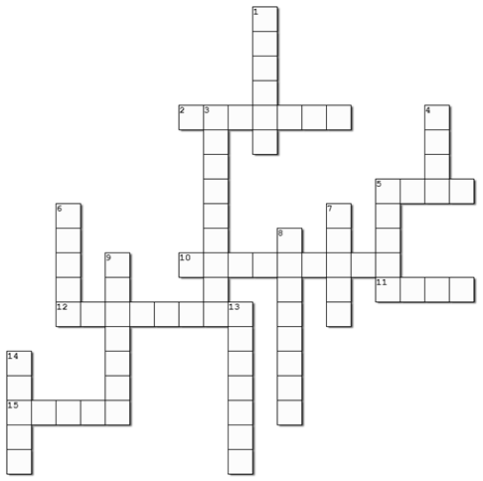
Family Activities
Yes, I see the hint for 1 Down. Looks like the guy is snoozing or snoring, but neither one of those fit. We should probably check out 1 Thes. 5:4 – 15 in the NIV. Or we could go to https://tinyurl.com/j4dwefwb for help. Oh yes, the color page is there too!

Slide 21
Doing Life Together in Christ
May 19

