Slide 1
Does It Bring Conviction?
January 29

Slide 2

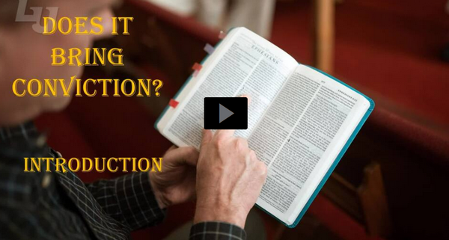
Video Introduction
View Video

Slide 3

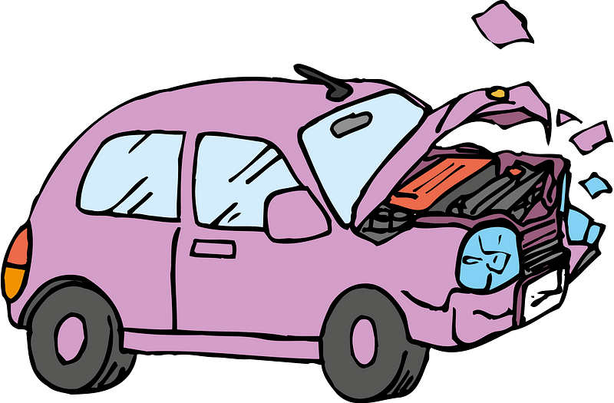

Be honest, now …
When has it been difficult for you to admit you’ve made a mistake?
God speaks to us through different means to bring us to confession and repentance.
  The voice of God seeks to convict (convince) us of His Truth

Slide 4
Listen for praise for Jesus.
Acts 2:32-36 (NIV) God has raised this Jesus to life, and we are all witnesses of the fact. 33 Exalted to the right hand of God, he has received from the Father the promised Holy Spirit and has poured out what you now see and hear. 34 For David did not ascend to heaven,

Slide 5
Listen for praise for Jesus.
and yet he said, "'The Lord said to my Lord: "Sit at my right hand 35 until I make your enemies a footstool for your feet."' 36 "Therefore let all Israel be assured of this: God has made this Jesus, whom you crucified, both Lord and Christ."

Slide 6
Crucified and Resurrected
Peter gave an eyewitness testimony.
  God resurrected Jesus from the dead.
  Many people saw this personally.
Why is it important that many people in the early church were personal witnesses to Jesus’ resurrection?
What words and phrases express the imagery of the exaltation of Jesus?

Slide 7
Crucified and Resurrected
Peter offers scriptural support for his claim that Jesus had been ascended and exalted as Lord and Christ. "The Lord said to my Lord: ‘Sit at my right hand …’” Note the meaning of this psalm.
  God the Father says to God the Son, “Sit at my right hand”
  Jesus was a descendant of David
  So, David is expressing his worship of “my Lord”, the Messiah

Slide 8
Crucified and Resurrected
What are the personal implications of recognizing Jesus as Lord?
What can cause people to struggle with the certainty that Jesus is Lord?
What do we learn from this passage about the Holy Spirit?

Slide 9
Crucified and Resurrected
It was the Holy Spirit who accomplished the miracles they had recently seen and heard (from the first verses of chapter 2).
  Sound of a mighty wind
  Tongues of fire above their heads
  People speaking in different languages (not their own)

Slide 10
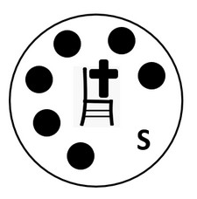
Crucified and Resurrected
God’s Holy Spirit indwells believers … both then and now

Slide 11
Listen for the response of Peter’s audience.
Acts 2:37-38 (NIV) When the people heard this, they were cut to the heart and said to Peter and the other apostles, "Brothers, what shall we do?" 38 Peter replied, "Repent and be baptized, every one of you, in the name of Jesus Christ for the forgiveness of your sins. And you will receive the gift of the Holy Spirit.

Slide 12
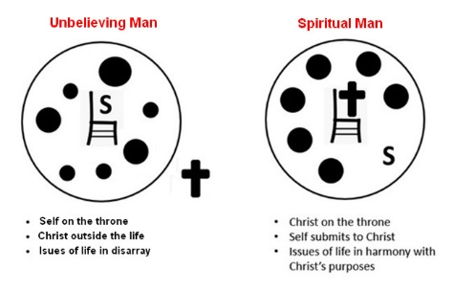
Respond to Christ
What effect did Peter’s preaching have on the people?
What actions did Peter tell them to take?

Slide 13
Respond to Christ
What does it mean to repent?
Describe the differences between condemnation and conviction.
Condemnation | Conviction

Slide 14

Respond to Christ
As we share the gospel, how can we work toward the goal of conviction rather than condemnation?

Slide 15
Listen for the response to Peter’s call.
Acts 2:39-41 (NIV) The promise is for you and your children and for all who are far off--for all whom the Lord our God will call." 40 With many other words he warned them; and he pleaded with them,

Slide 16
Listen for the response to Peter’s call.
"Save yourselves from this corrupt generation." 41 Those who accepted his message were baptized, and about three thousand were added to their number that day.

Slide 17
Conviction Leads to Obedience
Unto whom is the promise of forgiveness given?
Note Peter’s role in this situation …
  Willing to stand up and communicate the Truth of the Gospel message
  Answer people’s questions
  Direct them how to respond to the salvation message

Slide 18
Conviction Leads to Obedience
Now note the different roles the Holy Spirit played in this situation ..
  The Holy Spirit directed Peter in what to say, how to say it
  The Holy Spirit was convicting them, convincing them
  John 16:8 When he comes, he will convict the world of guilt in regard to sin and righteousness and judgment:
  That’s how they were “cut to the heart”
  Then He came into their lives as God’s gift

Slide 19
Conviction Leads to Obedience
When you share the Gospel message with someone, how does this take pressure off you?
Even though the responsibility to do the convincing belongs to God’s Holy Spirit, what responsibility is still ours?

Slide 20
Application
Receive Christ.
  If you have never repented of your sin and placed your faith in Christ, do so now.
  Make an appointment with a pastor or Christian friend and settle this crucial matter.
  Check out the inside front cover of your Personal Study Guide

Slide 21
Application
Confess sin.
  The convicting work of the Holy Spirit is not limited to your need for salvation.
  After salvation, we still sin.
  What has the Holy Spirit been convicting you of?
  Consider what sins the Holy Spirit is pinpointing in your life that He wants to cleanse and forgive.
  Respond to everything God points out to you. Don’t be satisfied until you have been set free from every sin.

Slide 22
Application
Share Christ.
  Even as the Holy Spirit worked through Peter, He wants to work through you.
  Pray for opportunities to be used by Him to speak His truth into the lives of others.
  When that opportunity arises, trust God to work through you to reveal His salvation.

Slide 23
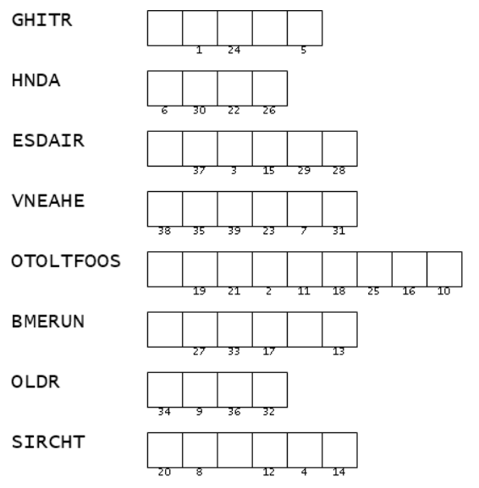

Family Activities
All the words are scrambled! The actual words are found in your Bible Study passage. If you can sort them out, you can use the numbers to figure out the message. If you get stuck, go to https://tinyurl.com/4h5kv2wm And there’s other cool stuff there too. I want to do the color page!
What is “OTOLTFOOS” ?

Slide 24
Does It Bring Conviction?
January 29

