Slide 1
Does It Align with God’s Character?
February 12

Slide 2
Video Introduction
View Video

Slide 3
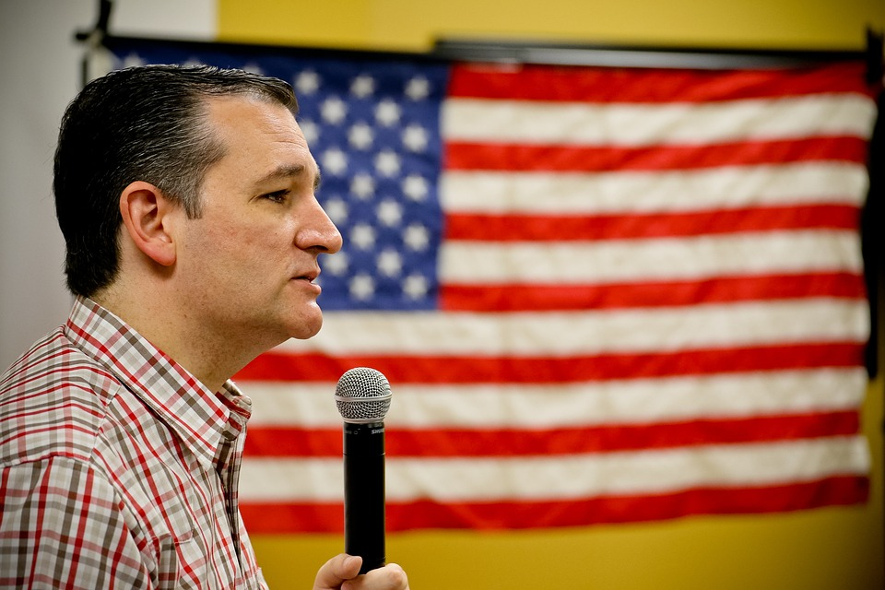
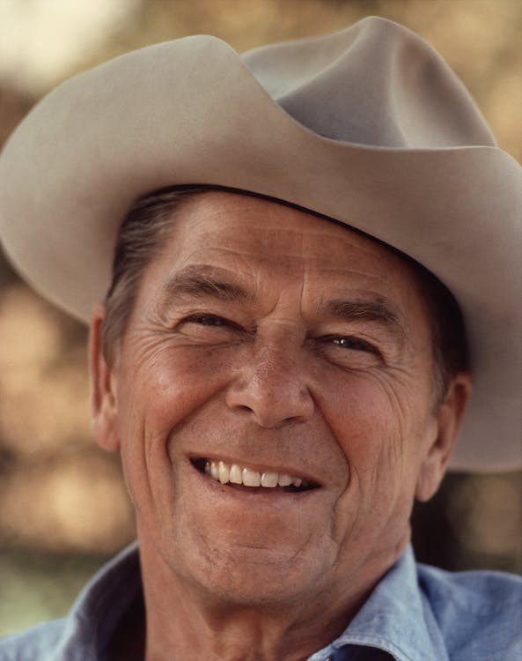
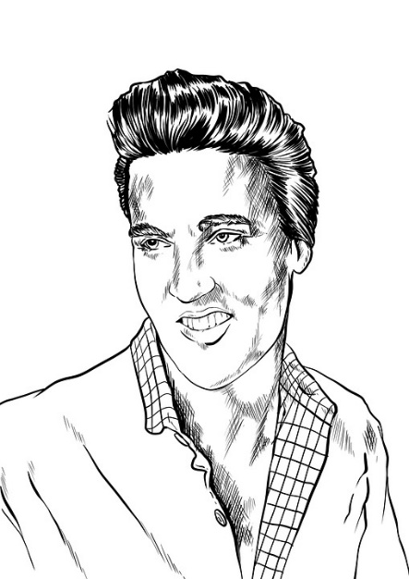
You can brag …
Who is someone famous you have met?
A face-to-face meeting with powerful, influential, or famous people can be intimidating.
Moses got to meet God Himself in a personal experience
Today we look at specific character traits God shared with Moses
We learn that God will never do something outside of His character

Slide 4
Listen for a personal meet and greet.
Exodus 34:1-5 (NIV) The LORD said to Moses, "Chisel out two stone tablets like the first ones, and I will write on them the words that were on the first tablets, which you broke. 2 Be ready in the morning, and then come up on Mount Sinai. Present yourself to me there on top of the mountain.

Slide 5
Listen for a personal meet and greet.
No one is to come with you or be seen anywhere on the mountain; not even the flocks and herds may graze in front of the mountain." 4 So Moses chiseled out two stone tablets like the first ones and went up Mount

Slide 6
Listen for a personal meet and greet.
Sinai early in the morning, as the LORD had commanded him; and he carried the two stone tablets in his hands. 5 Then the LORD came down in the cloud and stood there with him and proclaimed his name, the LORD.

Slide 7
God Is Holy
What instruction did the Lord give to Moses?
Who did God declare Himself to be and what is the significance of His calling out His name?
What would be both positive and negative feelings by Moses returning for a second set of tablets?
Positive Feelings | Negative Feelings

Slide 8
God Is Holy
We must navigate the tension between intimacy and reverence in our relationship with God.
Be in awe of who God is
Remember He is Creator, Sustainer, Savior
Seek to discover what He has communicated in His Word
Submit to His authority
Declare your faith and dependence on Him
Worship, declare His worth (“worth-ship”)
Tell Him your feelings, your problems, your joys, your thanks

Slide 9
God Is Holy
When have you experienced God’s presence in a meaningful way?
Moses was often dealing with the sinful rebellion of the people. How can you talk to God about the same problem over and over, without nagging or complaining?

Slide 10
Listen for the revelation of God’s character.
Exodus 34:6-7 (NIV) And he passed in front of Moses, proclaiming, "The LORD, the LORD, the compassionate and gracious God, slow to anger, abounding in love and faithfulness, 7 maintaining love to thousands, and forgiving

Slide 11
Listen for the revelation of God’s character.
wickedness, rebellion and sin. Yet he does not leave the guilty unpunished; he punishes the children and their children for the sin of the fathers to the third and fourth generation."

Slide 12
God’s Character: Perfect, Unchanging
List the traits that are given to describe God’s character.
Consider how God exercises these traits in practical terms.
Jesus came to earth as the God-Man – wholly God and wholly man
Accomplished forgiveness for our sinful condition
Indwells believers in the person of the Holy Spirit
Produces those same qualities in our lives as we submit to His authority

Slide 13
God’s Character: Perfect, Unchanging
What words or phrases imply the vastness of God’s mercy (not giving us the punishment we deserve)?
Note the warning of the last part of verse 7. What is a danger of our sin, at least in respect to those who follow us?

Slide 14
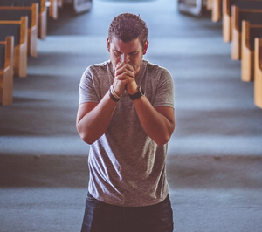
God’s Character: Perfect, Unchanging
Why doesn’t God ever tire of our repentance and dependence on Him for forgiveness?

Slide 15
Listen for Moses’ response.
Exodus 34:8-9 (NIV) Moses bowed to the ground at once and worshiped. 9 "O Lord, if I have found favor in your eyes," he said, "then let the Lord go with us. Although this is a stiff-necked people, forgive our wickedness and our sin, and take us as your inheritance."

Slide 16
Respond to God’s Holiness
How did Moses respond to what God made known about Himself?
What were the three requests he made?
On what basis did Moses make his requests to God?

Slide 17
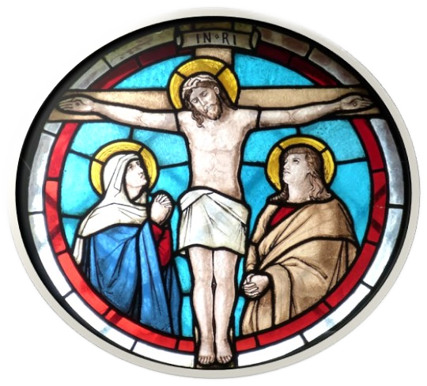
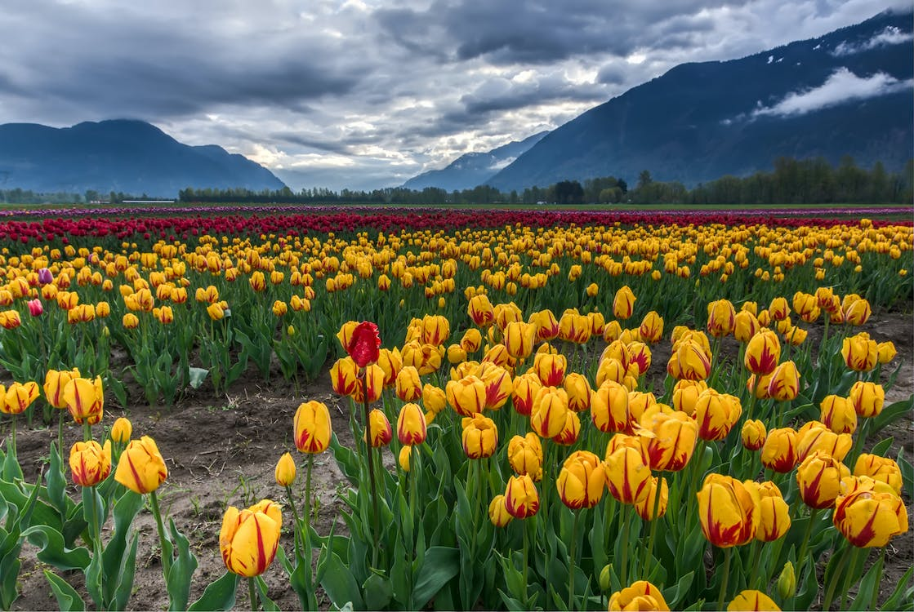
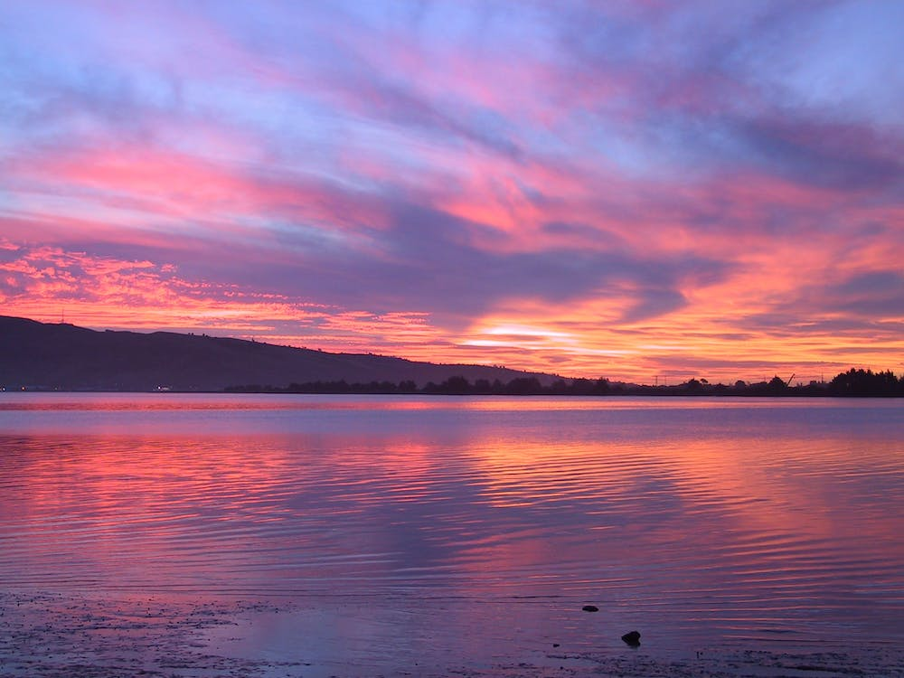
Respond to God’s Holiness
Recall an event, an example, or a place that confronts you with the grandeur and holiness of God and caused you to stand in awe that you were in a covenant relationship with Him as His child.

Slide 18
Respond to God’s Holiness
How can we maintain an attitude of awe and reverence toward God?
How does understanding God’s character help us discern His voice?

Slide 19
Application
Worship.
Reflect on the character of God noted in this passage and respond to God with a prayer of praise.
Thank Him for each one of these attributes and for how you have experienced these attributes in your walk with Him.

Slide 20
Application
Evaluate.
Consider some of the messages you’ve heard from religious leaders who claim to speak for God.
Evaluate how their messages contrast with the character of God seen in this passage

Slide 21
Application
Obey.
Is there something specific God is wanting you to do in service to Him or in the life of another person?
Consider how that task reflects the character of God.
Obey Him and let the loving, gracious character of the One you serve be seen in you.

Slide 22
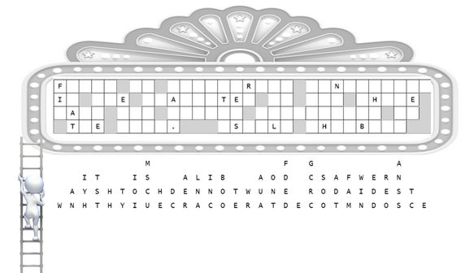
Family Activities
We need your help. An earthquake caused the letters to fall. Some letters will be easy. You can get help at https://tinyurl.com/ycxya43c . There’s other Fun Family Activities there also.

Slide 23
Does It Align with God’s Character?
February 12

