Slide 1
Does It Agree with the Bible?
January 22

Slide 2


Video Introduction
View Video

Slide 3


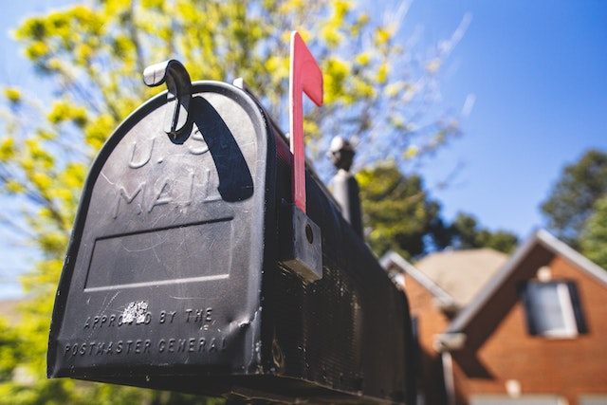
Yikes …
What are some interesting (or scary) scams or cons you’ve heard about?
Scammers tell you one thing but do something different.
  Not so with what God tells us.
  The Voice of God never disagrees with the Bible

Slide 4

Listen for a “crafty” lie.
Genesis 3:1 (NIV) Now the serpent was more crafty than any of the wild animals the LORD God had made. He said to the woman, "Did God really say, 'You must not eat from any tree in the garden'?"

Slide 5

Don’t Question God’s Word
The serpent is characterized as “crafty”. Note some synonyms of “crafty”.
  Cunning, sneaky
  Sly, shrewd
  Devious, wily
  Underhanded

Slide 6
Don’t Question God’s Word
What does that suggest about any person’s encounter with Satan?
How did the tempter distort what God said?

Slide 7
Don’t Question God’s Word
How would you describe the difference between asking questions about God’s Word and questioning His word? Give examples.
What can cause us to question God’s Word?
Questioning what God says | Questions about what God says

Slide 8
Listen for Eve’s initial response to the serpent.
Genesis 3:2-3 (NIV) The woman said to the serpent, "We may eat fruit from the trees in the garden, 3 but God did say, 'You must not eat fruit from the tree that is in the middle of the garden, and you must not touch it, or you will die.'"

Slide 9
Don’t Alter God’s Word
How did the woman respond to the tempter?
Check what God originally told Adam in Genesis 2:16-17 (NIV) And the LORD God commanded the man, "You are free to eat from any tree in the garden; 17 but you must not eat from the tree of the knowledge of good and evil, for when you eat of it you will surely die."

Slide 10
Don’t Alter God’s Word
Why might she have added the “must not touch it”?
What kinds of things get “added” to what God has said to us? What have you heard someone declare that a Christian should never do that is probably not found in the Bible?

Slide 11
Don’t Alter God’s Word
Is it in the Bible or not???
  God helps those who help themselves.
  Gentleness and self-control. Against such things there is no law.
  Cleanliness is next to godliness.
  Hate sin, love the sinner.
  God works for the good of those who love him.

Slide 12
Don’t Alter God’s Word
Is it in the Bible or not???
  Money is the root of all evil.
  Offer your bodies as living sacrifices, holy and pleasing to God.
  This too shall pass.
  If anything is excellent or praiseworthy—think about such things.
  The lion shall lay down with the lamb.

Slide 13
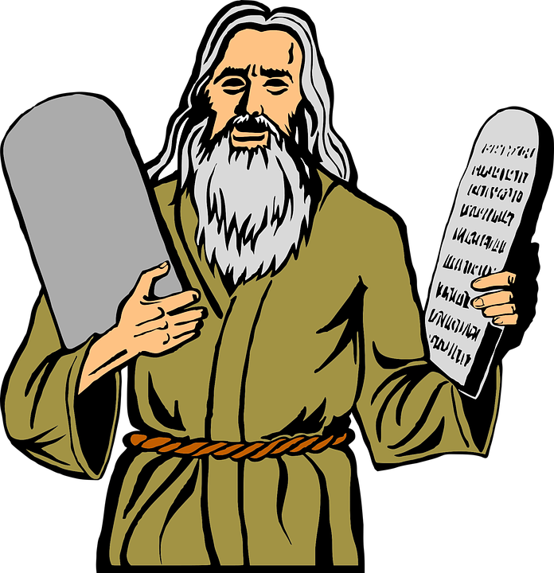
Don’t Alter God’s Word
Why does God give prohibitive commands, anyway?

Slide 14
Listen for more ways Satan tempts us.
Genesis 3:4-6 (NIV) "You will not surely die," the serpent said to the woman. 5 "For God knows that when you eat of it your eyes will be opened, and you will be like God, knowing good and evil." 6 When the woman saw that

Slide 15
Listen for more ways Satan tempts us.
the fruit of the tree was good for food and pleasing to the eye, and also desirable for gaining wisdom, she took some and ate it. She also gave some to her husband, who was with her, and he ate it.

Slide 16
Don’t Contradict God’s Word
What did the tempter seem to suggest about God’s intentions?
What steps define the woman’s fall into disobedience?

Slide 17
Don’t Contradict God’s Word
Note the man’s role and responsibility in this incident of contradicting God’s Word.
  “You” pronouns used by Satan were plural
  Indicates Adam was probably present in this interchange
  Note also the “he was with her”
  Had nothing to say initially
  After Eve ate the fruit, she offered it to Adam
  He ate it also

Slide 18
Don’t Contradict God’s Word
What are some current examples in our culture that are contradictions of God’s Word?
How are people tempted to change the meaning of God’s Word to align with our preferences?

Slide 19
Don’t Contradict God’s Word
Paul said, “But when you are tempted, he will also provide a way out so that you can stand up under it.” 1 Cor. 10:13 (NIV)
How can we recognize these places of escape from Satan’s temptations?

Slide 20
Application
Evaluate.
  List the most common ways the world rejects God’s Word today.
  Consider why people choose to reject God and His Word.

Slide 21
Application
List.
  Write down some decisions you need to make and note the different “voices” that are advising you.
  Consider if those voices line up with God’s Word. Pray for wisdom and discernment to do that which lines up with God’s commands recorded in Scripture.

Slide 22
Application
Study.
  Develop a plan of Bible study for the next twelve months where you intentionally learn more of God’s Word than you already know.
  Identify books and Bible studies that will deepen your understanding of God’s Word.

Slide 23
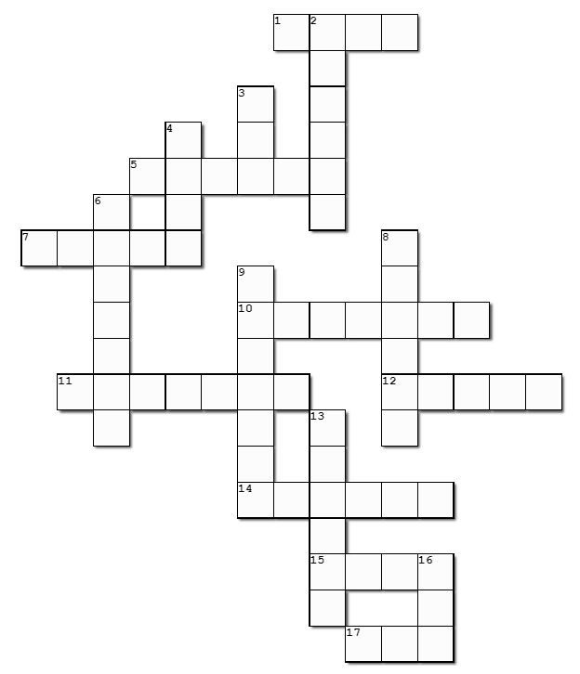

Family Activities
Well, I’d much rather do the Family Activities crossword. You know, the clues and words come from the Bible passage. And you can get help at https://tinyurl.com/4k9pje3e . Oh yes, there’s other activities for the whole family, also.

Slide 24
Does It Agree with the Bible?
January 22

