Slide 1
Do We Need to Defend Our Faith?
December 1

Slide 2
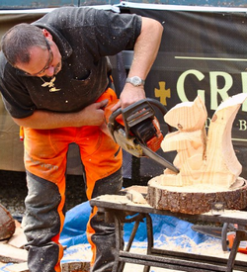
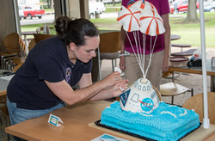
Don’t be bashful, now …
What’s the closest you’ve come to being an expert at something?
We are often good enough at something to give help or pointers to others.
As believers we can know enough to share our faith.
God can use you to show others His Truth

Slide 3
Listen for a crisis.
Jude 1:1-4 (NIV) Jude, a servant of Jesus Christ and a brother of James, To those who have been called, who are loved by God the Father and kept by Jesus Christ: 2 Mercy, peace and love be yours in abundance. 3 Dear friends, although I was very eager to write to you about the salvation we share, I felt I had to write and urge you to contend for the faith

Slide 4
Listen for a crisis.
that was once for all entrusted to the saints. 4 For certain men whose condemnation was written about long ago have secretly slipped in among you. They are godless men, who change the grace of our God into a license for immorality and deny Jesus Christ our only Sovereign and Lord.

Slide 5
Contend for the Faith
How does Jude identify himself to his readers?
How does he address his readers and what is his greeting?
What indicates he wrote this letter in the context of crisis? What did Jude urge his readers to do?
Why was such action necessary?

Slide 6
Contend for the Faith
How could the grace of God be changed into a license for immorality?
Why do you think the presence of these men was dangerous to the health of the body?
What are some ways the Christian faith is being challenged today?
What are some ways we can “contend for the faith” in today’s culture?

Slide 7
Listen for how to defend the faith.
Jude 1:20-23 (NIV) But you, dear friends, build yourselves up in your most holy faith and pray in the Holy Spirit. 21 Keep yourselves in God's love as you wait for the mercy of our Lord Jesus Christ to bring you to eternal life.

Slide 8
Listen for how to defend the faith.
22 Be merciful to those who doubt; 23 snatch others from the fire and save them; to others show mercy, mixed with fear--hating even the clothing stained by corrupted flesh.

Slide 9
Defend the Faith with Mercy and Love
What spiritual actions did Jude urge his readers to take to be prepared to contend for the faith?
Who are three groups of people to whom Jude urged believers to show mercy?
How can we balance showing mercy and contending for the faith?

Slide 10
Defend the Faith with Mercy and Love
Why is it important to show mercy and love while defending the faith?
How can you show mercy to believers who doubt?
How is it possible to build yourself up in the faith?

Slide 11
Listen for why we can rely on God
Jude 1:24-25 (NIV) To him who is able to keep you from falling and to present you before his glorious presence without fault and with great joy-- 25 to the only God our Savior be glory, majesty, power and authority, through Jesus Christ our Lord, before all ages, now and forevermore! Amen.

Slide 12
Rely on God
What assurances are given to believers in these verses of praise to God?
What does God deserve and for how long?
What kinds of things cause us forget these attributes of God, these wonderful Truths?

Slide 13
Rely on God
Consider downloading this document “Who We Are in Christ” and using it as a devotional aid. Read through and meditate on one of the sections each day.
How do these verses encourage you as you seek to defend the faith?

Slide 14
Application video
View Video

Slide 15
Application
Pray.
Ask the Lord for courage to stand up for what you believe.
Ask His forgiveness for times when you have been silent and unprepared to defend the faith.

Slide 16
Application
Memorize.
As a reminder of God’s presence and power in defending the faith, memorize Jude 24-25:
“To him who is able to keep you from stumbling and to present you before his glorious presence without fault and with great joy—to the only God our Savior be glory, majesty, power and authority, through Jesus Christ our Lord, before all ages, now and forevermore! Amen.”

Slide 17
Application
Invite.
Over the next five sessions, your group will be looking at some questions often raised about Christianity.
Use this as an opportunity to invite someone who has questions or doubts about the faith to learn more.
Pray for their openness to God’s Truth

Slide 18
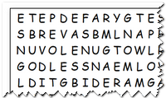
Family Activities
Ho, Ho, Ho … Humph … Humbug! Santa has your status. If you want to get off the “Naughty List” you better go find those words. You can get more “Nice” credits with him by doing the crossword, too. Go to https://tinyurl.com/vd7og8j for some good stuff.

Slide 19
Do We Need to Defend Our Faith?
December 1

