Slide 1
Deborah: Encouraging Faith
June 9

Slide 2
Introduction
View Video

Slide 3
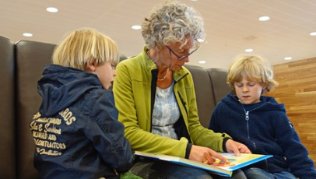
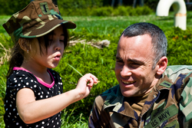
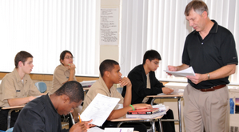
Remember when …
Who was a big influence in your life when you were young?
Consider that now, as an adult, you have influence on younger people around you.
You have an opportunity to be a positive influence on them.
You are called to use your influence for God’s kingdom and for His honor.

Slide 4
Listen for a cycle of events.
Judges 4:1-5 (NIV) After Ehud died, the Israelites once again did evil in the eyes of the LORD. 2 So the LORD sold them into the hands of Jabin, a king of Canaan, who reigned in Hazor. The commander of his army was Sisera, who lived in Harosheth Haggoyim. 3 Because he had nine hundred iron chariots and had cruelly oppressed the Israelites for

Slide 5
Listen for a cycle of events.
twenty years, they cried to the LORD for help. 4 Deborah, a prophetess, the wife of Lappidoth, was leading Israel at that time. 5 She held court under the Palm of Deborah between Ramah and Bethel in the hill country of Ephraim, and the Israelites came to her to have their disputes decided.

Slide 6
Influence Others
What spiritual assessment of Israel opens chapter 4? What cycle of spiritual ups and downs do we see?
What are some of the details of the opposing forces?
What do we learn of the judge or leader whom God raised up at this time?

Slide 7
Influence Others
What characteristics are necessary for leaders now as well as then?
What additional characteristics or attributes are need for spiritual leadership?
Who’s a “Deborah” in your life when you need to make difficult decisions?

Slide 8
Listen for God’s call.
Judges 4:6-9 (NIV) She sent for Barak son of Abinoam from Kedesh in Naphtali and said to him, "The LORD, the God of Israel, commands you: 'Go, take with you ten thousand men of Naphtali and Zebulun and lead the way to Mount Tabor. 7 I will lure Sisera, the commander of Jabin's army, with his chariots and his troops to the Kishon River

Slide 9
Listen for God’s call.
and give him into your hands.'" 8 Barak said to her, "If you go with me, I will go; but if you don't go with me, I won't go." 9 "Very well," Deborah said, "I will go with you. But because of the way you are going about this, the honor will not be yours, for the LORD will hand Sisera over to a woman." So Deborah went with Barak to Kedesh

Slide 10
Encourage Others
Whom did Deborah call and of what did she remind him? Note how specific the commands were.
What assurances of victory are evident in her reminder?
How did Barak respond to her?
What was he going to lose because of his reluctance to take the lead?

Slide 11
Encourage Others
Deborah agreed to accompany Barak in this battle. Why does a task seem easier with someone standing with you?
When has God used someone to encourage you to step into a ministry opportunity?

Slide 12
Encourage Others
Who are some persons in your circle of influence, whom you could be encouraging in matters of faith?
How can you encourage them to take on leadership responsibilities? In what ways can we be an influence for God where we live?

Slide 13
Listen for reasons to praise God.
Judges 5:1-5 (NIV) On that day Deborah and Barak son of Abinoam sang this song: 2 "When the princes in Israel take the lead, when the people willingly offer themselves-- praise the LORD! 3 "Hear this, you kings! Listen, you rulers! I will sing to the LORD, I will sing; I will make music

Slide 14
Listen for reasons to praise God.
to the LORD, the God of Israel. 4 "O LORD, when you went out from Seir, when you marched from the land of Edom, the earth shook, the heavens poured, the clouds poured down water. 5 The mountains quaked before the LORD, the One of Sinai, before the LORD, the God of Israel.

Slide 15
Honor God
For what does Deborah praise the Lord?
What imagery suggests that the Lord goes before His people? How does He demonstrate His power?
If you wrote a song about God’s work in your life, what would be its theme? What kinds of victories (should) cause us to praise the Lord?

Slide 16
Honor God
What could you do this week to praise the Lord for His faithfulness in your life?
How does praising God affect our view of victory? What are the benefits of celebrating what God has done?

Slide 17
Application
Thank someone.
Send a note of thanks to someone who has been an influence in your life.
Encourage the encourager!

Slide 18
Application
Praise.
Follow the example of Judges 5.
Look at how God has worked in your life and praise Him.
Make time in your day for listening to praise music.
Use this as a time of personal praise and worship.

Slide 19
Application
Embrace the call.
Consider how God may be calling you to be involved in a specific ministry in your church or community.
Find a godly person to counsel and encourage you.
Or be that person, the one who encourages someone else to embrace God’s call in his or her life.

Slide 20
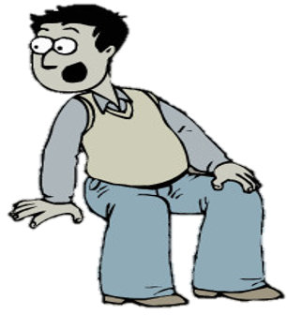
Family Activities
Wan’na have some Family Fun? Check out the puzzles and interesting activities at https://tinyurl.com/yy22d995

Slide 21
Deborah: Encouraging Faith
June 9

