Slide 1
David
August 4

Slide 2
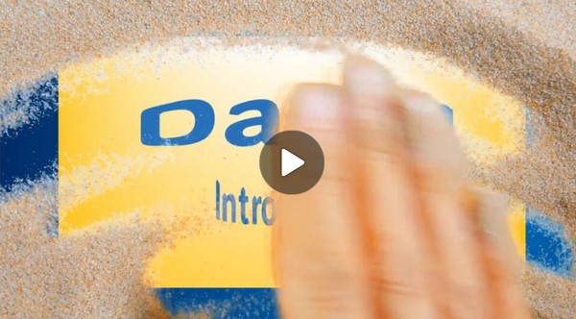
Video Introduction
View Video

Slide 3
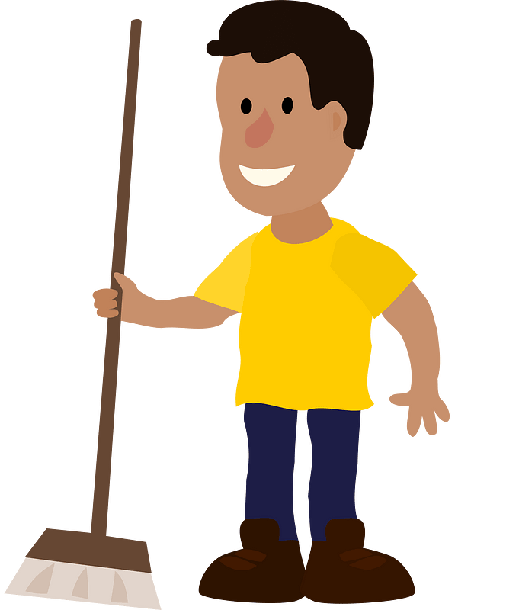
Admit it … have no shame …
What is the most menial job you have had to do?
God calls us to excellence in our lives
Serve with excellence
Even when that work is not appreciated by others.

Slide 4
Listen for successes.
1 Samuel 18:5-7 (NIV) Whatever Saul sent him to do, David did it so successfully that Saul gave him a high rank in the army. This pleased all the people, and Saul's officers as well. 6 When the men were returning home after David had killed the Philistine, the

Slide 5
Listen for successes.
women came out from all the towns of Israel to meet King Saul with singing and dancing, with joyful songs and with tambourines and lutes. 7 As they danced, they sang: "Saul has slain his thousands, and David his tens of thousands."

Slide 6
Give Your Best as a Follower
Note two preceding events that contributed to Saul’s decision to insist David reside in his house.
David brought in to play the harp when Saul was feeling depressed
David defeated the giant, Goliath

Slide 7
Give Your Best as a Follower
What are a couple of traits of David that led Saul, the troops, and others to accept him as worthy of their accolades?
What were some elements of the celebrations that took place in the cities as Saul, David, and the troops returned in triumph?

Slide 8
Give Your Best as a Follower
What motivates you to do your best at something?
What attitudes might a person need to adjust to become the best servant leader possible?
Why might David have been lauded as more of a hero than Saul from the time of his very first exploit?

Slide 9
Listen for how Saul saw David’s success.
1 Samuel 18:8-11 (NIV) Saul was very angry; this refrain galled him. "They have credited David with tens of thousands," he thought, "but me with only thousands. What more can he get but the kingdom?" 9 And from that time on Saul kept a jealous eye on David. 10 The next

Slide 10
Listen for how Saul saw David’s success.
day an evil spirit from God came forcefully upon Saul. He was prophesying in his house, while David was playing the harp, as he usually did. Saul had a spear in his hand 11 and he hurled it, saying to himself, "I'll pin David to the wall." But David eluded him twice.

Slide 11
Give Your Best Even If Not Valued
What disturbed Saul about the joyous singing of the women?
What was the source of the evil that was at work in Saul and how do you understand its having come from the Lord?
Why do you think Saul bestowed honors on David even though he resented him?

Slide 12
Give Your Best Even If Not Valued
What can cause jealousy tinged with paranoia in our lives?
What else can we learn about the destructive nature of jealousy from this passage?
What is the best way to respond to the jealousy of others towards you?

Slide 13
Listen for why David succeeded.
1 Samuel 18:12-16 (NIV) Saul was afraid of David, because the LORD was with David but had left Saul. 13 So he sent David away from him and gave him command over a thousand men, and David led the troops in their

Slide 14
Listen for why David succeeded.
campaigns. 14 In everything he did he had great success, because the LORD was with him. 15 When Saul saw how successful he was, he was afraid of him. 16 But all Israel and Judah loved David, because he led them in their campaigns.

Slide 15
Give Your Best as Honor to God
Why was Saul afraid of David?
What action did Saul take?
What words describe the quality of David’s life and what do they mean?

Slide 16
Give Your Best as Honor to God
How does humility or the lack of it influence these characters' interactions and outcomes?
How can we have an assurance of God’s presence with us in a place of responsibility?
Saul – Lack of Humility | David - Demonstrates Humility

Slide 17
Application
Confess your shortcomings.
Identify an area where you’ve not strived for excellence.
Commit to giving God your best in that area.
Keep growing by learning from your battles and helping others with their burdens.

Slide 18
Application
Give the credit to God.
When you succeed or when others compliment or praise you for a job well-done…
Thank them for the encouragement
Give God the glory
Make a list of opportunities you’ve had to praise God at the end of the week.

Slide 19
Application
Maintain your integrity.
Always do the right thing, even when others are doing the wrong thing to you.
Don’t retaliate against hate, knowing that the presence of God is there for your peace of mind and protection.
List a few adversarial people you can pray for in the coming week.

Slide 20
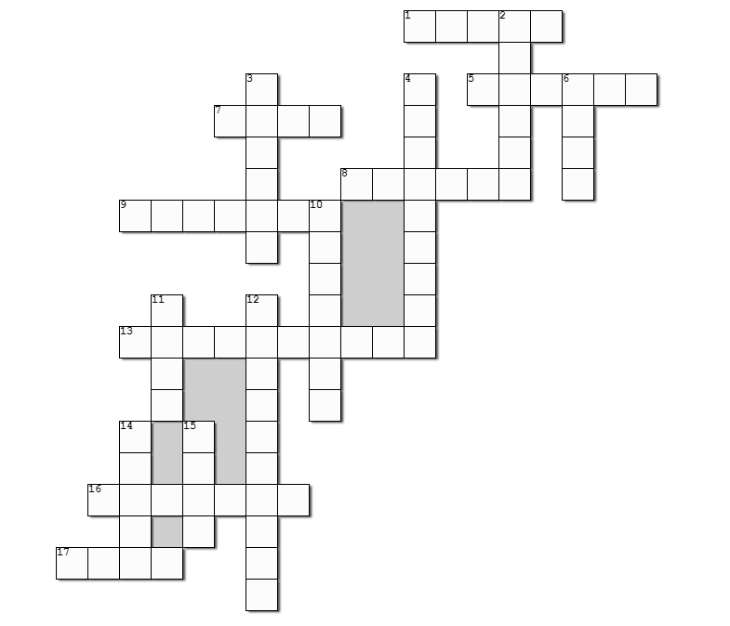
Family Activities
Attention … all clues and words are found in the Bible Study passage. No foreign embassies have contributed to this crossword puzzle. Top Secret classification has been rescinded.
Help IS provided at https://tinyurl.com/y38fpk6j

Slide 21
David
August 4

