Slide 1
David: Faith That Meets Adversity Head-on
June 22

Slide 2

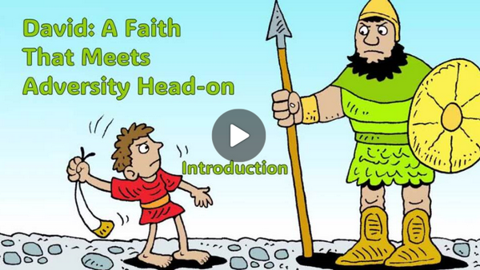
Video Introduction
View Video

Slide 3

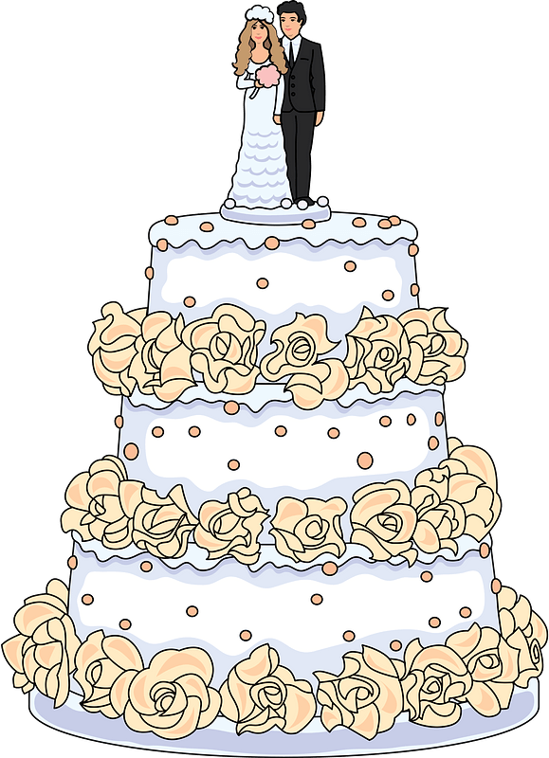
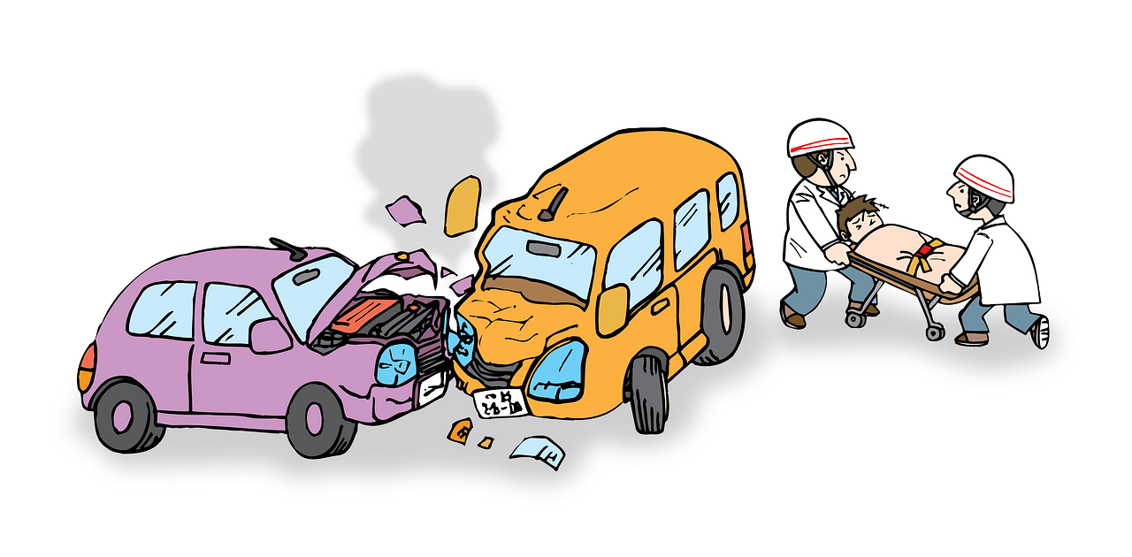
Can’t forget …
What is the most chaotic day you’ve had in recent weeks?
We never know exactly what each day will bring.
  Know that God will help us meet and defeat big challenges
  Faith moves with confidence in God

Slide 4
Listen for a potential NBA draft pick
1 Samuel 17:3-8 (NIV) The Philistines occupied one hill and the Israelites another, with the valley between them. 4 A champion named Goliath, who was from Gath, came out of the Philistine camp. He was over nine feet tall. 5 He had a bronze helmet on his head and

Slide 5
Listen for a potential NBA draft pick
wore a coat of scale armor of bronze weighing five thousand shekels; 6 on his legs he wore bronze greaves, and a bronze javelin was slung on his back. 7 His spear shaft was like a weaver's rod, and its iron point weighed six hundred shekels. His

Slide 6
Listen for a potential NBA draft pick
shield bearer went ahead of him. 8 Goliath stood and shouted to the ranks of Israel, "Why do you come out and line up for battle? Am I not a Philistine, and are you not the servants of Saul? Choose a man and have him come down to me.

Slide 7
Adversity: Display Your Faith
Lets list the specifics which caused Goliath to appear to be so invincible.
Why do you think the writer goes into such detail?
What challenge did he offer to the army of Saul?

Slide 8
Adversity: Display Your Faith
What kind of “giants” can we face in our lives—something overwhelming or intimidating?
What are some ways people typically respond when they are up against a situation that seems impossible to overcome?

Slide 9
Listen for Saul’s objection.
1 Samuel 17:32-37 (NIV) David said to Saul, "Let no one lose heart on account of this Philistine; your servant will go and fight him." 33 Saul replied, "You are not able to go out against this Philistine and fight him; you are only a boy, and he has been a fighting man from his youth." 34 But David said to Saul, "Your

Slide 10
Listen for Saul’s objection.
servant has been keeping his father's sheep. When a lion or a bear came and carried off a sheep from the flock, 35 I went after it, struck it and rescued the sheep from its mouth. When it turned on me, I seized it by its hair, struck it and killed it. 36 Your servant has killed both the lion and the bear; this uncircumcised Philistine

Slide 11
Listen for Saul’s objection.
will be like one of them, because he has defied the armies of the living God. 37 The LORD who delivered me from the paw of the lion and the paw of the bear will deliver me from the hand of this Philistine." Saul said to David, "Go, and the LORD be with you."

Slide 12
Experience Grows Faith
Why was Saul skeptical about David’s ability to defeat Goliath?
What are words and phrases that show how confident David was when he met the king?
What do you think motivated Saul to dress David in his armor?

Slide 13
Experience Grows Faith
What kinds of things do we try to use as "armor" against our "Goliaths"?
David rejected the armor … what was the source of his courage and confidence?
What sources do we have for courage and confidence?

Slide 14
Listen for David’s response to trash talk.
1 Samuel 17:45-47 (NIV) David said to the Philistine, "You come against me with sword and spear and javelin, but I come against you in the name of the LORD Almighty, the God of the armies of Israel, whom you have

Slide 15
Listen for David’s response to trash talk.
defied. 46 This day the LORD will hand you over to me, and I'll strike you down and cut off your head. Today I will give the carcasses of the Philistine army to the birds of the air and the beasts of the

Slide 16
Listen for David’s response to trash talk.
earth, and the whole world will know that there is a God in Israel. 47 All those gathered here will know that it is not by sword or spear that the LORD saves; for the battle is the LORD's, and he will give all of you into our hands."

Slide 17
Faith Moves Us Forward
What did David have to say to and about Goliath personally?
What did David have to say about the end results for other people?
What would David have to say about the end results of the battles with our “giants” when we depend on God?

Slide 18
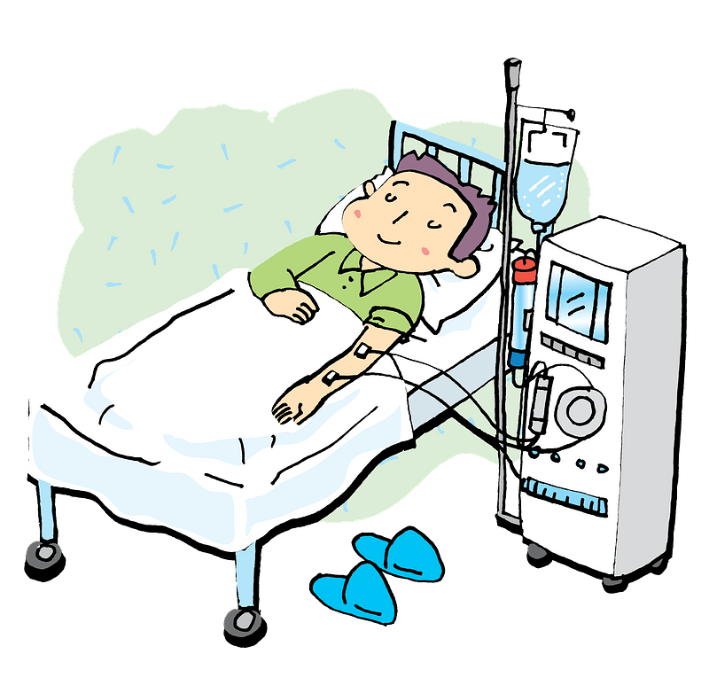
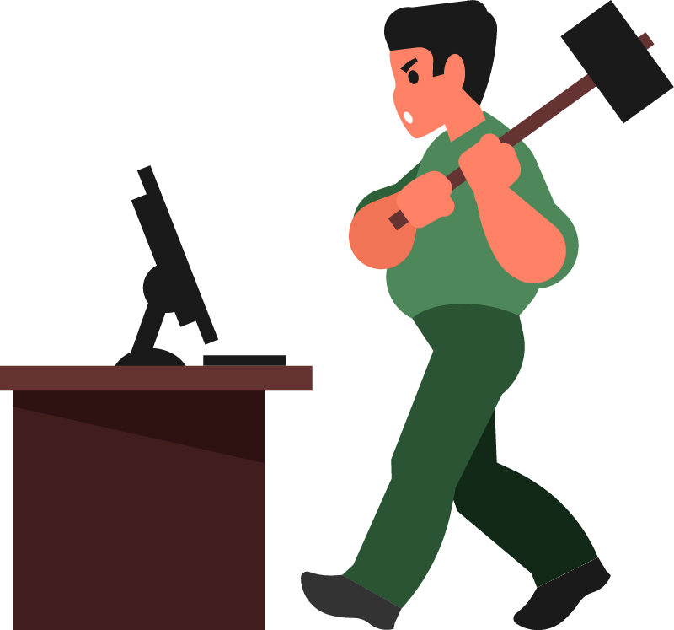
Faith Moves Us Forward
If we truly believed that our battles are the Lord's, how should we react differently to difficult circumstances?

Slide 19
Faith Moves Us Forward
Your “Goliaths” may not be so quickly eliminated
  God is still just as powerful
  His plan for you may not be like that of David
  God can and will give victory
  Keep focusing on Him long term
  We need God’s power to endure
  Ultimately the world will see God is victorious

Slide 20
Application
Remember.
  Think back to the times in your life when you faced adversity and hardships.
  Did your response reveal weak or strong faith?
  Did your actions reflect God’s Word?
  Trust God to keep His word as you pray and ask God for greater faith in adversity.

Slide 21
Application
Review.
  How did God respond when you showed strong faith?
  Remember how wonderful it felt for God to act on behalf of your faith?
  Don’t hesitate to continue to trust God as your faith grows.
  Journal the victories God has given you.

Slide 22
Application
Relationship.
  Your relationship with God will mature along with your faith.
  Teach others to strengthen their relationship with God through Scripture, prayer, and personal experience.
  Spend time mentoring someone who is working on his or her faith journey

Slide 23
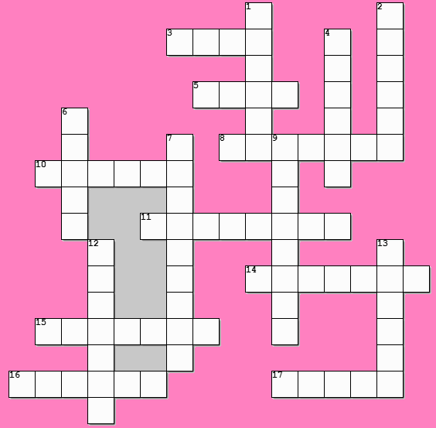
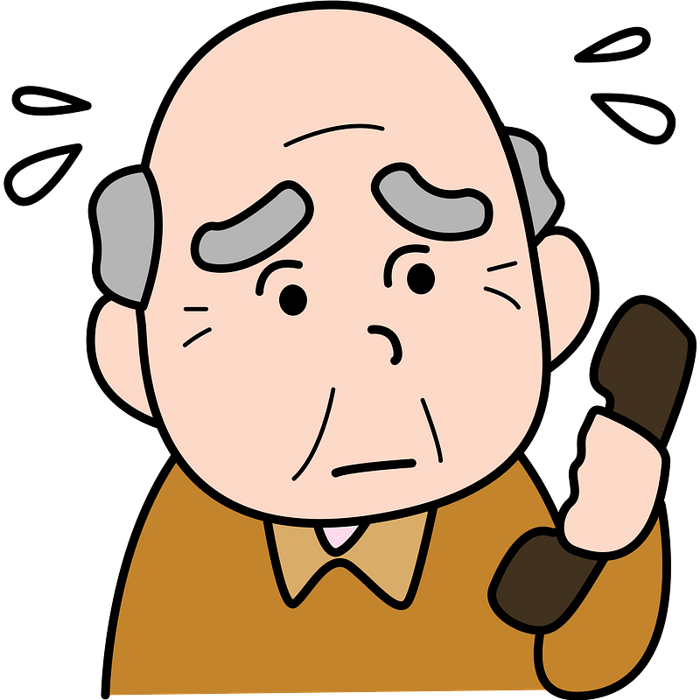
Family Activities
I’m sorry, I don’t know what word is 11-across. But you can get help at https://tinyurl.com/z6cdstshv . And the color page is available there if the crossword is too hard. Maybe if you use the portions from the Bible study, that would help.

Slide 24
David: Faith That Meets Adversity Head-on
June 22

