Slide 1
Created for a Purpose
January 17

Slide 2

Video Introduction
View Video

Slide 3



Be honest, now …
What would a personality test reveal about you?
Each of us unique as created by God.
  God values that specific combination that He created.
  He has created each unique individual for a unique purpose.

Slide 4

Listen for God’s message.
Jeremiah 1:4-5 (NIV) The word of the LORD came to me, saying, 5 "Before I formed you in the womb I knew you, before you were born I set you apart; I appointed you as a prophet to the nations."

Slide 5
God’s Purpose for Every Life
What made this event in Jeremiah’s life one he felt compelled to give attention to?
What four actions were attributed to God and what is the significance of each in giving value to a person?
God’s Action | Significance

Slide 6
God’s Purpose for Every Life
What difference can it make to know that God knew us and set us apart even before our birth?
God gave Jeremiah a specific task. When have you felt called or drawn to accomplishing a specific task?
We don’t know how God spoke to Jeremiah … maybe in a dream or vision, maybe from an angel messenger. How can God speak to us and give us specific directions today?

Slide 7
Listen for Jeremiah’s initial response.
Jeremiah 1:6-8 (NIV) 6 "Ah, Sovereign LORD," I said, "I do not know how to speak; I am only a child." 7 But the LORD said to me, "Do not say, 'I am only a child.' You must go to everyone I send you to and say whatever I command you. 8 Do not be afraid of them, for I am with you and will rescue you," declares the LORD.

Slide 8
God’s Enabling for God’s Purpose
What were Jeremiah’s excuses, God’s responses and promises?
Jeremiah’s Excuses | God’s Responses and Commands

Slide 9
God’s Enabling for God’s Purpose
What are some excuses we use for not doing what God commands us to do? What reservations do you have about your ability to serve God according to His call?
How do God’s reassurances to Jeremiah (and to us) help and encourage?
How do excuses rob us of the blessings that result from faithful service?

Slide 10
Listen for how God equips Jeremiah.
Jeremiah 1:9-10 (NIV) Then the LORD reached out his hand and touched my mouth and said to me, "Now, I have put my words in your mouth. 10 See, today I appoint you over nations and kingdoms to uproot and tear down, to destroy and overthrow, to build and to plant."

Slide 11
God’s Equipping for God’s Purpose
What did God do to address Jeremiah’s concern about being able to declare God’s message?
What else indicates God’s message has global implications?
Note the two contrasting categories. What are negative elements in our culture to work against?

Slide 12

God’s Equipping for God’s Purpose
On the other side, what are some things that need to be built and planted?
In what ways does God equip us to do His work?

Slide 13

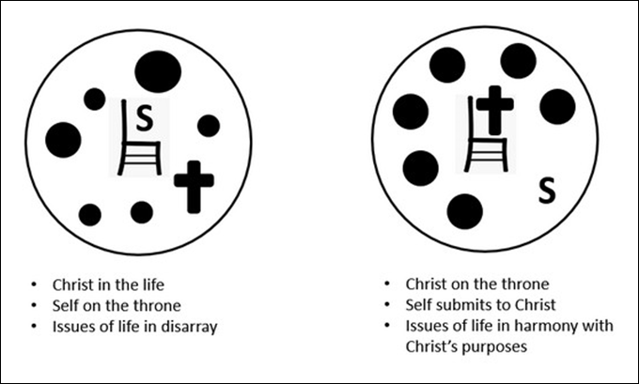
God’s Equipping for God’s Purpose
How do we make ourselves available for God to use us?

Slide 14
Application
Seek.
  Pray and seek God’s face.
  Ask Him to show you the ways He can use you for His kingdom.

Slide 15
Application
Surrender.
  Put your “yes” on the table and trust God to empower us for His service.
  Step out in obedience, trusting the power of the Holy Spirit, and carry out God’s calling on your life.

Slide 16
Application
Support.
  Support and encourage people who are forgotten or overlooked by others.
  Find practical ways to help those whom the culture deems helpless because God values them and has a purpose for them.

Slide 17
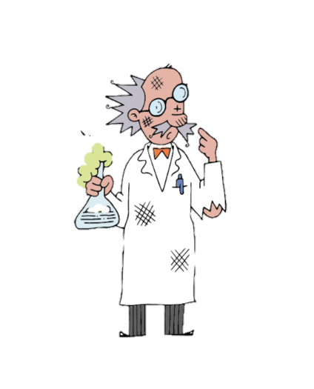
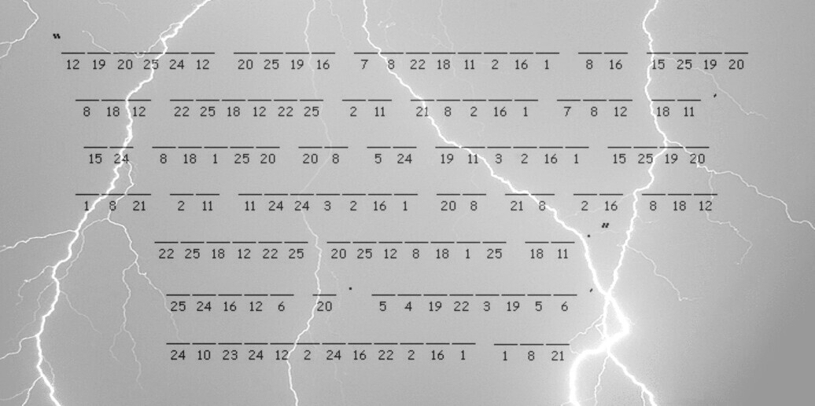
Family Activities
Not sure what level of electrostatic charge did that. You’ll need to get that decoded and passed along as soon as possible before it goes poof. If you need technical assistance, go to https://tinyurl.com/y9gj5wkv . There’s also other data available for everyone

Slide 18
Created for a Purpose
January 17

