Slide 1
Convicted by the Spirit
June 5

Slide 2
Video Introduction
View Video

Slide 3
Remember that time …
When did you think you had lost something only to discover it was never lost to begin with?
The disciples were beginning to fear the loss of their leader, Jesus.
Jesus now tells them He will be with them in a different way.
The Holy Spirit would come to guide them, empower them, convict them of sin and point to the truth of salvation.

Slide 4
Listen for who testifies.
John 15:26-27 (NIV) "When the Counselor comes, whom I will send to you from the Father, the Spirit of truth who goes out from the Father, he will testify about me. 27 And you also must testify, for you have been with me from the beginning.

Slide 5
Jesus Sends the Holy Spirit
What did Jesus reaffirm to the disciples?
How is the truth of the union of the Trinity, the Father, Son, and Spirit seen in verse 26?
Why do you think it is important that Jesus called Him the “Spirit of Truth?”

Slide 6
Jesus Sends the Holy Spirit
The Greek word used for counselor has to do with one who “comes along side.” When you hire a counselor, what kind of service do you anticipate? How will they come alongside?
What are ways in which the Holy Spirit testifies/witnesses about Christ?
What does this have to do with Jesus instruction in verse 27?

Slide 7
Jesus Sends the Holy Spirit
In what ways does the Holy Spirit enable us to be witnesses?

Slide 8
Listen for the convincing work of the Spirit.
John 16:7-11 (NIV) But I tell you the truth: It is for your good that I am going away. Unless I go away, the Counselor will not come to you; but if I go, I will send him to you. 8 When he comes, he will convict the world of guilt in regard to sin and

Slide 9
Listen for the convincing work of the Spirit.
righteousness and judgment: 9 in regard to sin, because men do not believe in me; 10 in regard to righteousness, because I am going to the Father, where you can see me no longer; 11 and in regard to judgment, because the prince of this world now stands condemned.

Slide 10
The Spirit Convicts/Convinces of Sin
What advantage would come to the disciples only if Jesus went away to the Father? What did Christ’s going away have to do with the coming of the Holy Spirit?
What work of the Holy Spirit does Jesus introduce and what are the three areas to which it is applied?

Slide 11
The Spirit Convicts/Convinces of Sin
What are some ways the Holy Spirit helps us recognize our sins?
Why is it a positive thing to be convicted of your sin?

Slide 12
Listen for how Jesus is glorified.
John 16:12-15 (NIV) "I have much more to say to you, more than you can now bear. 13 But when he, the Spirit of truth, comes, he will guide you into all truth. He will not speak on his own; he will speak only what he hears, and he will tell

Slide 13
Listen for how Jesus is glorified.
you what is yet to come. 14 He will bring glory to me by taking from what is mine and making it known to you. 15 All that belongs to the Father is mine. That is why I said the Spirit will take from what is mine and make it known to you.

Slide 14
The Holy Spirit Guides to Truth
What work of the Spirit does Jesus identify in verse 13?
Whose message does the Spirit declare and to whom does He bring glory?

Slide 15
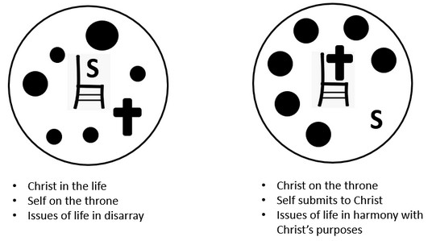
The Holy Spirit Guides to Truth
What are some obstacles that can prevent us from clearly hearing from the Holy Spirit?
Verse 14 speaks of the Spirit’s task to glorify Jesus. Why is it so important that the Spirit always points to Jesus?

Slide 16
Application
Think.
When has the Holy Spirit provided specific guidance for you?
Recall the details of that event and then thank Him for speaking truth into your life.

Slide 17
Application
Decide.
Hearing the voice of the Holy Spirit above all the other voices that call out to you is a necessity.
Decide today to investigate the many biblical ways the Holy Spirit can speak.

Slide 18
Application
Act.
We’re all a work in process, being shaped more and more into the image of Christ.
Maybe there’s an area of your life that needs a course correction.
You know what area it is because the Holy Spirit has told you, perhaps repeatedly.
Confess your sin and form an action plan to be more faithful in that area of your life.

Slide 19
Family Activities
Another case of substandard glue. The letters slid down the page. We need your help because the Word Ninja is taking final exams this week. He left a link for tech help https://tinyurl.com/3a3yvhah where there are other items of intrigue also available.

Slide 20
Convicted by the Spirit
June 5

