Slide 1
Contentment
August 17

Slide 2


Video Introduction
View Video

Slide 3
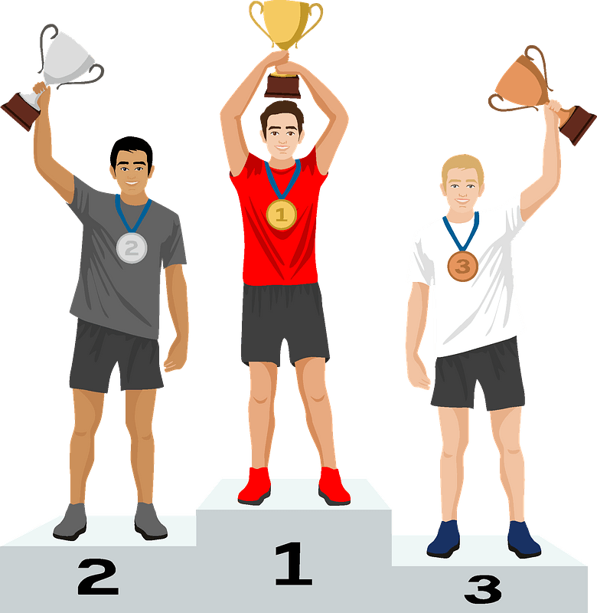

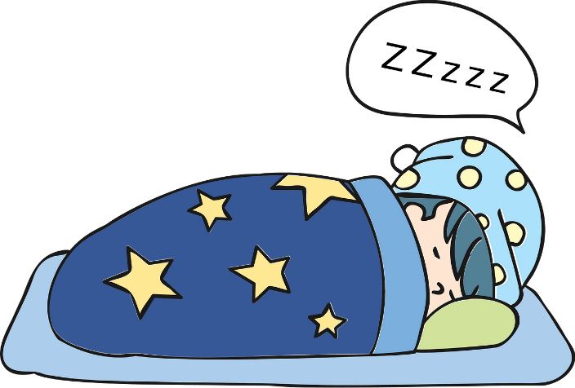
Think about this …
What experiences bring you the most contentment?
It’s easy to think that our “stuff” or our experiences dictate whether or not we are content
Actually true contentment comes through Christ alone.
Today we look at Paul’s teaching of the contentment that God gives.

Slide 4
Listen for a contentment.
Philippians 4:10-12a (NIV) I rejoice greatly in the Lord that at last you have renewed your concern for me. Indeed, you have been concerned, but you had no opportunity to show it. 11 I am not saying this because I am in need, for I have learned to be content whatever the circumstances. 12 I know what it is to be in need, and I know what it is to have plenty.

Slide 5
More than Right Circumstances
What prompted Paul to rejoice in the Lord?
How would you describe what it means to be content?
What are some enemies of contentment in today’s culture? Why do you think so many people are discontent?

Slide 6
More than Right Circumstances
What experiences had Paul gone through that had taught him contentment?
What steps can we take to learn to be more content?

Slide 7
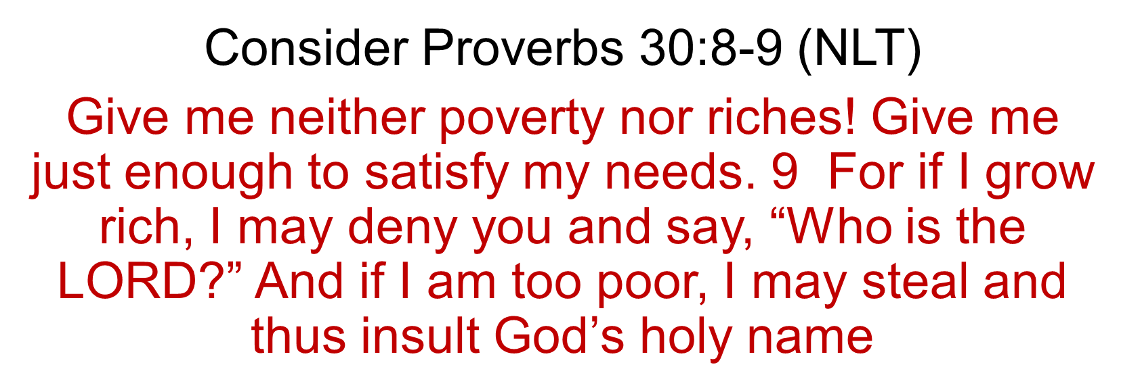
More than Right Circumstances

Slide 8
Listen for a secret.
Philippians 4:12b -14 (NIV) I have learned the secret of being content in any and every situation, whether well fed or hungry, whether living in plenty or in want. 13 I can do everything through him who gives me strength. 14 Yet it was good of you to share in my troubles.

Slide 9
Grounded in Christ
What do you think Paul means by “I have learned the secret of being content”? What might that secret be?
Paul’s view of contentment challenges the way our culture views success and satisfaction. How can someone “have it all” and still not be content?

Slide 10
Grounded in Christ
Think of a time in your life where you felt content despite difficult circumstances. What helped you stay grounded during that time?

Slide 11
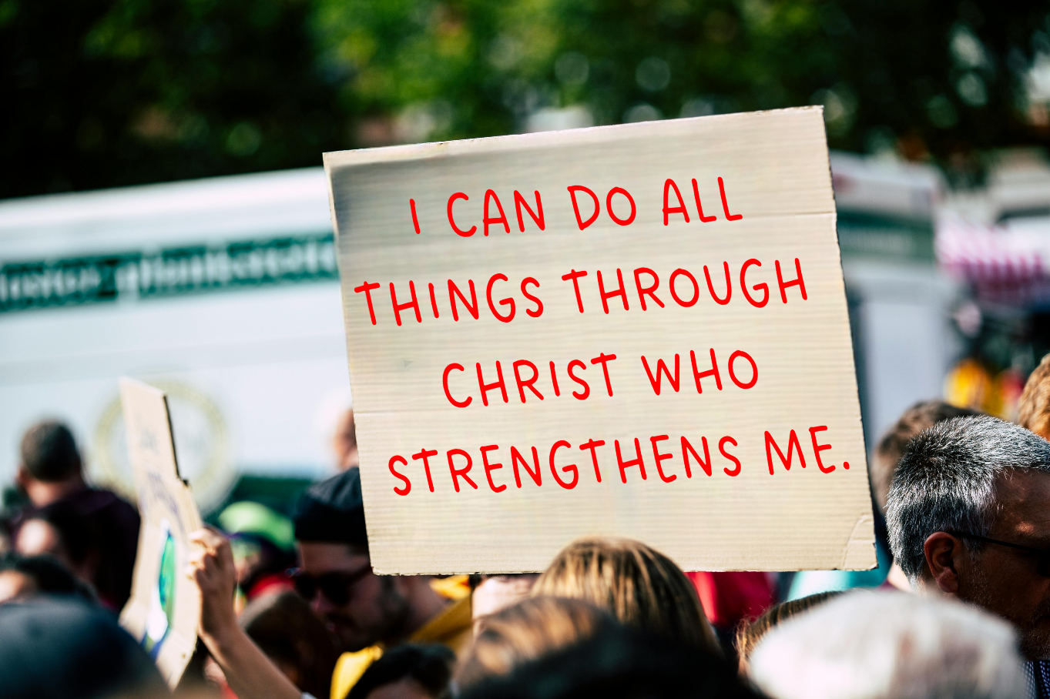
Grounded in Christ
High School football cheerleaders in Texas displayed this banner …
They were accused of promoting religion in public schools
How might this verse be used out of context?

Slide 12
Grounded in Christ
What might it look like to “learn contentment” in your own life? What are some practical ways to pursue this?

Slide 13
Listen for how Paul had been supported.
Philippians 4:15-20 (NIV) Moreover, as you Philippians know, in the early days of your acquaintance with the gospel, when I set out from Macedonia, not one church shared with me in the matter of giving and receiving, except you only; 16 for even when I was in Thessalonica, you sent

Slide 14
Listen for how Paul had been supported.
me aid again and again when I was in need. 17 Not that I am looking for a gift, but I am looking for what may be credited to your account. 18 I have received full payment and even more; I am amply supplied, now that I have received from Epaphroditus the

Slide 15
Listen for how Paul had been supported.
gifts you sent. They are a fragrant offering, an acceptable sacrifice, pleasing to God. 19 And my God will meet all your needs according to his glorious riches in Christ Jesus. 20 To our God and Father be glory for ever and ever. Amen.

Slide 16
God’s Provision
What history did Paul have with receiving support from the Philippian Christians? What was his point in noting their faithfulness in giving in the past?
What did Paul say about giving being an act of worship?

Slide 17
God’s Provision
The Philippian Christians helped Paul when he needed it; how are you able to help others in trouble?
How can supporting others … those in need … those in spiritual ministries … be the result of contentment?

Slide 18
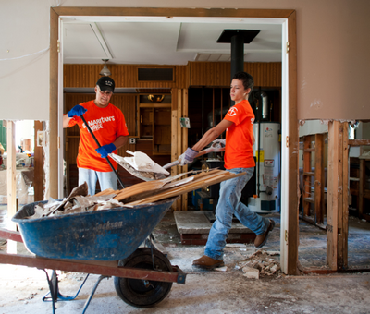
God’s Provision
How does giving financially make us partners in ministry, not just contributors?

Slide 19
Application
Monitor.
Don’t make discontentment worse by comparing yourself and your situation to that of others.
Make a gratitude list of all the things for which you are thankful.

Slide 20
Application
Ask.
Give a close friend or a spouse permission to point out anytime your conversation reflects a dissatisfaction with your status in life.
Promise them that you won’t get mad when they do.

Slide 21
Application
Give.
Look for a worthy kingdom ministry or mission to which you can make a financial contribution over and above your regular giving to your church.
Find one that your church supports or one in which someone you know serves.

Slide 22
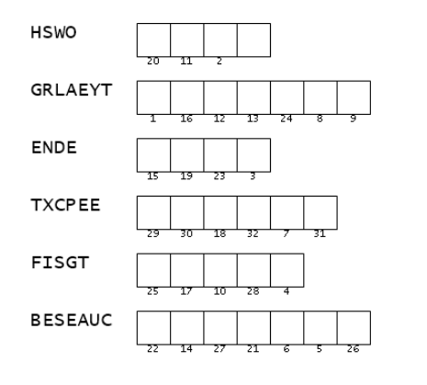

Family Activities
We got this to the Baptist Consulate in Czechti Ijanden. Can you help decode our message. Unscramble words that came from the Bible Study. Use the numbers to complete the message. If you’re stuck, go to https://tinyurl.com/2ncexrc9 You might also want to do the color page !

Slide 23
Video Introduction
View Video

