Slide 1
Connecting to Christ’s Body
February 21

Slide 2
Video Introduction
View Video

Slide 3
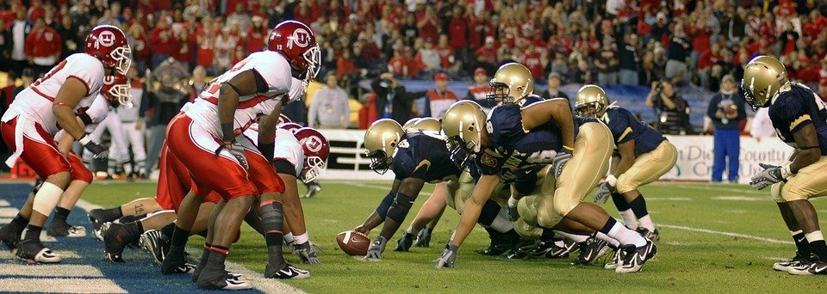
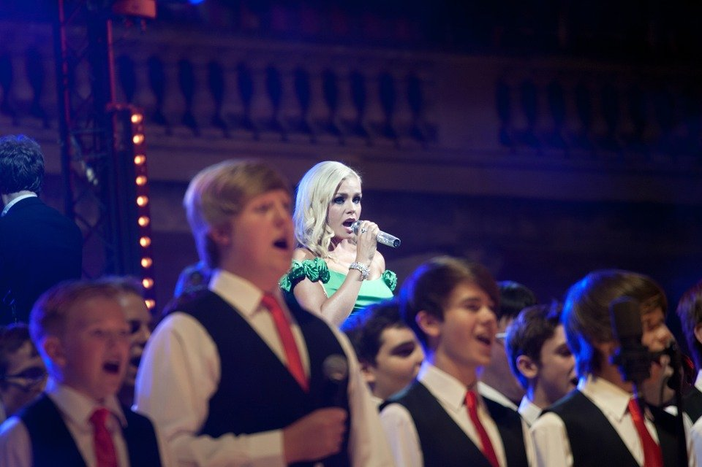
Think about it …
When has being part of a group really helped you succeed?
Working as a team multiplies our efforts as individuals.
This is especially true as members of the Body of Christ, the Church
Spiritual growth calls for regular interaction with and ministry to other believers.

Slide 4
Listen for an analogy.
1 Corinthians 12:12-13 (NIV) The body is a unit, though it is made up of many parts; and though all its parts are many, they form one body. So it is with Christ. 13 For we were all baptized by one Spirit into one body--whether Jews or Greeks, slave or free--and we were all given the one Spirit to drink.

Slide 5
One United Body
According to this passage, in what way are Christians (the body of believers) like a human body?
In what way was the human body an apt illustration?
In what ways are believers bound together as one?
The Human Body | The Body of Believers

Slide 6
One United Body
What are the benefits of unity in the church?
What are some ways we can maintain unity in the church?

Slide 7
Listen for the attitude “I don’t belong”.
1 Corinthians 12:14-18 (NIV) Now the body is not made up of one part but of many. 15 If the foot should say, "Because I am not a hand, I do not belong to the body," it would not for that reason cease to be part of the body. 16 And if the ear should say, "Because I am not an eye, I do not belong to the body," it would not

Slide 8
Listen for the attitude “I don’t belong”.
for that reason cease to be part of the body. 17 If the whole body were an eye, where would the sense of hearing be? If the whole body were an ear, where would the sense of smell be? 18 But in fact God has arranged the parts in the body, every one of them, just as he wanted them to be..

Slide 9
Roles and Responsibilities within the Body
Why is every member of the church important to the church’s ability to function effectively?
Why should members not brag about or disparage the gifts they have been given or minimize the value of the grace-gifts God has given to others?
Who arranged the parts of the body of Christ? Why is that significant?

Slide 10
Roles and Responsibilities within the Body
What body parts come to action when you receive an injury such as a cut?
What elements of the Body of Christ come to action when our church communicates the Gospel message?

Slide 11
Listen why every believer is needed.
1 Corinthians 12:19-24 (NIV) If they were all one part, where would the body be? 20 As it is, there are many parts, but one body. 21 The eye cannot say to the hand, "I don't need you!" And the head cannot say to the feet, "I don't need you!" 22 On the contrary, those parts of the body that seem to be weaker are indispensable,

Slide 12
Listen why every believer is needed.
and the parts that we think are less honorable we treat with special honor. And the parts that are unpresentable are treated with special modesty, 24 while our presentable parts need no special treatment. But God has combined the members of the body and has given greater honor to the parts that lacked it,

Slide 13
Each Believer a Necessary Part of the Body
What did Paul conclude would be the result if each body part were the same?
By implication, what would be the result if we all had the same gift or role within the Body of Christ? Why shouldn’t all Christians perform the same function?
What would be the consequences of this kind of disunity in the church?

Slide 14
Each Believer a Necessary Part of the Body
According to Paul’s argument, which parts of a physical body seem to be treated most honorably?
Why do people often assume that certain duties in the Body of Believers are more important?

Slide 15
Each Believer a Necessary Part of the Body
Why should the “less honorable” parts be treated with special attention?
How can you honor the contributions of others in your church?

Slide 16
Application
Talk to someone new.
Get to know someone in your church you do not know or do not know well.
Make an intentional effort to build a relationship with the person.

Slide 17
Application
Restore a relationship.
If you are at odds with someone in your church, get together with the person and seek to work the problem out.
If you need to confess a wrong attitude or wrong behavior, then do it, and seek to restore that relationship.

Slide 18
Application
Step out and serve.
Use some of your vacation time to immerse yourself in a new culture and serve a people group that is unfamiliar to you.
Be part of a mission work that serves the body of Christ in another culture or setting.

Slide 19
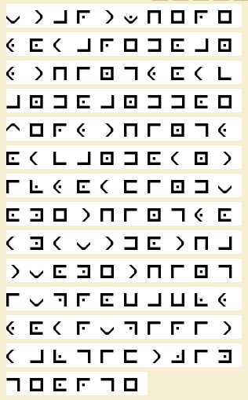
Family Activities
I found this in a secret message drop under a rug in the Zilny Egeor National Hotel. I passed it on to Spiros, but his decoder expert has been grounded by his mother. You can help. If you get stuck, go to tinyurl.com/2uccbmu9. By solving other puzzles there, your family can build one another up as you use your mental and spiritual gifts.

Slide 20
Connecting to Christ’s Body
February 21

