Slide 1
Confident Faith
February 18

Slide 2
Video Introduction
View Video

Slide 3
Be honest, now …
When have you worried about something that turned out to be no big deal?
In today’s Bible passage, Jesus tells us not to worry.
Faith displaces worry
Test tomorrow
Clunk … Clunk!

Slide 4
Listen for why not to worry.
Luke 12:22-26 (NIV) Then Jesus said to his disciples: "Therefore I tell you, do not worry about your life, what you will eat; or about your body, what you will wear. 23 Life is more than food, and the body more than clothes. 24 Consider the ravens: They do not sow or reap, they have

Slide 5
Listen for why not to worry.
no storeroom or barn; yet God feeds them. And how much more valuable you are than birds! 25 Who of you by worrying can add a single hour to his life? 26 Since you cannot do this very little thing, why do you worry about the rest?

Slide 6
Worry Does Not Help
Jesus says,
“Don’t worry about life”
“Don’t worry about stuff, like food, health, clothes”
Why don’t the birds worry?
Why do you think people tend to worry?
How might we justify worrying?

Slide 7
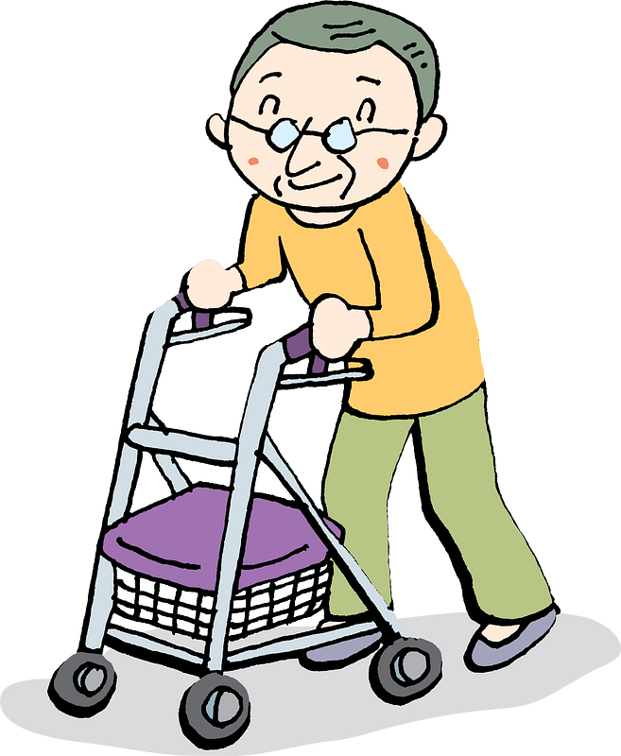
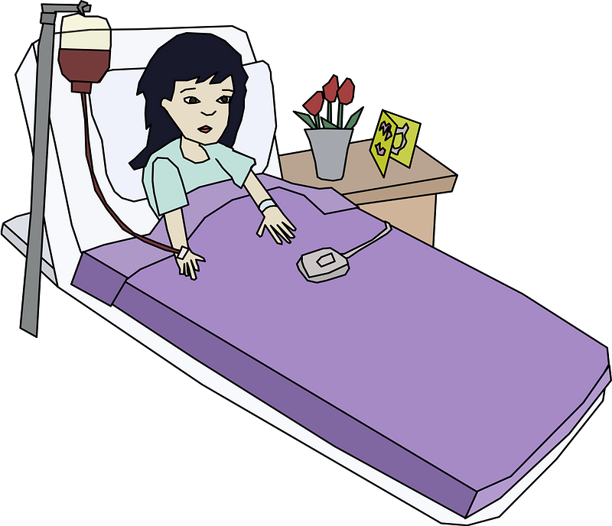
Worry Does Not Help
Why do we worry about food and clothes?
What situations bring out the worrier in you?

Slide 8
Listen for God’s awareness.
Luke 12:27-30 (NIV) "Consider how the lilies grow. They do not labor or spin. Yet I tell you, not even Solomon in all his splendor was dressed like one of these. 28 If that is how God clothes the grass of the field, which is here today, and tomorrow

Slide 9
Listen for God’s awareness.
is thrown into the fire, how much more will he clothe you, O you of little faith! 29 And do not set your heart on what you will eat or drink; do not worry about it. 30 For the pagan world runs after all such things, and your Father knows that you need

Slide 10
God Knows what We Need
What do flowers teach us?
What conclusion did Jesus draw from the illustration?
What kinds of things are we prone to classify as a need that is really a want?
Why do you think Jesus might also say to us, “Oh ye of little faith”?

Slide 11
God Knows what We Need
Consider these truths about how we can increase our faith …
Anyone’s faith is only as good as the object of that faith
We must become convinced that the Object of our faith (Jesus) is capable
We do that by getting to know Jesus better … reading, studying, applying His word
We also do that by talking to Him in prayer … telling Him not only your needs, but confessing your worries, your lack of faith

Slide 12
God Knows what We Need
When have you experienced God knowing exactly what you needed?

Slide 13
Listen for how faith displaces worry.
Luke 12:31-34 (NIV) But seek his kingdom, and these things will be given to you as well. 32 "Do not be afraid, little flock, for your Father has been pleased to give you the kingdom. 33 Sell your possessions and give to the poor.

Slide 14
Listen for how faith displaces worry.
Provide purses for yourselves that will not wear out, a treasure in heaven that will not be exhausted, where no thief comes near and no moth destroys. 34 For where your treasure is, there your heart will be also.

Slide 15
Seek the Kingdom, Trust the Father
The Kingdom of God is the realm where God rules. How can a person seek God’s kingdom?
What are some ways in which we can make God’s kingdom our first priority with our resources?

Slide 16
Seek the Kingdom, Trust the Father
How can we store up treasure in heaven?
What do you think Jesus meant by “Provide purses for yourselves that will not wear out”?

Slide 17
Seek the Kingdom, Trust the Father
Giving of yourself to God’s work is like investing money and receiving compounded interest.
God receives your investment of time, talent, treasure
God multiplies that investment
You end up getting more back than what you put in
The returns are eternal … contrasted with a bank’s returns

Slide 18
Application
Inventory.
List the things that you’ve been worrying about during this season of life.
What are some specific actions you can take to let go of those worrisome thoughts?

Slide 19
Application
Give.
What do you have in your storage space that would be valued more by someone else?
Make some room by giving those things away and enjoy the extra space created by their absence.

Slide 20
Application
Pray.
Ask God to show you how you can be more connected to what he’s doing in your church.
Ask God to lead you to your call and passion, whether it’s going overseas to serve in disaster relief or perhaps just mentoring a fatherless third grader.

Slide 21
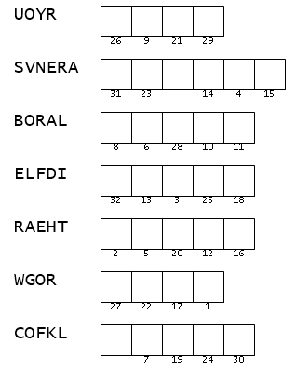
Family Activities
Spiros the Spy needs our help. He’s struggling with worry in Guadutusoraq. If you can unscramble these words from your Bible passage, we can decrypt the message and send him the reassurance he needs. You can get help at http://tinyurl.com/4yrmw2vd And the crossword is there also, if missing it gives you hives.

Slide 22
Confident Faith
February 18

