Slide 1
Confidence in the
Face of Fear
October 24

Slide 2

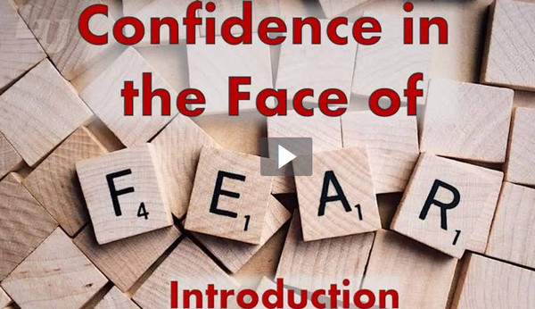
Video Introduction
View Video

Slide 3
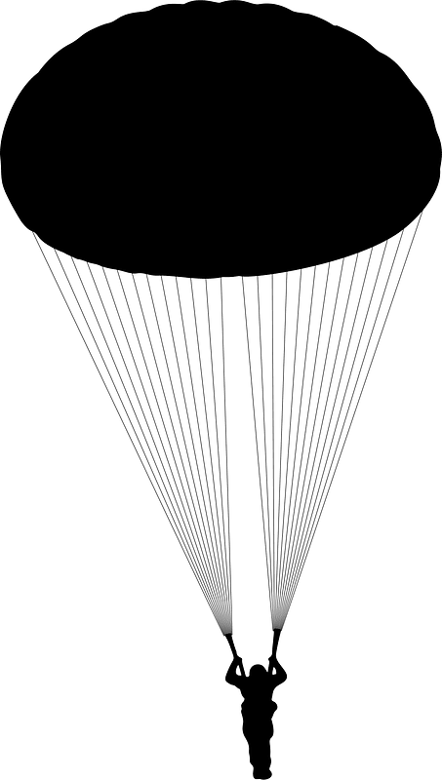

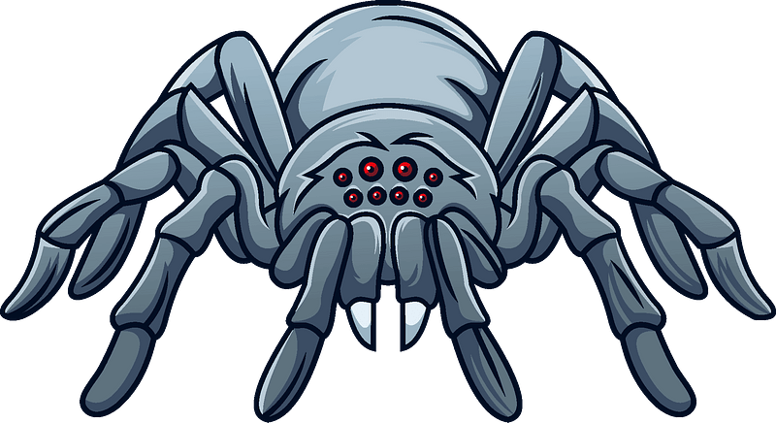
Admit it, now …
What are some things others might fear that cause you no fear at all?
Probably all of us have at least a few things we fear or dread.
  Today we study Abram’s actions when he had a specific fear.
  We learn that we can trust God when we are overwhelmed with fear

Slide 4
Listen for how Abram didn’t trust God.
Genesis 12:10-13 (NIV) Now there was a famine in the land, and Abram went down to Egypt to live there for a while because the famine was severe. 11 As he was about to enter Egypt, he said to his wife Sarai, "I know what a beautiful

Slide 5
Listen for how Abram didn’t trust God.
woman you are. 12 When the Egyptians see you, they will say, 'This is his wife.' Then they will kill me but will let you live. 13 Say you are my sister, so that I will be treated well for your sake and my life will be spared because of you."

Slide 6
Trust God Despite Circumstances
What situation resulted in Abram’s traveling to Egypt?
What fear surfaced for him as he arrived there?
What was his plan to alleviate his fear of being harmed?
What were the flaws in taking such an approach?

Slide 7
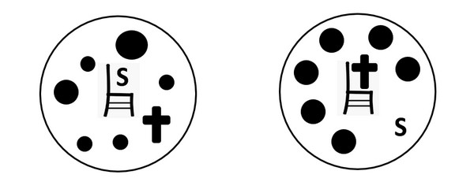
Trust God Despite Circumstances
What are some ways fear can lead to sin? What are some situations that can cause us to fear instead of trusting God?
We contrast the Spirit led life on the right with what we call the “carnal” Christian on the left.
In what kinds of situations can we be tempted to respond as a carnal Christian; professing love for God but living for yourself; protecting yourself, your rights, your dreams?

Slide 8
Trust God Despite Circumstances
What are some ways that we can return to God’s promises as New Testament believers?
How might insisting your own way on social media be expressing fear or acting in fear?

Slide 9
Listen for how Abram’s fear affected others.
Genesis 12:17-20 (NIV) But the LORD inflicted serious diseases on Pharaoh and his household because of Abram's wife Sarai. 18 So Pharaoh summoned Abram. "What have you done to me?" he said. "Why didn't you tell me she was your wife?

Slide 10
Listen for how Abram’s fear affected others.
Why did you say, 'She is my sister,' so that I took her to be my wife? Now then, here is your wife. Take her and go!" 20 Then Pharaoh gave orders about Abram to his men, and they sent him on his way, with his wife and everything he had.

Slide 11
Our Fear Can Affect Others
What happened to Pharaoh and his household because of Abram’s deceptive plan generated by his fear?
What perceptions about Abram are implied by the Pharaoh’s comments to him?
What action did Pharaoh take?

Slide 12
Our Fear Can Affect Others
What implies Pharaoh may not have trusted Abram to depart on his own?
How does the enemy use fear to wreak havoc in our lives?
How can fear affect our witness?

Slide 13
Listen for how Abram gets back on track.
Genesis 13:1-4 (NIV) So Abram went up from Egypt to the Negev, with his wife and everything he had, and Lot went with him. 2 Abram had become very wealthy in livestock and in silver and gold. 3 From the Negev he went from place

Slide 14
Listen for how Abram gets back on track.
place to place until he came to Bethel, to the place between Bethel and Ai where his tent had been earlier 4 and where he had first built an altar. There Abram called on the name of the LORD.

Slide 15
Return to Trust and Worship of God
Where did Abram go after being expelled from Egypt?
What may have been the spiritual significance of eventually returning to Bethel?
What did he do once he arrived?

Slide 16
Return to Trust and Worship of God
What are some obstacles we face to returning to God after failure?
How does God’s Word, our roadmap, help us get back on track after unwise “detours?”

Slide 17
Application
Reflect.
  Be honest.
  Take some time and ask yourself how your level of faith and level of fear have been affecting you and those around you.
  Identity a specific fear that you need to focus less on and then shift that focus more on the Father.

Slide 18
Application
Confess.
  Take a quick break and self-evaluate if there are any half-truths that you may be covering up due to fear.
  Confess it today. Remember concealing keeps you from healing.

Slide 19
Application
Worship.
  Do an Internet search for a list of different names of God that are found in the Scriptures.
  Take some time and contemplate each title.
  Allow each name of God to deepen your understanding and fear of Him, while at the same time increasing your faith in His mercy

Slide 20
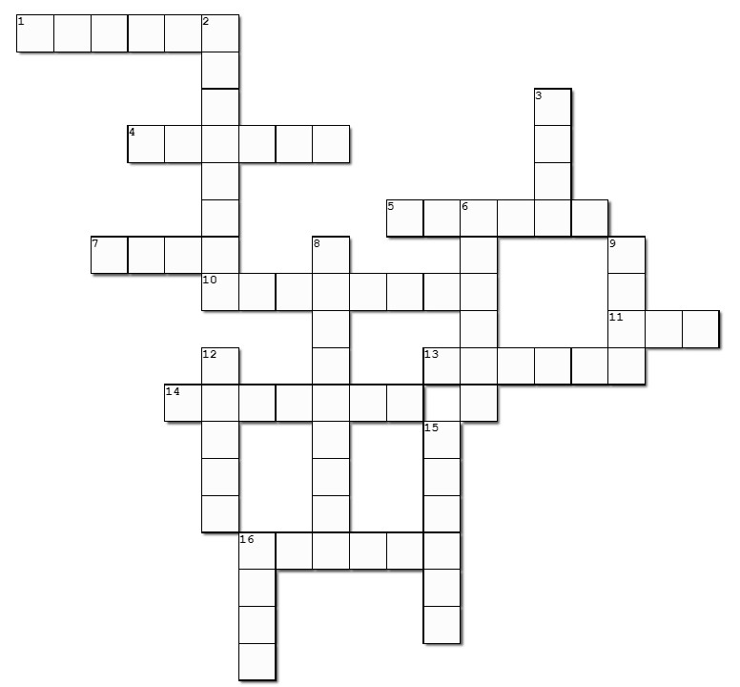
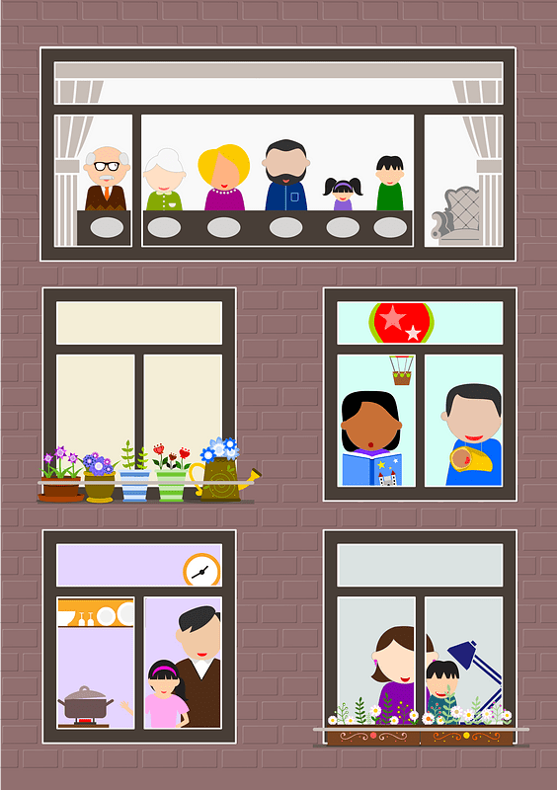
Family Activities
I like the word search.
It’s about time for the crossword!
Humph!
But I want the color page!

Slide 21

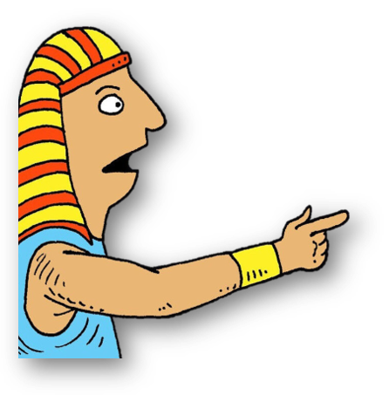
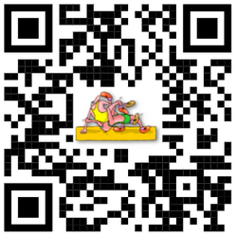
Family Discussion Video
You have a chance to see if you would respond in Fear or respond with Faith … find out what your family thinks.

Slide 22
Confidence in the
Face of Fear
October 24

