Slide 1
Confidence in Times of Testing
November 28

Slide 2
Video Introduction
View Video

Slide 3
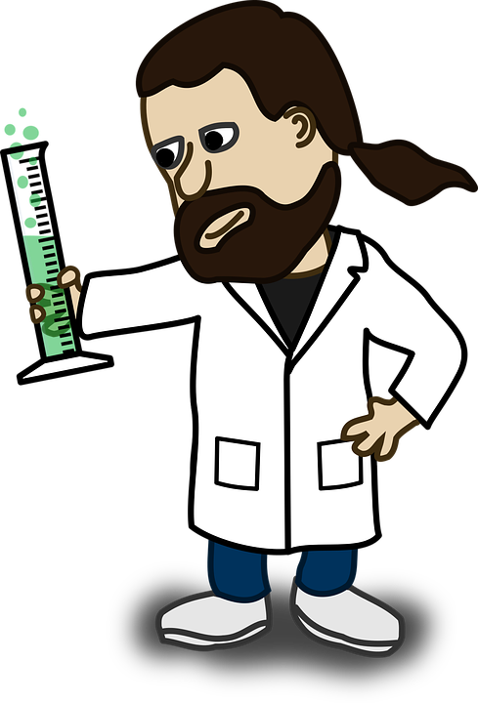
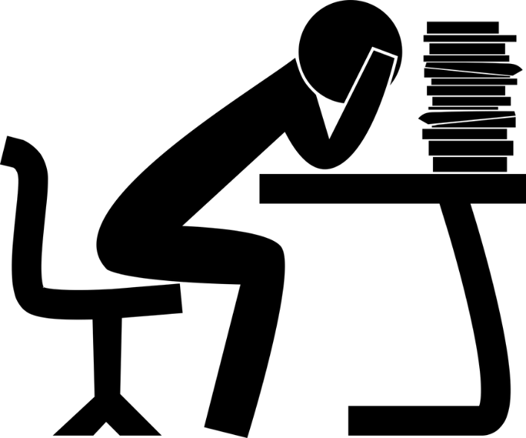
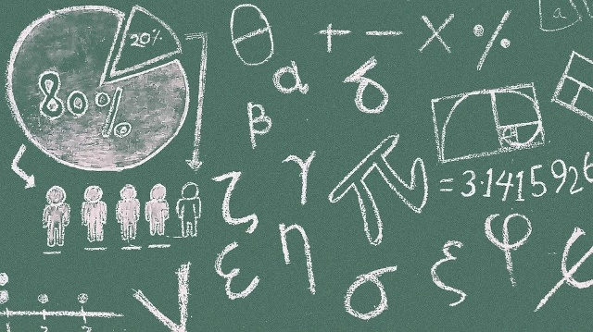
Be honest, now …
In school, what was the most difficult test you had to take?
Today we look at a test God gave to Abraham.
There are more difficult tests in life than in school.
When our faith is tested during those situations, trust God.

Slide 4
Listen for God’s test of Abraham.
Genesis 22:1-2 (NIV) Some time later God tested Abraham. He said to him, "Abraham!" "Here I am," he replied. 2 Then God said, "Take your son, your only son, Isaac, whom you love, and go to the region of Moriah. Sacrifice him there as a burnt offering on one of the mountains I will tell you about."

Slide 5
Faith Will Be Tested
What three imperatives summarize the task God gave to Abraham?
In what ways might this task seem counterintuitive to the promises God had made to Abraham?
Teachers give tests to find out if students know the material. If God is omniscient, knows all things, why do you think He decided to give Abraham this test?
⇨ We must be willing to separate ourselves from anything and give it over to God’s control

Slide 6
Faith Will Be Tested
How would you describe the difference between temptation and testing?
What kinds of feelings or thoughts do you think Abraham experienced?
Note that these initial feelings and thoughts are normal …
⇨Initial fear and struggling with obedience are OK
Temptation | Testing

Slide 7
Faith Will Be Tested
However, how could this have been a temptation for Abraham? How might he respond and it not be OK to doubt God’s goodness and wisdom
What kinds of obedience tests does God place before us?

Slide 8
Listen for how Abraham trusted God.
Genesis 22:3-10 (NIV) Early the next morning Abraham got up and saddled his donkey. He took with him two of his servants and his son Isaac. When he had cut enough wood for the burnt offering, he set out for the place God had told him about. 4 On the third day Abraham looked up and saw the place in the distance.

Slide 9
Listen for how Abraham trusted God.
He said to his servants, "Stay here with the donkey while I and the boy go over there. We will worship and then we will come back to you." 6 Abraham took the wood for the burnt offering and placed it on his son Isaac, and he himself carried the fire and the knife. As the two of them went on together, Isaac spoke up and said to his father Abraham, "Father?" "Yes, my son?"

Slide 10
Listen for how Abraham trusted God.
Abraham replied. "The fire and wood are here," Isaac said, "but where is the lamb for the burnt offering?" 8 Abraham answered, "God himself will provide the lamb for the burnt offering, my son." And the two of them went on together.

Slide 11
Listen for how Abraham trusted God.
When they reached the place God had told him about, Abraham built an altar there and arranged the wood on it. He bound his son Isaac and laid him on the altar, on top of the wood. 10 Then he reached out his hand and took the knife to slay his son.

Slide 12
Trust God in the Test
Identify the actions in these verses that indicate Abraham intended to carry out the instructions of God.
What would be hard about each of these tasks?
We previously listed examples of tests God takes us through. In what ways do we demonstrate faith?

Slide 13
Trust God in the Test
Abraham told the servants, “We will worship and then we will come back to you." What could he have been implying by that?
What tips might Abraham have about obedience for us?

Slide 14
Listen for God’s timing.
Genesis 22:11-14 (NIV) But the angel of the LORD called out to him from heaven, "Abraham! Abraham!" "Here I am," he replied. 12 "Do not lay a hand on the boy," he said. "Do not do anything to him. Now I know that you fear God, because you have not withheld from me your son, your only son."

Slide 15
Listen for God’s timing.
Abraham looked up and there in a thicket he saw a ram caught by its horns. He went over and took the ram and sacrificed it as a burnt offering instead of his son. 14 So Abraham called that place The LORD Will Provide. And to this day it is said, "On the mountain of the LORD it will be provided."

Slide 16
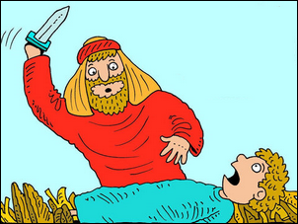
God Provides on Time
How did God spare Isaac’s life?
What reasons does God give for stopping him from killing Isaac?
God provided a substitute sacrifice, a ram caught in the thicket. How does this story anticipate or parallel what God would do through His Son, Jesus ?
Art by Richard Gunther

Slide 17
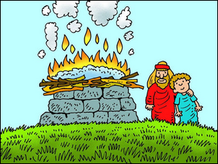
Listen for God’s timing.
What lessons do you think Isaac learned from this experience?
Art by Richard Gunther

Slide 18
Application
Ask.
Where might God be testing you with what seems like a ridiculous request?
Have you been delaying, or are you obeying promptly?
Where might the enemy be tempting you physically or mentally to get off course?

Slide 19
Application
Remember.
Take a moment to look back on God’s track record in your life.
Write down where you have seen God show off His power.
Take some time now and ask God to continue to show off in your seasons of testing.

Slide 20
Application
Share.
Where have you seen God’s prevention as protection played out in your life?
Take some time right now to thank Him for that prevention.
Then share that testimony with someone who may need to hear it in the coming days.

Slide 21
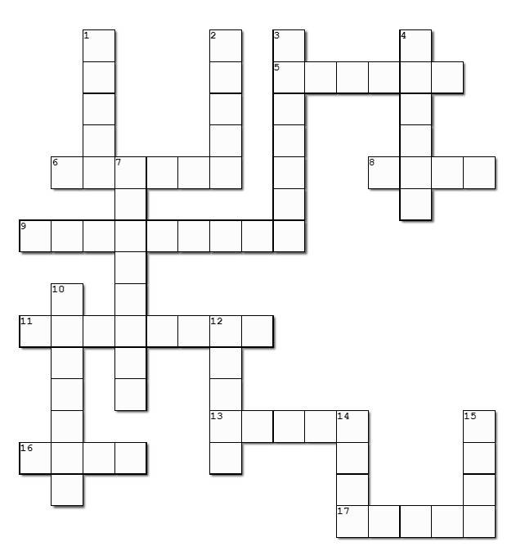
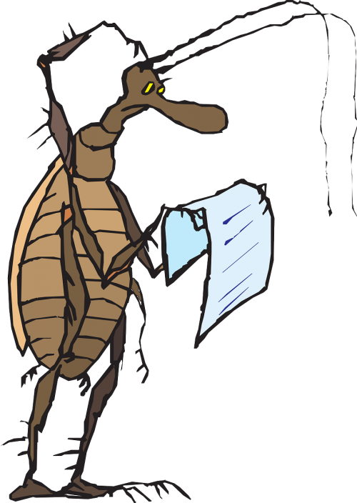
Family Activities
Aiee Cucaracha! Hope you people know the clues and words come from Genesis 22. If you need help or also want to try the Cryptography puzzle, go to https://tinyurl.com/56az7n5f

Slide 22
Confidence in Times of Testing
November 28

