Slide 1
Confidence After We Fail
November 14

Slide 2
Video Introduction
View Video

Slide 3
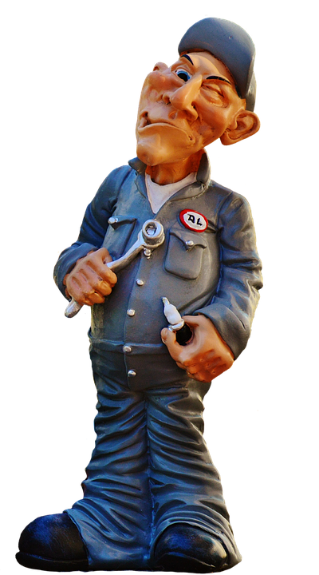
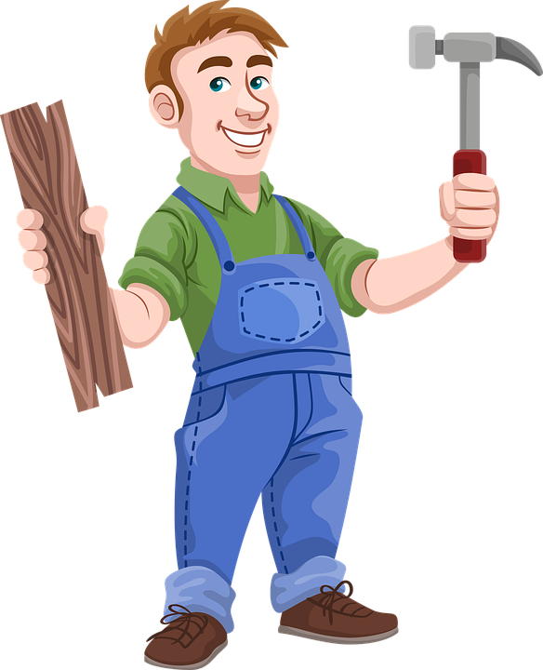
Come on, admit it …
When have you had a scheme that you concocted backfire on you?
After we have one of those situations, we can be afraid to try anything else new.
Failures can discourage and disappoint
God wants to redeem our failures

Slide 4
Listen for Sarai’s “solution”.
Genesis 16:1-5 (NIV) Now Sarai, Abram's wife, had borne him no children. But she had an Egyptian maidservant named Hagar; 2 so she said to Abram, "The LORD has kept me from having children. Go, sleep with my maidservant; perhaps I can build a family through her." Abram agreed to what Sarai said. 3 So after Abram had been living in

Slide 5
Listen for Sarai’s “solution”.
Canaan ten years, Sarai his wife took her Egyptian maidservant Hagar and gave her to her husband to be his wife. 4 He slept with Hagar, and she conceived. When she knew she was pregnant, she began to despise her mistress. 5 Then

Slide 6
Listen for Sarai’s “solution”.
Sarai said to Abram, "You are responsible for the wrong I am suffering. I put my servant in your arms, and now that she knows she is pregnant, she despises me. May the LORD judge between you and me."

Slide 7
Don’t Take Matters into Your Own Hands
What was Sarai’s plan to deal with her barrenness?
What about the plan proved it to be ill-conceived?
How did Sarai respond after Hagar became pregnant?
When are we tempted to take shortcuts?

Slide 8
Don’t Take Matters into Your Own Hands
Why are we tempted to take ungodly steps to achieve a godly goal?
So, what was wrong with Abram sleeping with Hagar to gain an heir?
God has given us a mind, so how can we know when to rely on logic as we are trying to serve God faithfully?

Slide 9
Listen for what God expects of Abram.
Genesis 17:1-3 (NIV) When Abram was ninety-nine years old, the LORD appeared to him and said, "I am God Almighty; walk before me and be blameless. 2 I will confirm my covenant between me and you and will greatly increase your numbers." 3 Abram fell facedown, and God said to him,

Slide 10
Do What God Expects of You
Note the chronology of this event in relationship to Abram’s initial call and even the event involving Sarai and Hagar.
Abram now 99 years old
Initial call was when he was 75
86 when Ishmael was born (Gen. 16)

Slide 11
Do What God Expects of You
God expects His people to walk with Him in faith and to walk before Him in a way that is pleasing to Him
How did the Lord identify Himself?
What two expectations did He have for Abram?
What do you think God meant by “walk before me?”
What about the blameless? Is that an impossible perfection?

Slide 12
Do What God Expects of You
How might Abram be struggling with God’s plan for his life?
How do we struggle with accepting God's will for our lives?
⇨ We should know that God is able to do all that is needed

Slide 13
Listen for covenant details.
Genesis 17:4-9 (NIV) "As for me, this is my covenant with you: You will be the father of many nations. 5 No longer will you be called Abram; your name will be Abraham, for I have made you a father of many nations. 6 I will make you very fruitful; I will make nations of you,

Slide 14
Listen for covenant details.
and kings will come from you. 7 I will establish my covenant as an everlasting covenant between me and you and your descendants after you for the generations to come, to be your God and the God of your descendants after you. 8 The whole land of Canaan,

Slide 15
Listen for covenant details.
where you are now an alien, I will give as an everlasting possession to you and your descendants after you; and I will be their God." 9 Then God said to Abraham, "As for you, you must keep my covenant, you and your descendants after you for the generations to come.

Slide 16
God Seeks a Covenant Relationship
What promise did the Lord reaffirm?
Though the covenant was described as everlasting, what expectation did the Lord have for Abraham and his descendants?
What is the relevance of God's covenant with Abraham have for us today?
What kinds of things does God make new in our lives as we walk with Him?

Slide 17
Application
Own it.
Take some time and ask God to search out your heart.
Identify any mistakes or failures that rise to the surface.
Stop pretending. Stop playing the game. Stop hiding and take responsibility.
Now is the time to own up to it.

Slide 18
Application
Confess it.
Don’t delay; remember every moment counts.
Literally change your position right now if you are physically able and get on your knees.
Go before the holy living God and seek His forgiveness.
Let Him know how much you hate that specific sin in your life.

Slide 19
Application
Believe it.
Remember His forgiveness is instant; it is not a journey.
Trust in the power of His forgiveness.
Don’t doubt it. Stand up. Suit up. The dirt is gone. You are clean. Keep playing.
Then tell someone else about the victory He has given you.

Slide 20
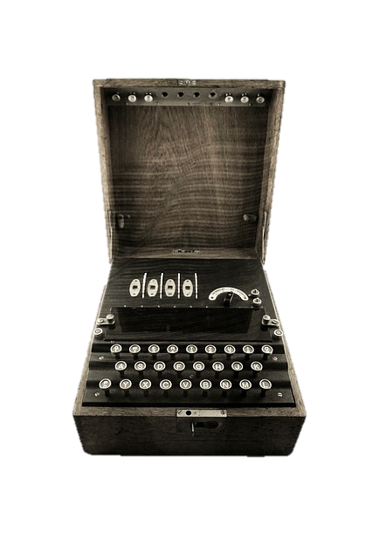
Family Activities
You won’t need a German Enigma machine for this secret message. Just use the secret key and note how it works. Our in-house decoders are busy at a Lego Robotics competition. Help them out

Slide 21
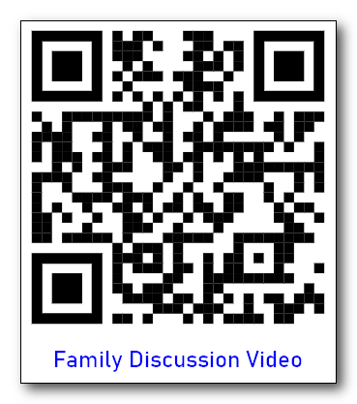
Family Discussion Time
Use the QR code on the handout

Slide 22
Confidence After We Fail
November 14

