Slide 1
Wholehearted Confession
October 1

Slide 2

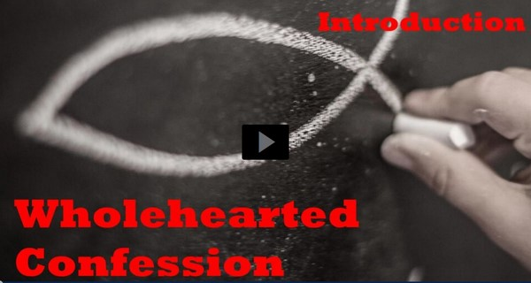
Video Introduction
View Video

Slide 3



Admit it, now …
What is your favorite place to hide or go to when you want to be left alone?
We might want to get away from people, but we want to stay close to God.
  Today we look at Daniel’s prayer of confession.
  Confession and repentance keep us close to God.

Slide 4
Listen for Daniel’s attitude.
Daniel 9:3-6 (NIV) So I turned to the Lord God and pleaded with him in prayer and petition, in fasting, and in sackcloth and ashes. 4 I prayed to the LORD my God and confessed: "O Lord, the great and awesome God, who keeps his covenant of love with all who love him and obey

Slide 5
Listen for Daniel’s attitude.
his commands, 5 we have sinned and done wrong. We have been wicked and have rebelled; we have turned away from your commands and laws. 6 We have not listened to your servants the prophets, who spoke in your name to our kings, our princes and our fathers, and to all the people of the land.

Slide 6
Confession Is Necessary
What words describe Daniel’s attitude in prayer?
What do those words say about what the attitude should be of any petitioner who comes before the Lord?
What is the significance of fasting, sackcloth, and ashes?

Slide 7
Confession Is Necessary
Where did Daniel get his understanding and motivation for his prayer?
What words and phrases did Daniel use to describe the characteristics of God?

Slide 8
Confession Is Necessary
Why do you think Daniel would begin his prayer with these words?
How does our attitude toward God affect our belief that He will answer prayer?

Slide 9
Listen for a contrast between good and bad.
Daniel 9:7-10 (NIV) "Lord, you are righteous, but this day we are covered with shame--the men of Judah and people of Jerusalem and all Israel, both near and far, in all the countries where you have scattered us because of our unfaithfulness to you. 8 O LORD, we and our kings, our

Slide 10
Listen for a contrast between good and bad.
princes and our fathers are covered with shame because we have sinned against you. 9 The Lord our God is merciful and forgiving, even though we have rebelled against him; 10 we have not obeyed the LORD our God or kept the laws he gave us through his servants the prophets.

Slide 11
Confession Draws Focus to God
What characteristics of the people do you see in contrast to God's character? You may also see some additional characteristics of God.
Why is it hard to say, “I have sinned”?
We see no blaming, no making excuses – why is it important to take responsibility for our lives and admit we are wrong?

Slide 12
Confession Draws Focus to God
What kinds of sins do we struggle with that we need to confess to God?
When we approach God in prayer we would do well to begin as Daniel did
  Adoration of god
  Confession of our own faults
We need to focus on who God is … not launch right into our list of “gimme’s”

Slide 13
Listen for Daniel’s prayer requests.
Daniel 9:17-19 (NIV) "Now, our God, hear the prayers and petitions of your servant. For your sake, O Lord, look with favor on your desolate sanctuary. 18 Give ear, O God, and hear; open your eyes and see the desolation of the city that bears your Name

Slide 14
Listen for Daniel’s prayer requests.
We do not make requests of you because we are righteous, but because of your great mercy. 19 O Lord, listen! O Lord, forgive! O Lord, hear and act! For your sake, O my God, do not delay, because your city and your people bear your Name."

Slide 15
Trust in God’s Mercy and Grace
As Daniel closed his prayer, what are various appeals he made to the Lord?
According to Daniel, for whose sake was he raising this prayer?
What is the relationship between trust, confession, and forgiveness?

Slide 16
Trust in God’s Mercy and Grace
We must come before God in prayer focusing on who He is … not on what we want!
How does the truths of Gods mercy and grace help us to pray for ourselves, our families, our nation?
Thus, we have every reason to believe that God wants to hear and answer our prayers.
Consider the sequence we see in Daniel’s prayer
  Adoration, confession
  And only then do we see requests, petitions

Slide 17
Application
Rejoice.
  As you spend time with God this week, compile a written list of attributes that show Him to be great and awe inspiring.
  Add to your list daily.
  Then affirm these attributes to Him in prayer.
  Let this be your offering of praise.

Slide 18
Application
Repent.
  Ask God to show you where sin has crept into your life, where you have “fallen short” of what you ought to be or do.
  Confess those to Him and ask for His forgiveness.

Slide 19
Application
Restore.
  If there are areas in which your sin has negatively affected your relationship with others, confess those sins to them and ask for their forgiveness.
  Explain that God is at work in you, and as a result, you want to make things right between you.

Slide 20
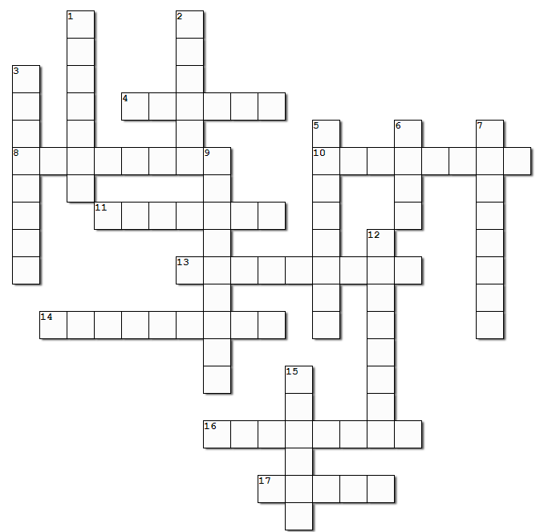

Family Activities
Hooray! The Crossword is back! If some of you folks would rather do the Word Search, go to https://tinyurl.com/5e4e3vc9 where there’s see a new twist on that puzzle. That web page also has help for the Crossword

Slide 21
Wholehearted Confession
October 1

