Slide 1
Compelled to Act
January 18

Slide 2

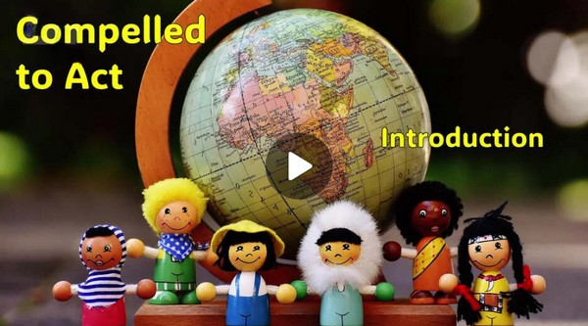
Video Introduction
View Video

Slide 3
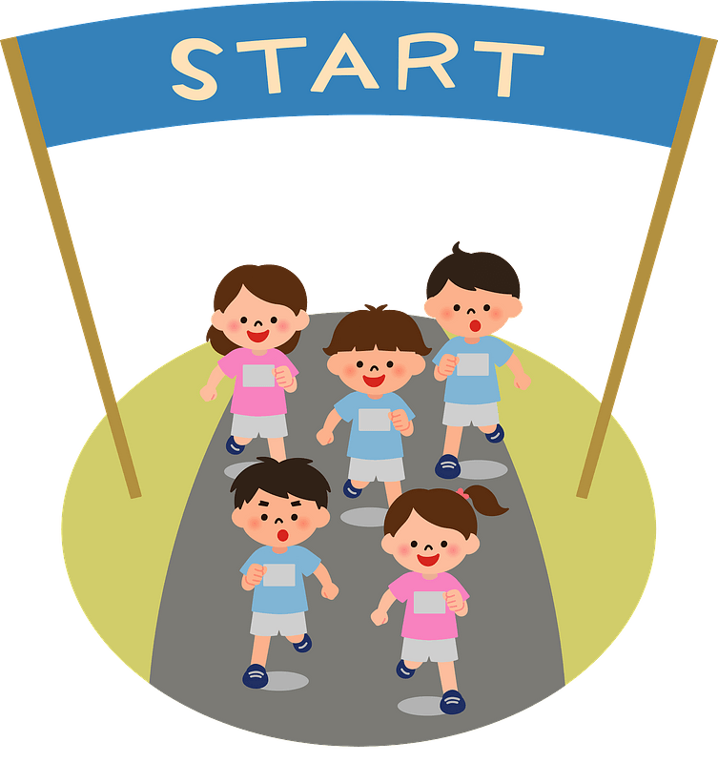


Yes, I remember …
When have you thought, “uh oh, brace yourself”?
Sometimes those moments affect you personally, other times it is friends or family.
  It’s normal to look out for yourself.
  But, let the fear and majesty of God compel you to look out for others.

Slide 4

Listen for Job’s motivation.
Job 31:13-15 (NIV) "If I have denied justice to my menservants and maidservants when they had a grievance against me, 14 what will I do when God confronts me? What will I answer when called to account? 15 Did not he who made me in the womb make them? Did not the same one form us both within our mothers?

Slide 5
We Are All God’s Handiwork
What example did Job use in these verses to show he treated others as equals, worthy of his just attention, and with respect for common rights?
What two reasons, expressed through rhetorical questions, did Job give for his attitude toward others?

Slide 6
We Are All God’s Handiwork
In verses 13–15, what reason does Job give for treating his servants justly?
If I have denied justice … what will I do when God confronts me? What will I answer when called to account?

Slide 7
We Are All God’s Handiwork
How does his view of God as Creator shape how he views other people?
How does Job’s logic in verse 15 apply to the unborn—those who cannot speak or advocate for themselves?
Did not he who made me in the womb make them? Did not the same one form us both within our mothers?

Slide 8
We Are All God’s Handiwork
Why do you think Job frames compassion for others as a matter of reverence toward God rather than kindness alone?
How can a humble view of ourselves lead to fair treatment of others?

Slide 9
Listen for specific people in need.
Job 31:16-20 (NIV) "If I have denied the desires of the poor or let the eyes of the widow grow weary, 17 if I have kept my bread to myself, not sharing it with the fatherless-- 18 but from my youth I reared him as would

Slide 10
Listen for specific people in need.
a father, and from my birth I guided the widow-- 19 if I have seen anyone perishing for lack of clothing, or a needy man without a garment, 20 and his heart did not bless me for warming him with the fleece from my sheep,

Slide 11
Accountable to Help Others
Who are those Job specifically identified he had been diligent to help in time of need?
"If I have denied the desires of the poor or let the eyes of the widow grow weary, if I have kept my bread to myself, not sharing it with the fatherless- … if I have seen anyone perishing for lack of clothing, or a needy man

Slide 12
Accountable to Help Others
What did he imply he had done for each group?
How does our abundance create a responsibility to help those who are in need?
What does this passage suggest about God’s concern for people affected by tragedy (loss, disaster, disability, or injustice)?

Slide 13
Accountable to Help Others
What excuses do people make for not helping people in need?
How can we train our eyes to see the needs of those who are vulnerable?

Slide 14
Listen for hyperbole, exaggeration for effect.
Job 31:21-23 (NIV) if I have raised my hand against the fatherless, knowing that I had influence in court, 22 then let my arm fall from the shoulder, let it be broken off at the joint. 23 For I dreaded destruction from God, and for fear of his splendor I could not do such things.

Slide 15
Seek Justice for Others
What situation is described in verse 21?
What cultural issues today may require you to stand alone in doing right?
Job treats neglect of the needy as a serious moral failure. What forms of “looking away” or “ignoring” might be common for believers today?
if I have raised my hand against the fatherless, knowing that I had influence in court …

Slide 16
Seek Justice for Others
In light of these kinds of excuses we might use, how does Job 31 challenge that mindset?
What are some ways our church can work against injustice toward the vulnerable in our community?

Slide 17
Application
Pray for help.
  Every day this week, ask God to reshape your perspective.
  Specifically regarding powerless people who need you to help them.

Slide 18
Application
Share your concern.
  Talk with others in your Bible study group.
  Consider specific ways God intends for growing believers to look out for people in need.

Slide 19
Application
Meet a need.
  Take the initiative to serve God.
  Locate and volunteer at a Christ-centered pregnancy clinic or a shelter for individuals or families in crisis.

Slide 20
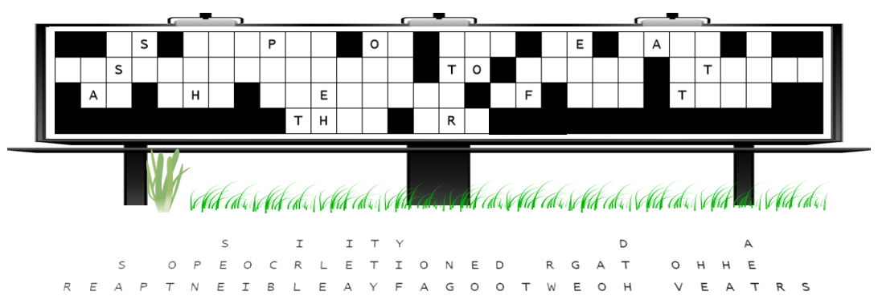
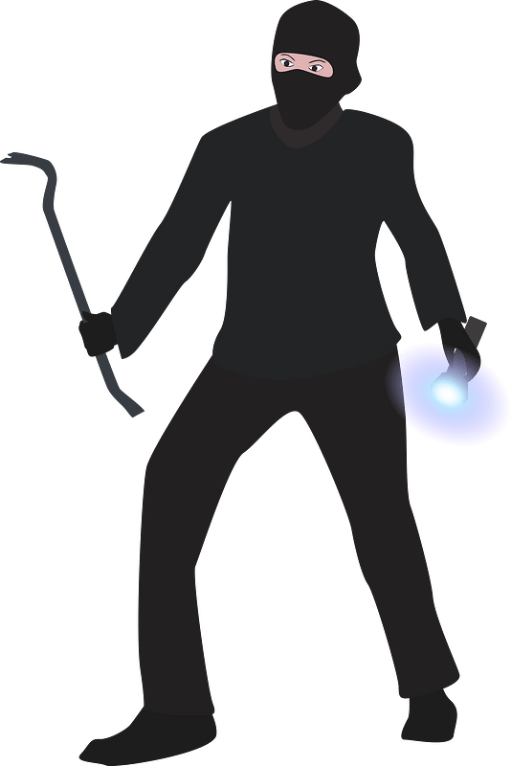
Family Activities
Whoo-eee … what FUN! You’ll never get that message back in time for this week. You’d have to work on columns with single letters missing and short words first. And I won’t tell you that Jack Webb, himself, is looking into this.

Slide 21
Compelled to Act
January 18

