Slide 1
Committed to Pray
November 15

Slide 2
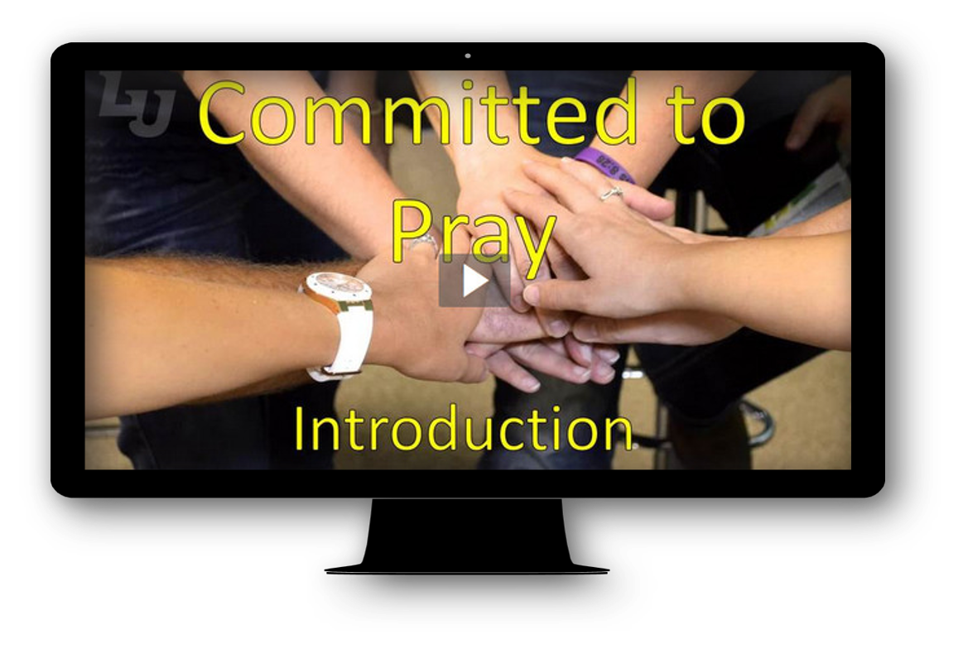
Video Introduction
View Video

Slide 3
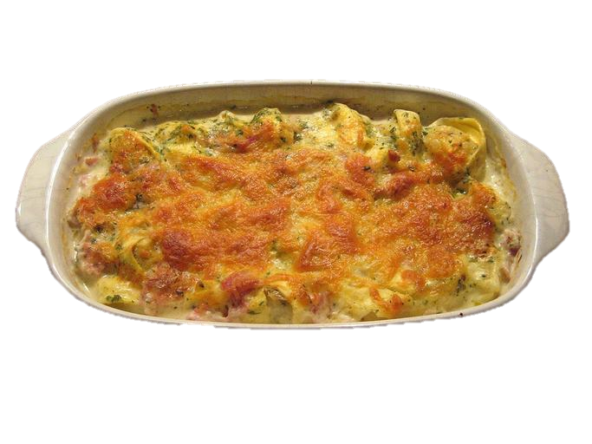

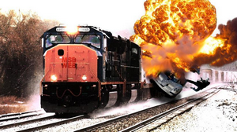
Be honest, now …
What would we learn about you from your recent calls or social media interactions?
We all have a variety of friends and interests.
  We like to follow people we know and share our views
  This week we look at God’s challenge to pray for the salvation and spiritual growth of these same people.

Slide 4
Listen for why Paul prays.
Colossians 1:3-6a (NIV) We always thank God, the Father of our Lord Jesus Christ, when we pray for you, 4 because we have heard of your faith in Christ Jesus and of the love you have for all the saints-- 5 the faith and love that spring from the hope that is stored up for you in heaven and that you have already heard about in the word of truth, the gospel that has come to you.

Slide 5
Thankful for Other Believers
What is the nature of the prayer with which Paul began his letter to the Colossians?
What moved him to pray with such gratitude?
What was the source of the hope Paul saw in the Colossians?
How might your prayer life be different if you focused on thanking God for other believers?

Slide 6
Thankful for Other Believers
When have you been thankful and encouraged by the prayers of others?
What do you find appealing about the way Paul started his letter to the Colossians?

Slide 7
Thankful for Other Believers
Why do you suppose Paul praised a group of Christians he had never met?
When we pray for those with whom we share a common faith in Christ Jesus, what kinds of things can we be thankful for?

Slide 8
Listen for whom to pray for.
Colossians 1:6b-8 (NIV) All over the world this gospel is bearing fruit and growing, just as it has been doing among you since the day you heard it and understood God's grace in all its truth. 7 You learned it from Epaphras, our dear fellow servant, who is a faithful minister of Christ on our behalf, 8 and who also told us of your love in the Spirit.

Slide 9
Those Who Minister And Spread the Gospel
What effect does the gospel have when it is faithfully declared? What action words did Paul use to define the response of the Colossians to the gospel?
What is the importance of each of these actions to functioning effectively as a Christian?

Slide 10
Those Who Minister And Spread the Gospel
How did Paul help the Colossians know that what had happened in their city was not just a regional phenomenon?
Why is it important for us to pray for those who spread the gospel?
What are specific things we can pray for ministers, church leaders, and missionaries?

Slide 11
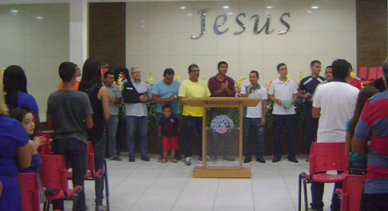
Those Who Minister And Spread the Gospel
Take a moment to pray specifically for the staff and leaders of your church.
  Thank God for their continued work and ministry.
  Echo Paul’s prayer that
  they would be filled with
  the knowledge of God’s
  will and strengthened
  with all power according
  to His purposes.

Slide 12
Listen for prayer for the Colossian church.
Colossians 1:9-12 (NIV) For this reason, since the day we heard about you, we have not stopped praying for you and asking God to fill you with the knowledge of his will through all spiritual wisdom and understanding. 10 And we pray this in order that you may live a life worthy of the Lord and may please him in every way: bearing

Slide 13
Listen for prayer for the Colossian church.
fruit in every good work, growing in the knowledge of God, 11 being strengthened with all power according to his glorious might so that you may have great endurance and patience, and joyfully 12 giving thanks to the Father, who has qualified you to share in the inheritance of the saints in the kingdom of light.

Slide 14
Spiritual Growth of Believers
According to verse 9, what is the focus and desire of Paul’s continued praying for the Colossians?
For this reason, since the day we heard about you, we have not stopped praying for you and asking God to fill you with the knowledge of his will through all spiritual wisdom and understanding.

Slide 15
Spiritual Growth of Believers
According to verse 10, what are evidences that one is living life that is worthy of the Lord and that brings Him pleasure?
And we pray this in order that you may live a life worthy of the Lord and may please him in every way: bearing fruit in every good work, growing in the knowledge of God,

Slide 16
Spiritual Growth of Believers
What does verse 11 tell us will be the results of being strengthened with God’s power and might?
being strengthened with all power according to his glorious might so that you may have great endurance and patience, and joyfully giving thanks to the Father

Slide 17
Spiritual Growth of Believers
How does praying regularly and specifically contribute to our spiritual growth?
  Consider the Gospel song, Learning to Lean
Based on these verses, what are some specific things our group can pray for this week?

Slide 18

Spiritual Growth of Believers
Check out the Practical Suggestions page for ways you can make your prayer life more purposeful
https://tinyurl.com/y3whe3nc

Slide 19
Applications
Morning prayer.
  Prayer is like a muscle; if you don’t use it, it atrophies and gets weak.
  If you never or rarely pray, commit to begin each day in prayer this week.
  Before you get moving each morning and before you pick up your smart phone, pause and pray.
  Pray that God would strengthen and use you throughout the day. Pray for your pastor and leaders in your church. Then pray for believers around you.

Slide 20
Applications
Deeper prayer.
  Commit to a regular time of prayer each day that is not rushed or hurried.
  Carve out an extended time of prayer where you can sit quietly and talk to God without the demands of your next appointment.
  Keep a journal of your prayers. Over time, you can look back and see how God answered them.

Slide 21
Applications
Focused prayer.
  Created a detailed list based on the three ways this session identified that we can pray for each other.
  List people in your life for whom you want to pray these specific prayers.

Slide 22
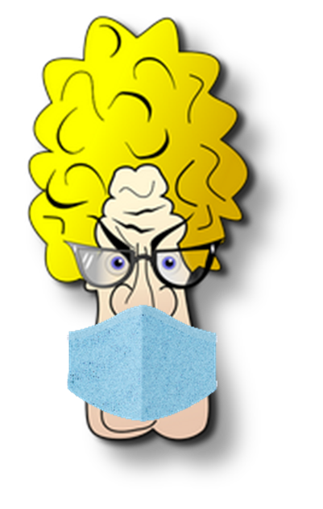
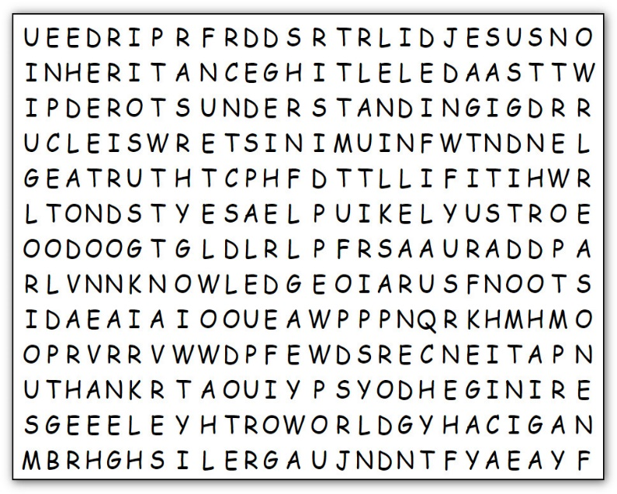
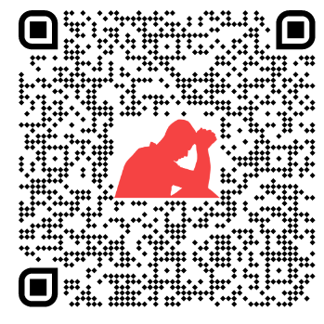
Family Activities
Humph! Our school finally mandated masks. I guess it will help. But you need more than a mask to do find all the words. Humph! And if you don’t, you can expect to come up with another book report! Use the QR code to find what help might be available.

Slide 23
Committed to Pray
November 15

