Slide 1
Committed to His Worship
November 22

Slide 2
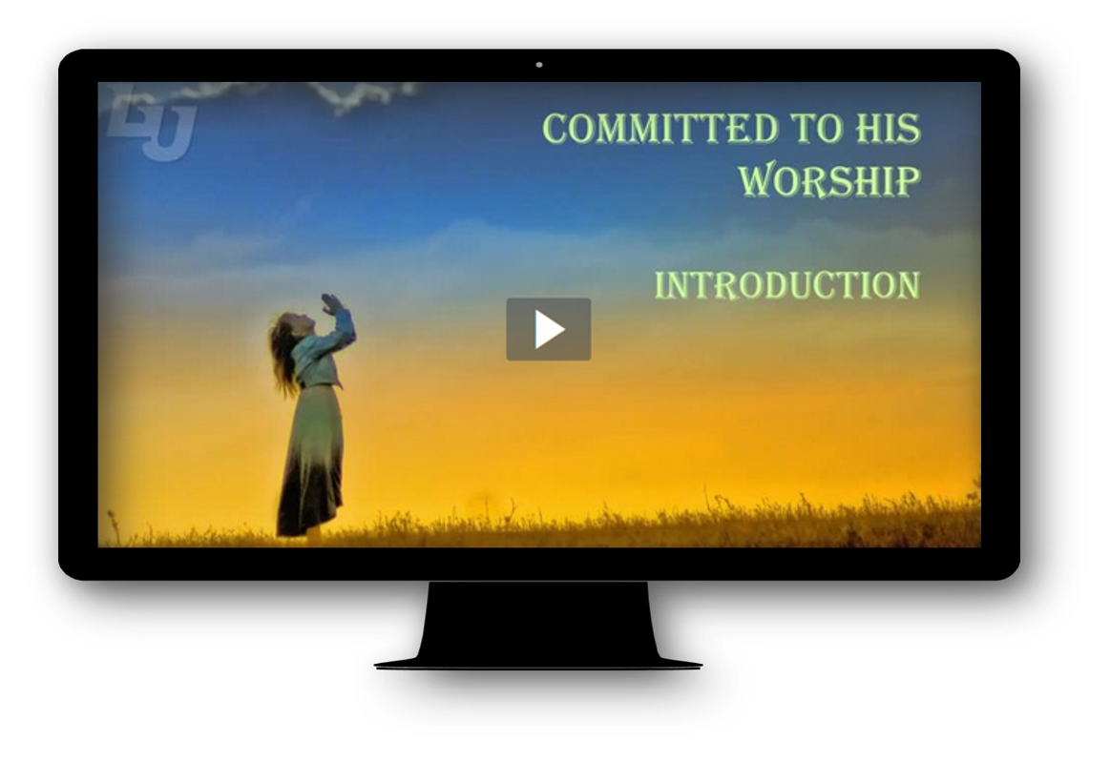
Video Introduction
View Video

Slide 3
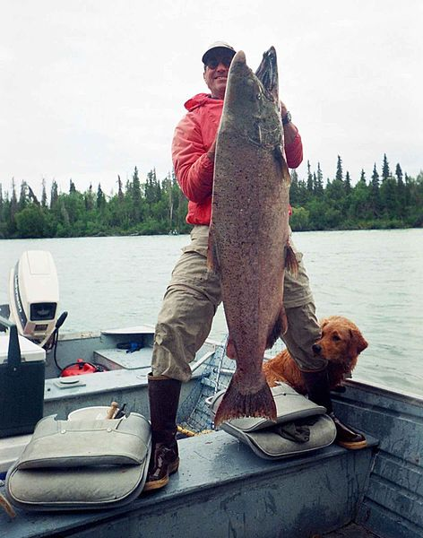
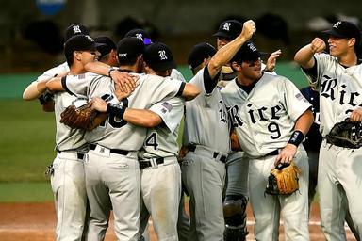
Remember that time …
When have you been swept up in a moment of excitement?
Lots of things can make us excited and thankful.
Today we consider why we should be just as excited about God’s working in our lives.
God deserves our worship and praise.

Slide 4
Listen for power demonstrated.
Psalm 99:1-3 (NIV) The LORD reigns, let the nations tremble; he sits enthroned between the cherubim, let the earth shake. 2 Great is the LORD in Zion; he is exalted over all the nations. 3 Let them praise your great and awesome name-- he is holy.

Slide 5
God’s Holiness and Great Power
How should the world respond to God’s holy reign?
What motivated the psalm writer to write this hymn of praise?
Study the verbs. How do (or should) others respond in relation to the exalted Lord? the Lord reigns … people tremble … He is exalted

Slide 6
God’s Holiness and Great Power
How has God revealed His power in your life in ways that caused you to worship Him?
God is terribly awesome and holy, forgiving and punishing. What does that say about the casual “God-is-my-buddy” approach or the presumptuous “God-is-my-bellhop” approach we often take in worship and prayer?

Slide 7
God’s Holiness and Great Power
Note the possible meanings of “holy.”
Current dictionary definition: dedicated or consecrated to God or a religious purpose; sacred
Biblical meaning: to be distinct, separate, in a class by oneself
No rivals, no competition
To be “other” … different in a special way

Slide 8
God’s Holiness and Great Power
This psalm invites us to tremble, praise, exalt and worship this holy (unique and distinct) Lord. What are some ways to practice those attitudes each day?

Slide 9
Listen for how God is a God of justice.
Psalm 99:4-5 (NIV) The King is mighty, he loves justice—you have established equity; in Jacob you have done what is just and right. 5 Exalt the Lord our God and worship at his footstool; he is holy

Slide 10
God’s Righteousness and Justice
Although the Lord is mighty in strength and in His sovereignty can do what He chooses, what characterizes His approach to judgment?
What should be the response of His people?
How does this psalm describe the quality of God’s reign?
How does God’s justice, fairness, or righteousness impact your daily routine?

Slide 11
God’s Righteousness and Justice
How can knowing God is always fair and just help you face injustice and unfair situations?
These verses again end with “He is holy.” How do we become convinced that God is distinct, separate, in a class by Himself ?

Slide 12
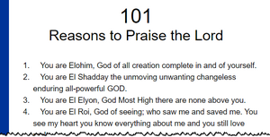
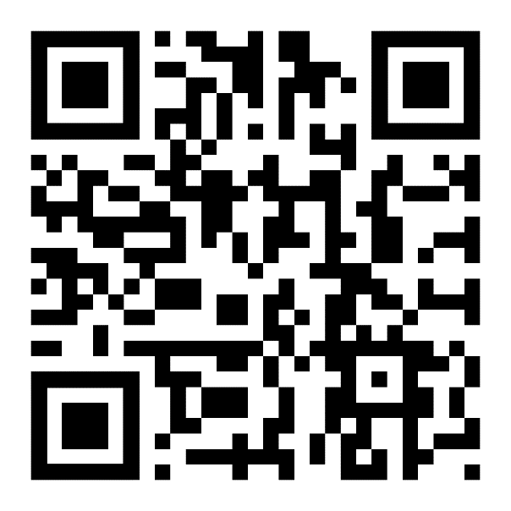
God’s Righteousness and Justice
Consider this website, 101 Reasons to Praise God
Spend time daily reading, meditating on these

Slide 13
Listen for men who prayed on behalf of God’s people.
Psalm 99:6-9 (NIV) Moses and Aaron were among his priests, Samuel was among those who called on his name; they called on the LORD and he answered them. 7 He spoke to them from the pillar of cloud; they kept his statutes and the

Slide 14
Listen for men who prayed on behalf of God’s people.
decrees he gave them. 8 O LORD our God, you answered them; you were to Israel a forgiving God, though you punished their misdeeds. 9 Exalt the LORD our God and worship at his holy mountain, for the LORD our God is holy.

Slide 15
God’s Answers
Why does the psalmist make reference to Moses, Aaron, and Samuel? For what were they commended?
What assurance does this psalm offer to those who call on the Lord?
What do these verses teach us about a lifestyle of worship?

Slide 16
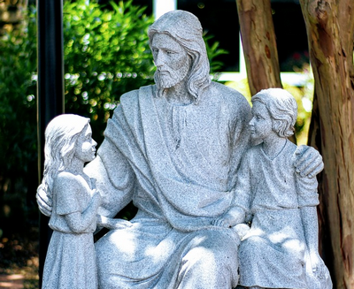
God’s Answers
How can we tremble at God’s holiness yet still have an intimate relationship with Him?

Slide 17
Application
Evaluate.
Make a list of the things you focus on doing during the week and the ways you like to spend your time.
Do an honest evaluation and determine if any of those things are objects of worship.
Ask God to reveal your heart and lead you to make Him first in your worship.

Slide 18
Application
Trust.
If you are currently in a situation marked by injustice, consider the ways you have responded and should respond.
Lift the matter to God in prayer and trust Him to respond. Praise Him for His love and justice.

Slide 19
Application
Worship.
Set aside a day or a half a day for extended worship—just you and God.
Confess sin.
Read Scripture to God as a form of worship.
Focus on God’s character and all He has done for you.
Let that focus lead you into worship and a closer walk with Christ.

Slide 20
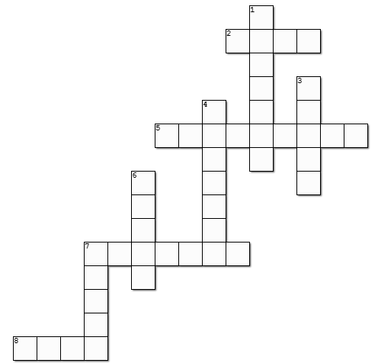
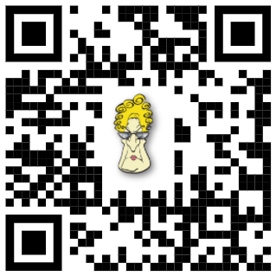
Family Activities
I don’t have a clue! This crossword puzzle doesn’t either. But if you go to https://tinyurl.com/yxaknsng you can get help. No doubt you’ll find other interesting things for the whole family to enjoy.

Slide 21
Committed to His Worship
November 22

